Slide 1
HM Elizabeth II – A Life Poured Out
On the Event of Her Funeral
Copyright sharondaveyillustration.com

Slide 2
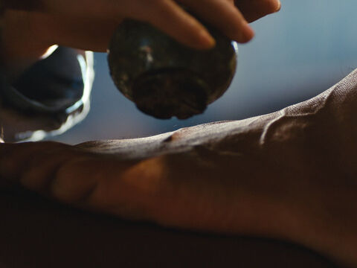
The Woman with the Alabaster Jar
“She has done a beautiful thing to me…
Truly I tell you, wherever this gospel is preached throughout the world, what she has done will also be told, in memory of her.”
Matthew 26

Slide 3
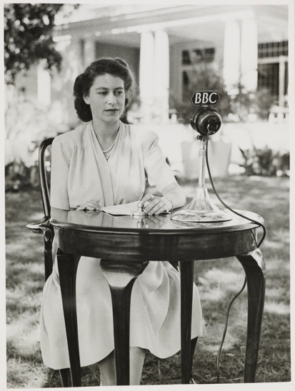
“I declare before you all that my whole life whether it be long or short shall be devoted to your service and the service of our great imperial family to which we all belong.
But I shall not have strength to carry out this resolution alone unless you join in it with me, as I now invite you to do: I know that your support will be unfailingly given. God help me to make good my vow, and God bless all of you who are willing to share in it.”
HM Queen Elizabeth 21st Birthday Message

Slide 4
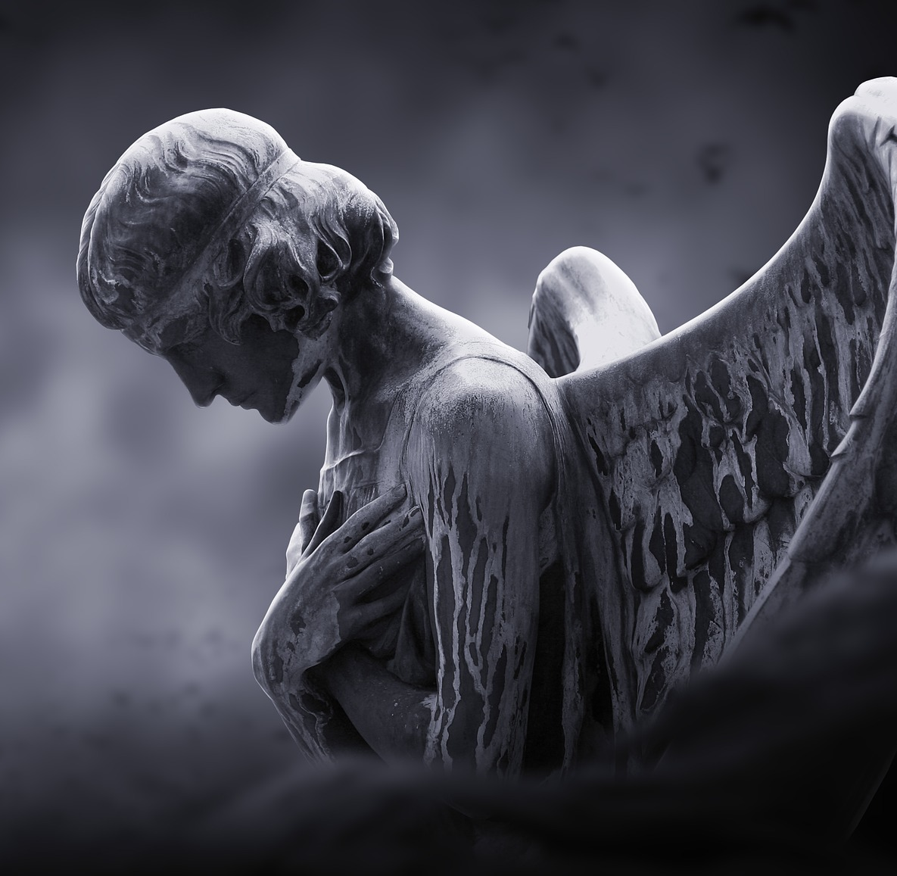
What are the common feelings/emotions that people experience when they grieve?

Slide 5
At this moment of HM Queen Elizabeth’s funeral, which emotions do you expect to see demonstrated? What lies beneath these expressions of emotion?
Copyright sharondaveyillustration.com

Slide 6
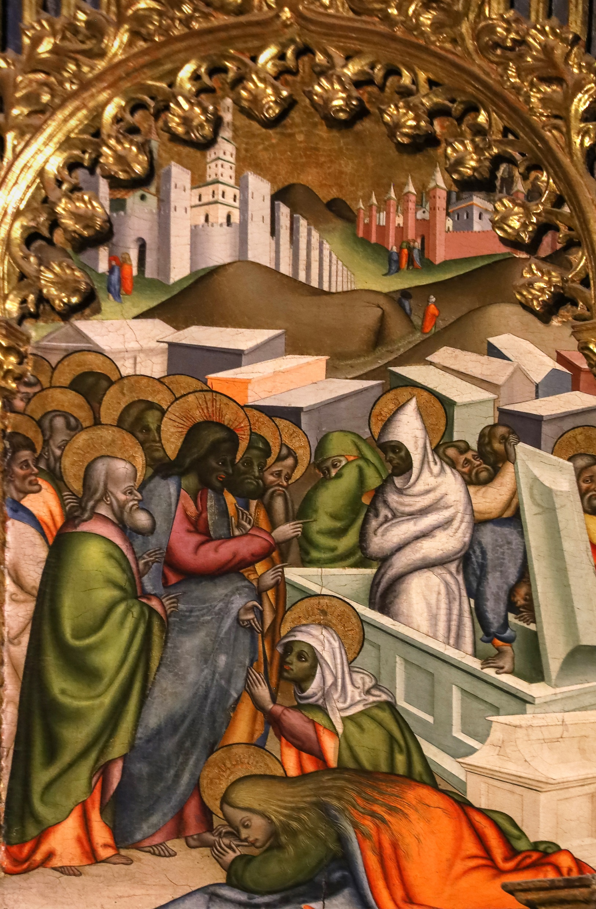
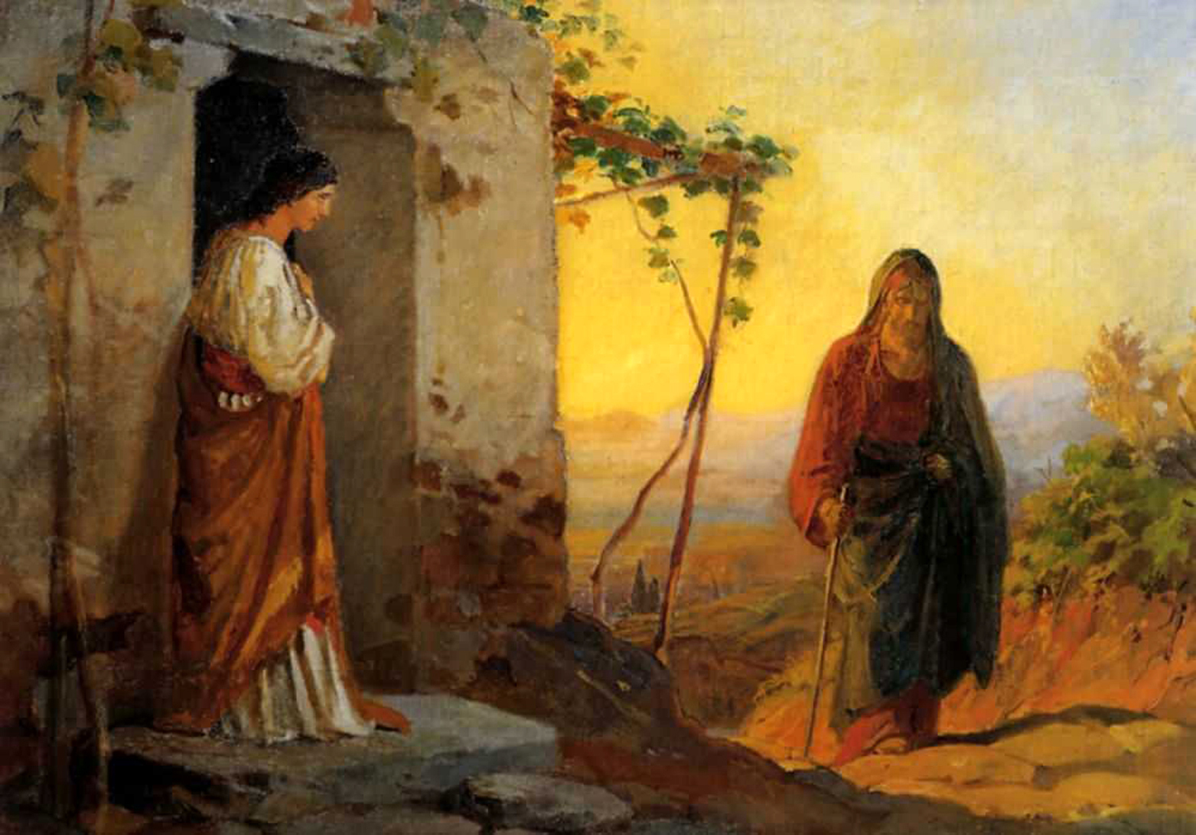
‘I am the Resurrection and the Life. The one who believes in me, even though he or she dies, will live.’ John 11
https://diglib.library.vanderbilt.edu/act-imagelink.pl?RC=58004
https://diglib.library.vanderbilt.edu/act-imagelink.pl?RC=56846

Slide 7
