Slide 1
Christian hope – how does faith help Christians navigate grief and loss? Preparing for the funeral of HM Queen Elizabeth II

Slide 2
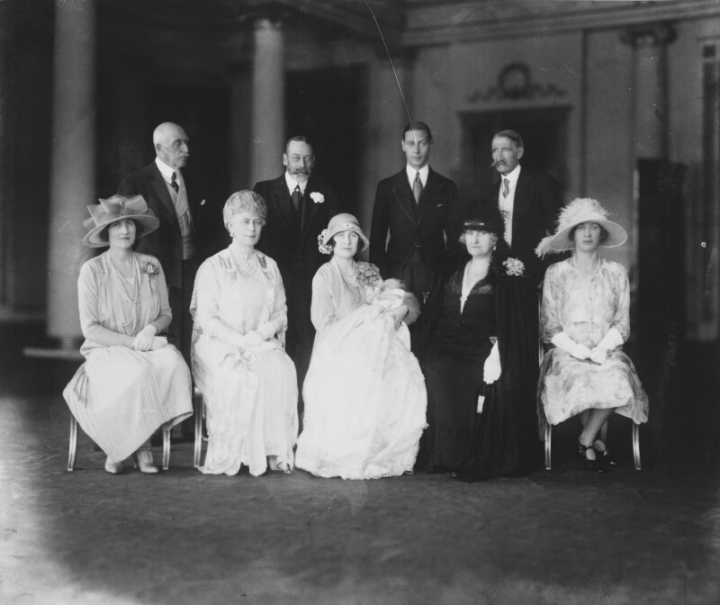
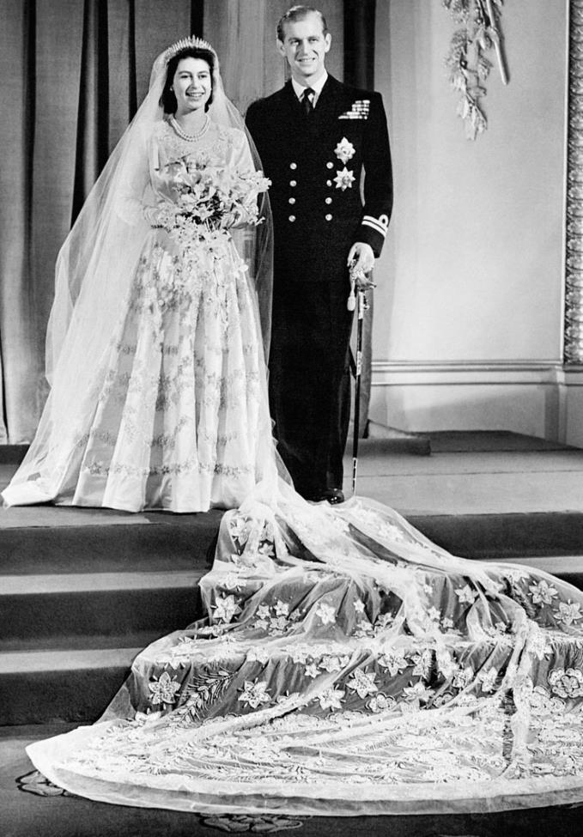
© www.royal.uk
© National Portrait Gallery, London
Christening of Elizabeth, 29 May 1926
Elizabeth’s wedding, 20 November 1947

Slide 3
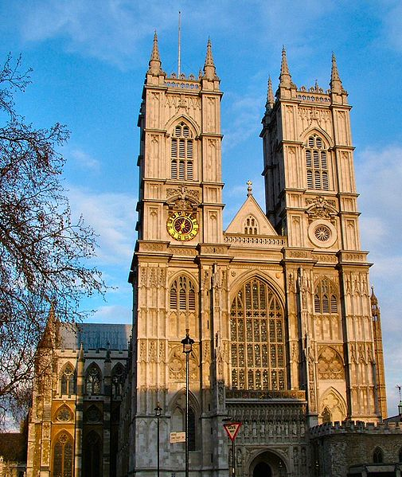
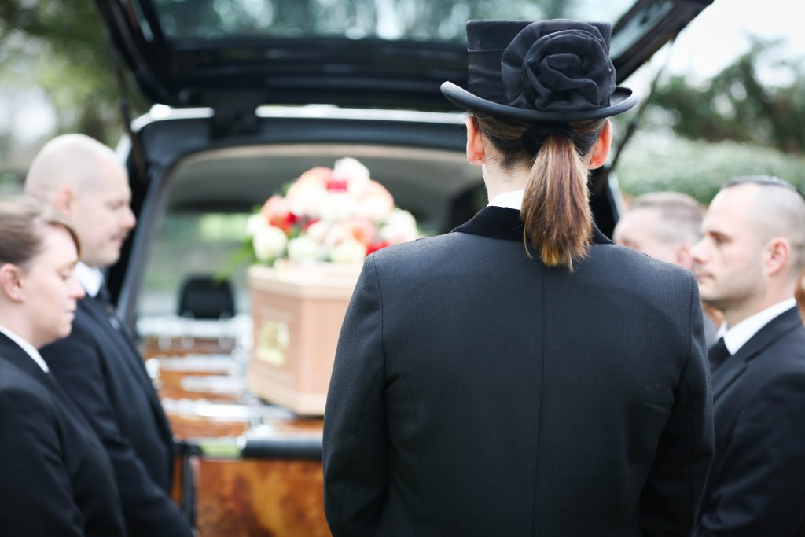
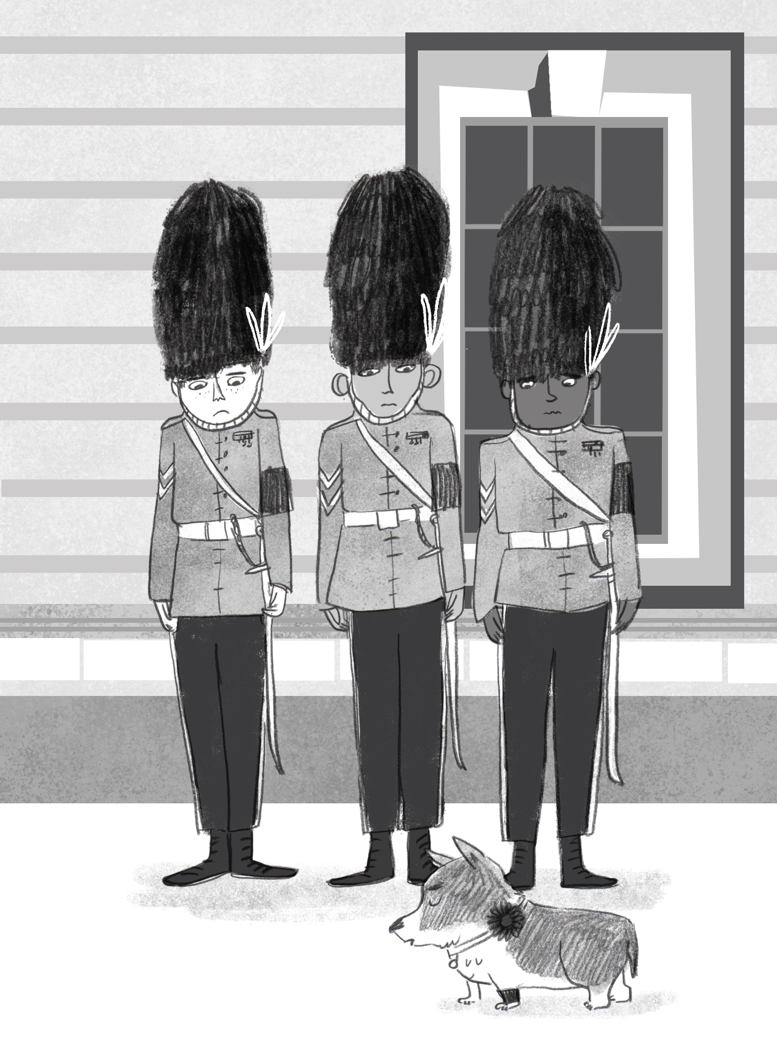
Photo by Jdforrester
Why do you think people dress and act in certain ways at funerals?

Slide 4
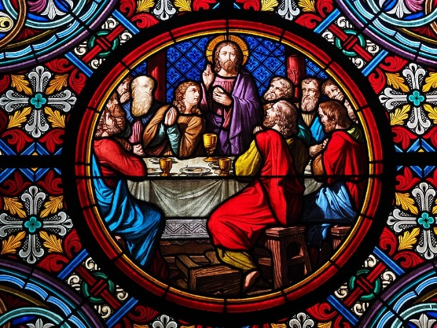
“Do not be worried and upset,” Jesus told them. “Believe in God and believe also in me. There are many rooms in my Father's house, and I am going to prepare a place for you. I would not tell you this if it were not so. And after I go and prepare a place for you, I will come back and take you to myself, so that you will be where I am.” (John 14: 1-3)
I wonder what words stand out to you in these verses?

Slide 5
Thanking
to remember the life of the person who died
to thank God for the gift of their life and treasured memories
to thank God for their hope in the life to come
Commending
a collective entrusting of the person to God and to the hope of new life
Comforting
words of hope are shared – the hope of new life and that God’s love is with all, always (Romans 8: 38, 39)
prayers that God would comfort those who mourn and give them strength at this difficult time
I wonder, what do you find comforting in times of sadness and grief?
How might we comfort one another?

Slide 6
As we and others prepare for the funeral of Queen Elizabeth II, let us spend a moment of silence together – to remember the Queen…
… we can use this opportunity to be thankful for her life and all she did…
… how she was ‘a good and faithful servant’ who led with love to make the world a better place for all…
…at this time of great sadness for us as a nation, we think of those who need comforting and strengthening. We think particularly of her family at this difficult time…

Slide 7
…
“I know just how much I rely on my own faith to guide me through the good times and the bad. Each day is a new beginning, I know that the only way to live my life is to try to do what is right, to take the long view, to give of my best in all that the day brings, and to put my trust in God. Like others of you who draw inspiration from your own faith, I draw strength from the message of hope in the Christian gospel.”
The Queen’s Christmas Message, 2002
As we prepare for the Queen’s funeral, I wonder which of these words particularly stand out to you?
Where do you draw strength from?
© www.royal.uk

Slide 8
Dear God,
Thank you for the gift of life you gave to Queen Elizabeth II.
We remember all the ways in which she cared for and loved others.
Please comfort and give strength to all who mourn at this time,
And remind them of the hope that you have prepared a place for the Queen.
In Jesus’ name we pray,
Amen.

Slide 9
Praise, my soul, the King of heaven, to his feet your tribute bring; ransomed, healed, restored, forgiven, who like you his praise should sing? Alleluia, alleluia! praise the everlasting King. Praise him for his grace and favour to our fathers in distress; praise him, still the same as ever, slow to blame and swift to bless; Alleluia, alleluia! glorious in his faithfulness. Father-like, he tends and spares us, All our hopes and fears he knows; in his hands he gently bears us, rescues us from all our foes: Alleluia, alleluia! widely as his mercy flows. Angels, help us to adore him; you behold him face to face; sun and moon, bow down before him, praise him all in time and space. Alleluia, alleluia! praise with us the God of grace.
The Lord's my shepherd, I'll not want; He makes me down to lie In pastures green; he leadeth me The quiet waters by. My soul he doth restore again, And me to walk doth make Within the paths of righteousness, E'en for his own name's sake. Yea, though I walk in death's dark vale, Yet will I fear no ill: For thou art with me, and thy rod And staff me comfort still. My table thou hast furnished In presence of my foes; My head thou dost with oil anoint And my cup overflows. Goodness and mercy all my life Shall surely follow me; And in God's house for evermore My dwelling-place shall be.

