Slide 1
Chief Officers & Non Execs
Working together to meet Chapter’s charitable and
Ecclesiastical Purposes

Slide 2
Charitable and Ecclesiastical Obligations
Chapters unusual in having a dual role
Charitable – trustees must manage the cathedral in the best interest of the charity in line with its charitable objects (CC3)
Ecclesiastical – trustees must have due regard to
(a) the cathedral as the seat of the bishop and a centre of worship and mission, and
(b) the importance of the cathedral’s role in providing a focus for the life and work of the Church of England in the diocese.

Slide 3
Objects
Cathedrals Measure 2021 (section 4)
The constitution must specify the following as the only objects of the Chapter of a cathedral
(a) to advance the Christian religion in accordance with the faith and practice of the Church of England, in particular by furthering the mission of the Church of England;
(b) to care for and conserve the fabric and structure of the cathedral church building;
(c) to advance any other charitable purposes which are ancillary to the furtherance of the purpose referred to in paragraph (a) or (b).

Slide 4
Role of Chapter (Section 11)
The Chapter must direct and oversee the administration of the affairs of the cathedral; and in performing that duty the Chapter must in particular
(a) order the worship of the cathedral and promote its mission;
(b) formulate, after consultation with the bishop, proposals relating to the general direction and mission of the cathedral;
(c) prepare an annual budget for the Chapter;
(d) prepare an annual report for the Chapter and annual accounts for audit and subsequent approval;
(e) keep under review the constitution and statutes;
(f) manage the property vested in the Chapter and the income accruing from it and, in particular, ensure that necessary repairs and maintenance in respect of the cathedral and its contents and other buildings and monuments are carried out.

Slide 5
Chapter Success
Dependent on the effective working of the Executive team and the Trustee team
Non Execs make up the majority of Chapter and vital in bringing both their particular skill set and for providing a sense check
Cathedral cannot function without the Chief Officers and the staff support

Slide 6
Key interdependencies
Chapter
Prepare annual budget
Prepare annual report and accounts
Manage property and income and ensure properly maintained
Chief Officers
Provide analysis, data and draught budget
Prepare accounts for approval and draft report
Will direct managing agents, contractors and staff team

Slide 7
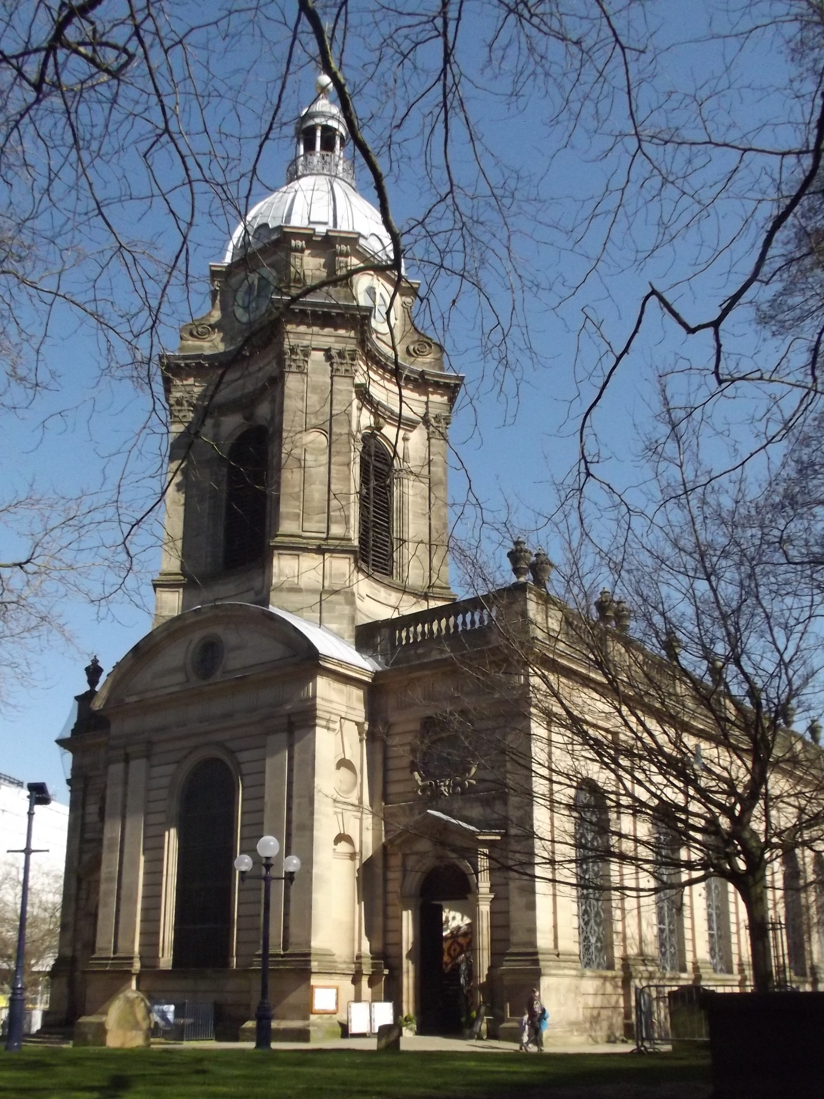
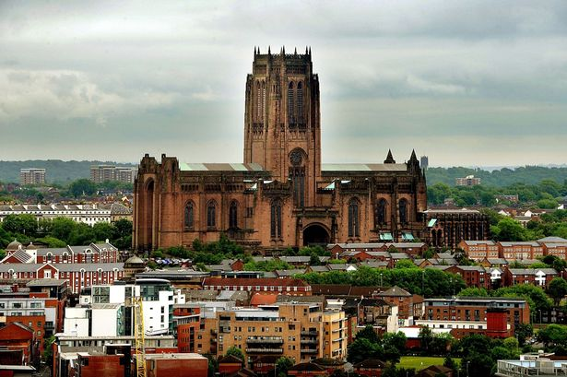
In Practice
Cathedrals are very different in scale and operation
How Non Execs work with Chief Officers has to be rooted in reality. It needs to work for you!
Hear from Ripon and Salisbury as to how their Non Execs and Chief officers work together.

Slide 8
Ripon
Parish Church Cathedral
Julia Barker - COO

Slide 9
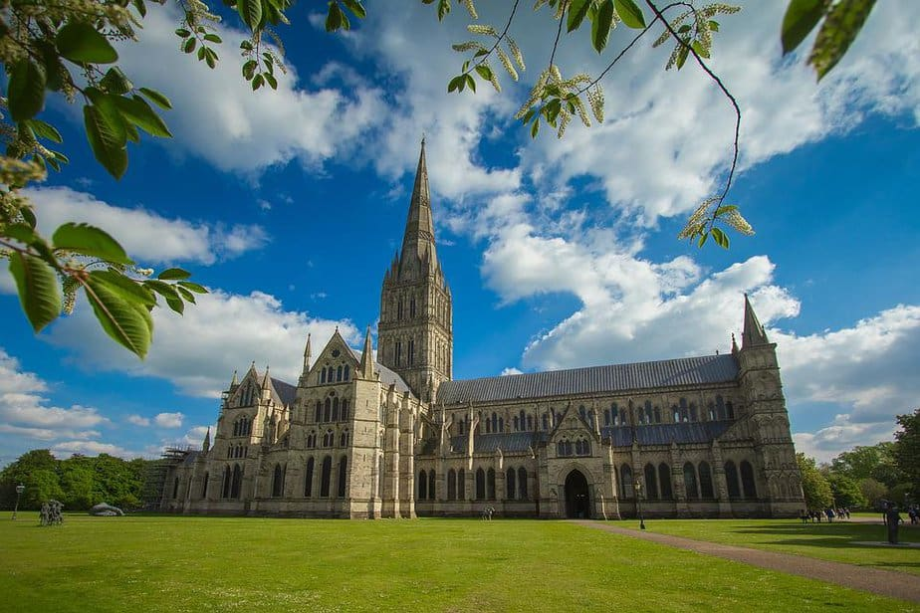
Salisbury
Jackie Molnar (COO)
Tim Daykin (Non Exec)

Slide 10
Question and Answer Session

Slide 11
Discussion Questions
1 How do you as Non Execs and Chief Officers currently work together to deliver the Chapter’s functions?
2 What works well and what could be improved?
3 Are there any obstacles and if so, how can they be overcome?
4 How can you implement what you have heard throughout the Event going forward?

