Slide 1

GENEROUS CHURCH
REVIEW

Slide 2
Generous Church Review
Together we will reflect on:
  What is generosity and how can we build a generous culture in our church?
  How and why are people giving to our Church?
  What do we need to get right for people to give?
  As a church what are we doing well and how could we improve?

Slide 3
A Question
“What was your first
experience of money?”

Slide 4
Giving Practice
Generous Culture
Mechanisms
direct debit – contactless –
web – app - legacy
Impact
mission – vision –
community engagement
Inspire
leadership – governance –
vision and strategy - celebrate
Disciple
individual study – group study –
preaching - retreat
Need
urgency – cause & effect –
responsibility
Trust
local church – diocese –
national church
Activate
21st century harvest – 1% more –
boomerang offertory
Embed
services – new members –
mission planning – cultural sensitivity

Slide 5
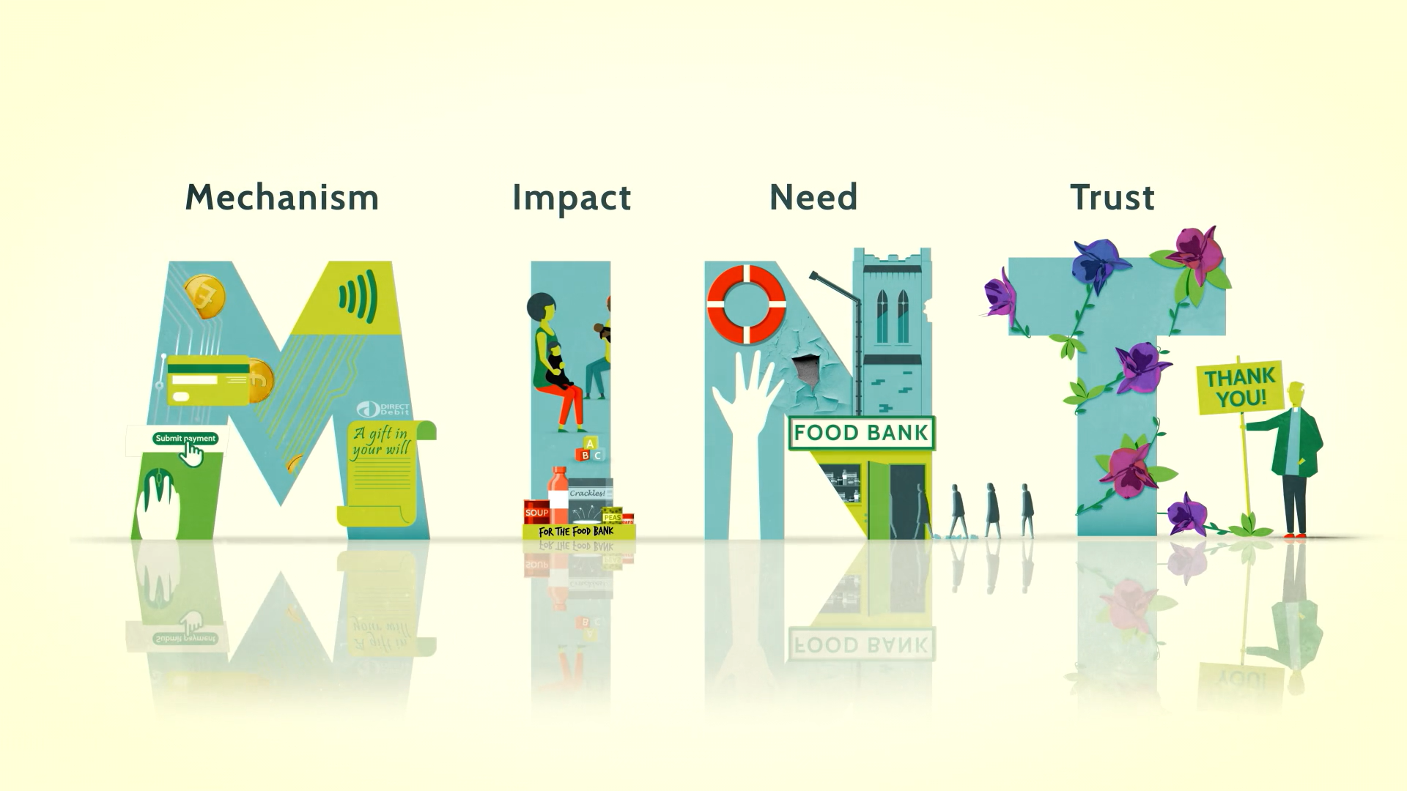
Giving Practice

Slide 6


Giving Practice
Mechanisms
Contactless
Online
Legacy
Direct Debit
Standing Order
Web

Slide 7
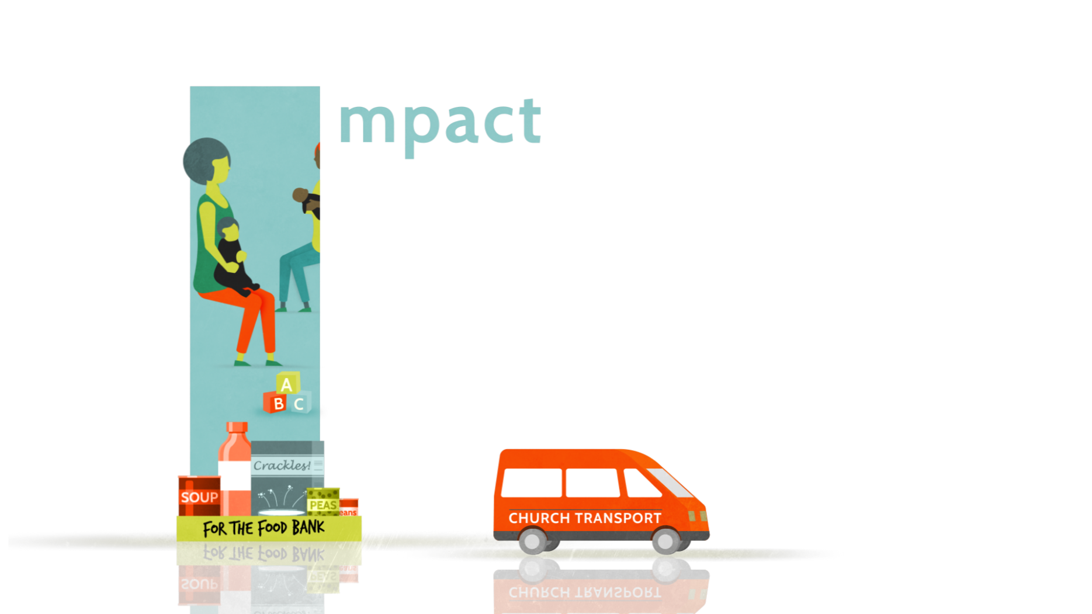
Giving Practice Impact
Vision
Mission
Community Engagement

Slide 8
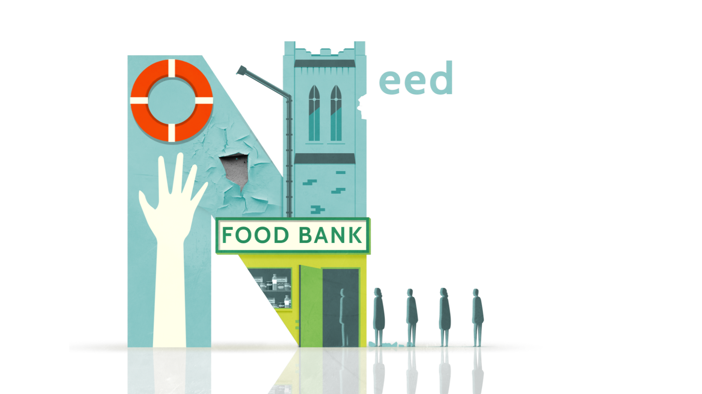
Giving Practice Need
Cause and effect
Urgency
Responsibility

Slide 9

Giving Practice Trust
Diocese
Local church
National church

Slide 10
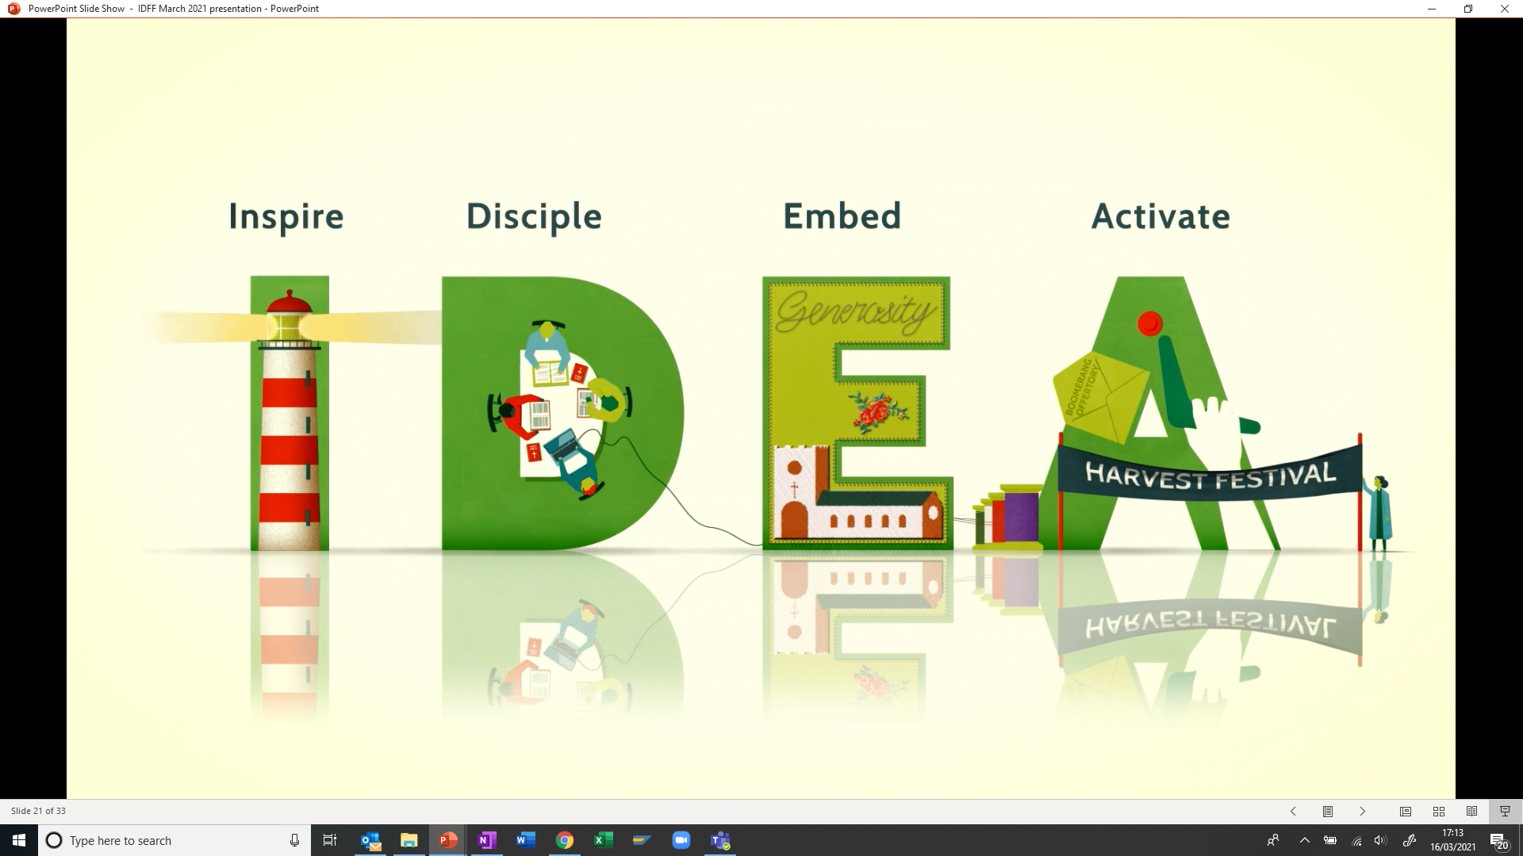
Generous Culture

Slide 11

Generous Culture Inspire
Leadership
Celebrate
Vision and Strategy
Governance

Slide 12

Generous Culture Disciple
Preaching & Teaching
Group Study
Individual Study
Retreat

Slide 13
Generous Culture Embed
Embed
New Members
Services
Cultural Sensitivity
Mission Planning

Slide 14

Generous Culture Activate
21st Century harvest
1% more
Boomerang offertory

Slide 15
Giving Practice
Generous Culture
Mechanisms
direct debit – contactless –
web – app - legacy
Impact
mission – vision –
community engagement
Inspire
leadership – governance –
vision and strategy - celebrate
Disciple
individual study – group study –
preaching - retreat
Need
urgency – cause & effect –
responsibility
Trust
local church – diocese –
national church
Activate
21st century harvest – 1% more –
boomerang offertory
Embed
services – new members –
mission planning – cultural sensitivity

Slide 16
Living As Generous Disciples
We believe in a generous God, a God who gave up everything for us and gave us everything we could ever need.
We are called by God to use the gifts He has given us to fulfil His mission and ministry within this community
Generosity takes many forms. We can give of our time, talents and material possessions.

Slide 17
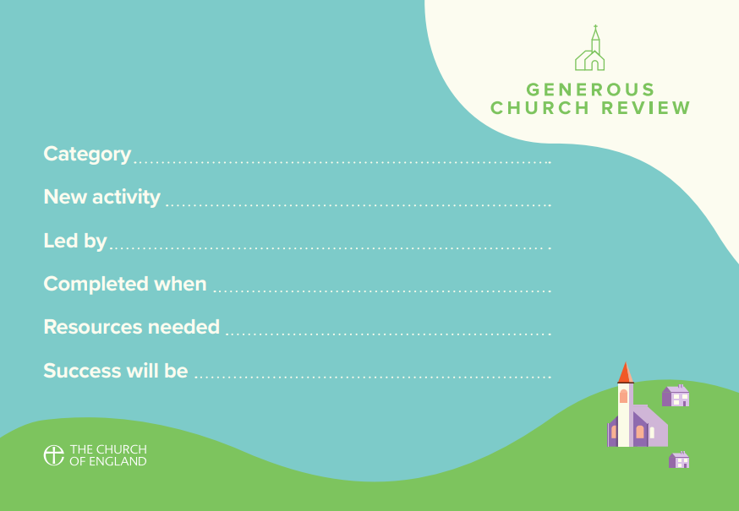

Slide 18
And finally ….
Questions? Thoughts? Comments?

Slide 19
Thank You

