Slide 1
How to use A Church Near You as your church’s free website
Notes:
Introduce ourselves and welcome the attendees
Todays objectives
How to ask questions
Act as a parish website
Able to point domain name towards ACNY page
OR direct visitors to the main church website
Allow churches to host outward-facing information like events
Comes top in a google search
Responsive to mobile – meaning it will change dimensions and font size so its easy to see on a mobile phone. Websites that are not mobile responsive are now being pushed further down in a google search.
Quiz Are you an editor and how many churches?

Slide 2
What are we covering today?
You can use AChurchNearYou.com:
as your main church or benefice website
or alongside an existing website
Notes:
Information shared today will be relevant in either case.
But we'll be sure to cover the full scope of features you may need to use it as your main website.

Slide 3
What are we covering today?
Intro and orientation (10 minutes)
Core features for churches (35 minutes)
Advanced features for churches (15 minutes)
BREAK – 5 minutes
Benefice features (20 minutes)
Becoming an editor / approving editors (5 minutes)
Notes:
We are going to take you through a few different steps today. Step 1, Step 2, Step 3.
Intro and orientation (10 minutes) includes benefits of the site and how to edit started with editing
Core features for churches (30 minutes) includes homepage editing and adding services and events, news and notices
Advanced features for churches (20 minutes) includes adding custom pages
BREAK – 5 minutes
Benefice features (20 minutes) understanding the benefice homepage and how to list services that appear on more than one church
Becoming an editor / approving editors (5 minutes) we'll do this webinar assuming you are already an editor but if you need help with that stay on to the end

Slide 4
Benefits of using the site
Free
No developer or admin fees
Mobile friendly
Google prioritises mobile friendly sites
Secure
We handle site security and access
Support
Help articles 24/7, contact us Mon-Fri, training
Future safe
Continuous development
Reach
Paid advertising driving to the site
Notes:
Quiz what do you want to cover -

Slide 5
Benefits of using the site
Pages viewed last year
Average page views per session
Busiest day of the week on the site
Visitors on the site are there for the first time
Have had visitors from ACNY
Source: Site views last 365 days prior to Jan 25 2022, Editor survey May 2021
70 million
5
Sunday
80%
40%
Notes:
Quiz what do you want to cover

Slide 6
Live demo of how to use AChurchNearYou.com
Notes:
Introduce ourselves and welcome the attendees
Todays objectives
How to ask questions
Act as a parish website
Able to point domain name towards ACNY page
OR direct visitors to the main church website
Allow churches to host outward-facing information like events
Comes top in a google search
Responsive to mobile – meaning it will change dimensions and font size so its easy to see on a mobile phone. Websites that are not mobile responsive are now being pushed further down in a google search.
Quiz Are you an editor and how many churches?

Slide 7
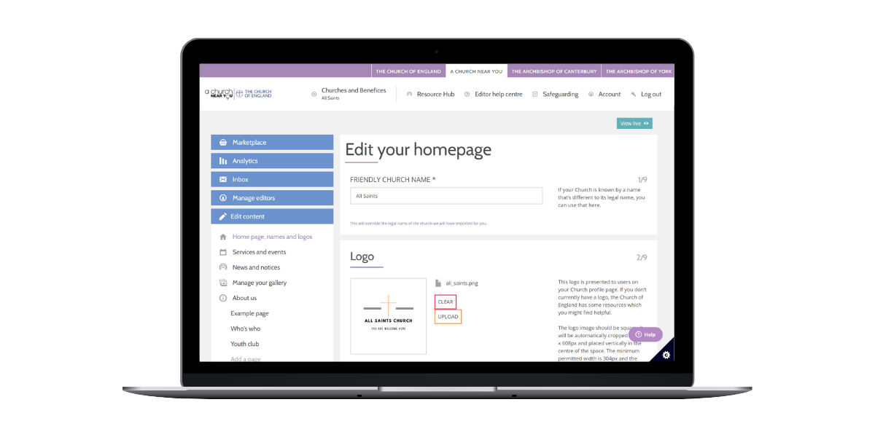
New editor view
Separate editor view for editing the site
Accessed by clicking the single ‘edit page’ button on your church's menu.
Or
Click churches and benefices then the cog beside the name of the church you want to edit
Notes:
Deep bluey purple colour shows it to me as a member of the public
Click where it says edit page

Slide 8
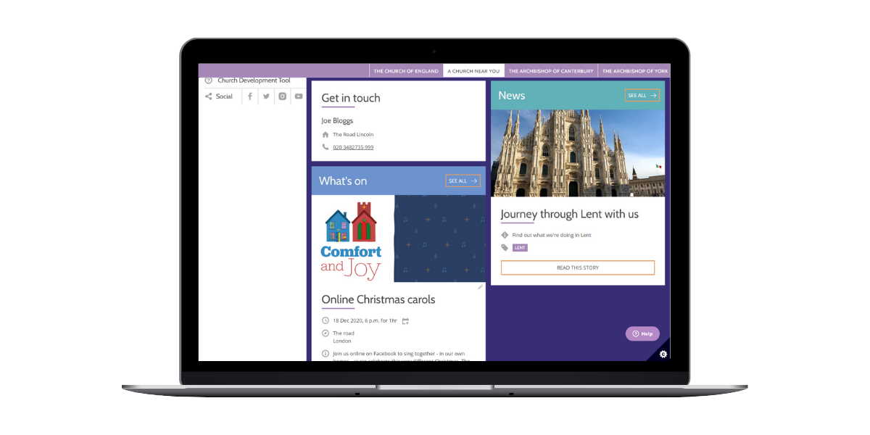
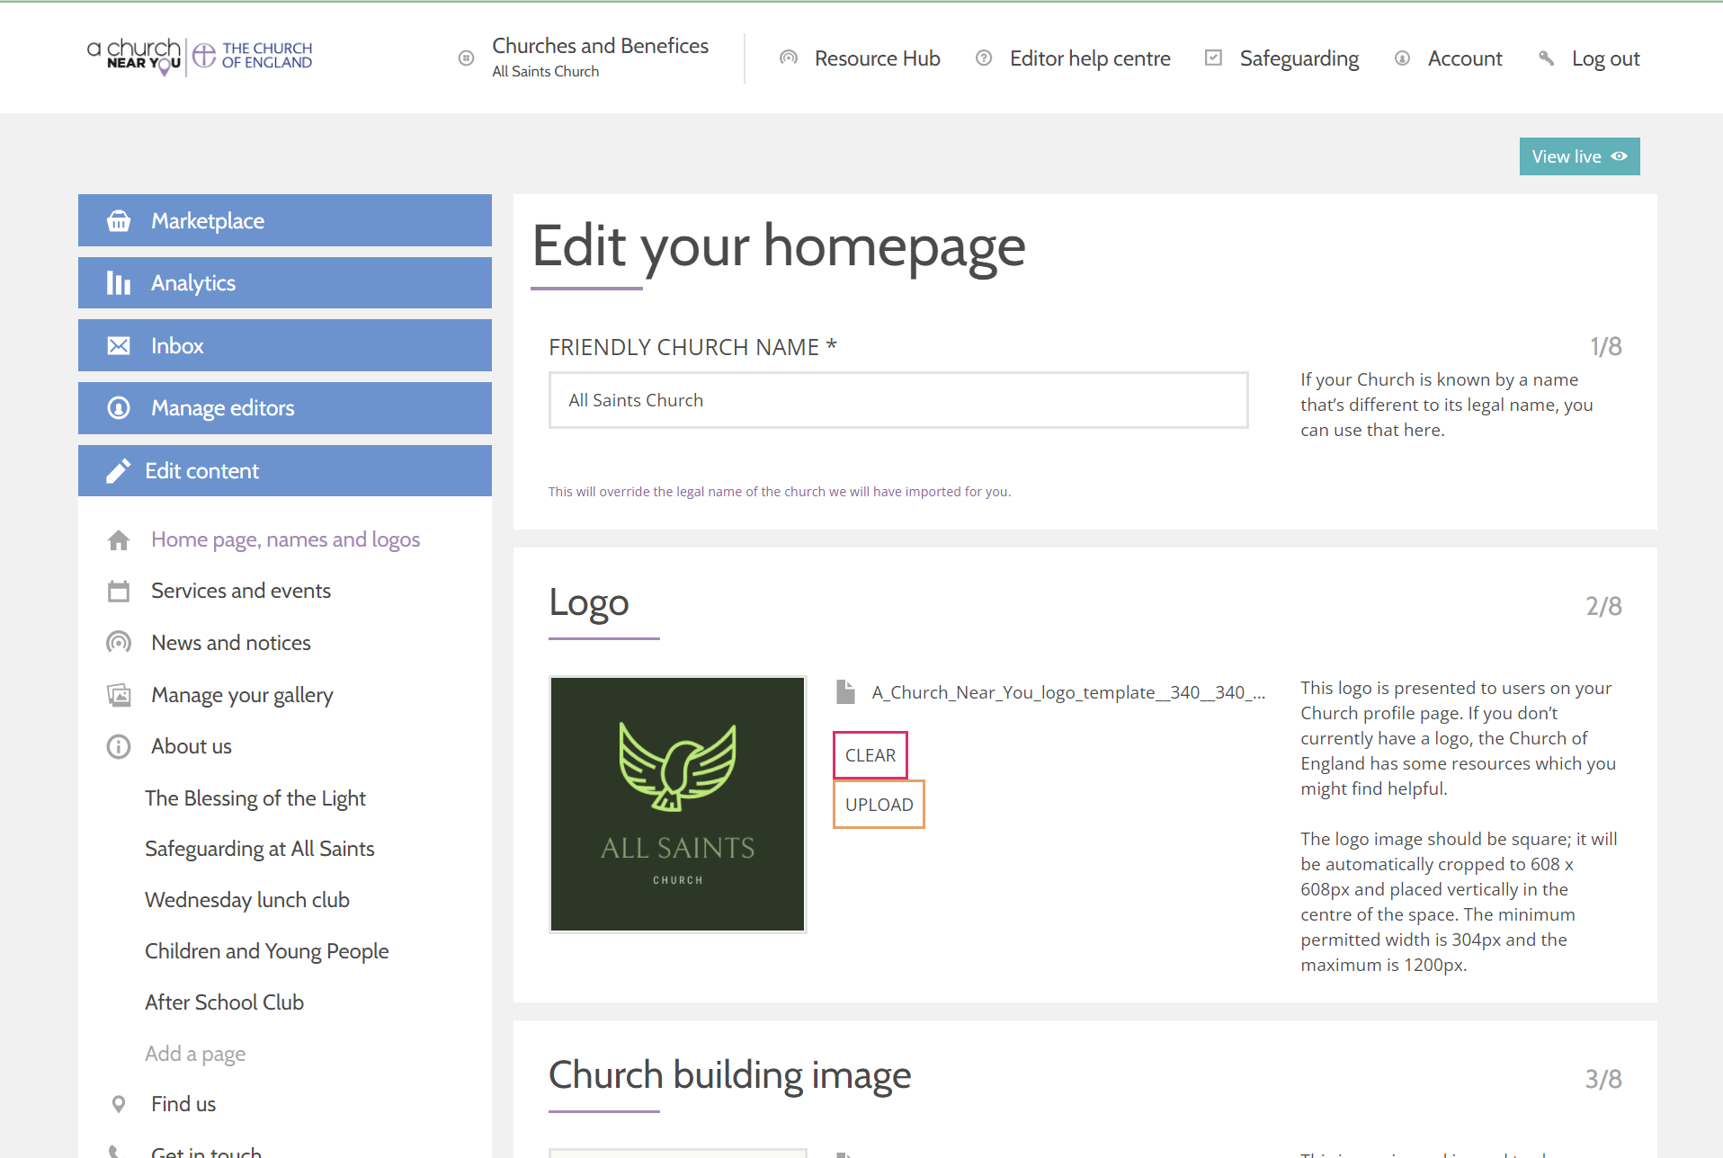
Edit your church homepage
Click on Homepage, names and logo to edit
Customise your homepage to add:
Logo
Welcome message
Cover image
Featured events and news
Notes:
At logos - talks about using canva for logos
Whenever you are editing we need to keep in mind those 80% who haven't been to the site before, might never have been to church before, not an anglican church before, or any church, not familiar with christian language

Slide 9
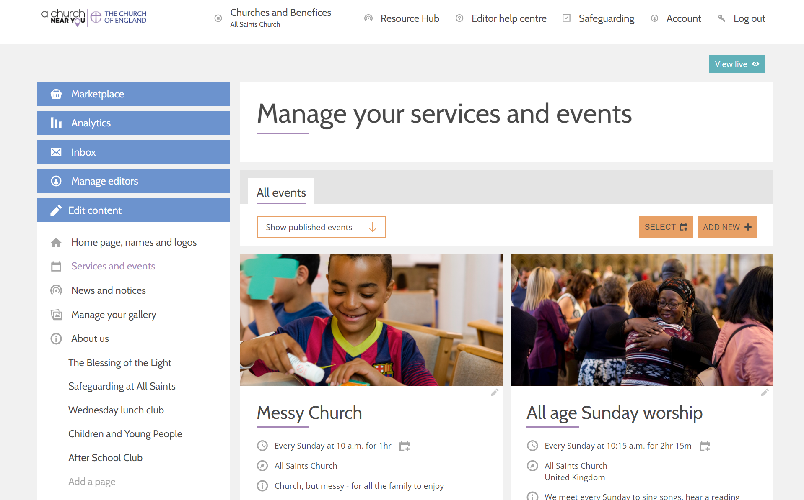
Add services and events
💻 Services and events
Click Add New to create an event
Click on the pencil beside an existing event to edit
Fill in the event details
Copy an event to another church by scrolling to the bottom of the editable event and selecting copy
Notes:
Talk about order
keep in mind people might not know what a eucharist is - if need a technical term, put a short expalantion, show that everyone is welcome - peopel think if eucharist they can't come, let's be welcoming, make sure it is really obvious - it is for everyone

Slide 10
Link to your online services
💻 Services and events
Click Add New to create an event
Click on the pencil beside an existing event to edit
Fill in the event details
Scroll down to section 6 and paste the link to the pre-recorded or live video
Notes:
Don’t forget to say livestream tag
At end of events, show copying, show drafting

Slide 11
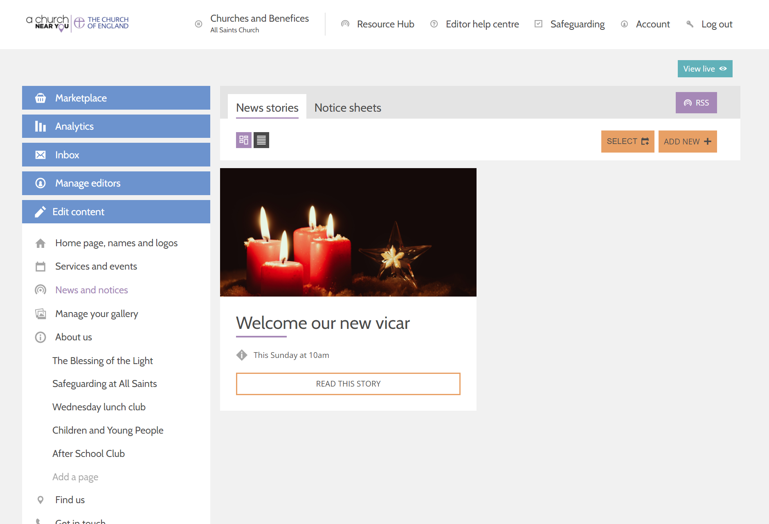
Create news stories and notice sheets
Click on News and notices
Click Add New
Select either the new stories or notice sheets tab
News stories are like blogs
Notice sheets are where you can upload a notice sheet as a file
Notes:
There is a way to do that called hyperlinking
Demonstrated hyperlinking
Acts like a button so someone could see it - helpful to link to a local village newsletter

Slide 12
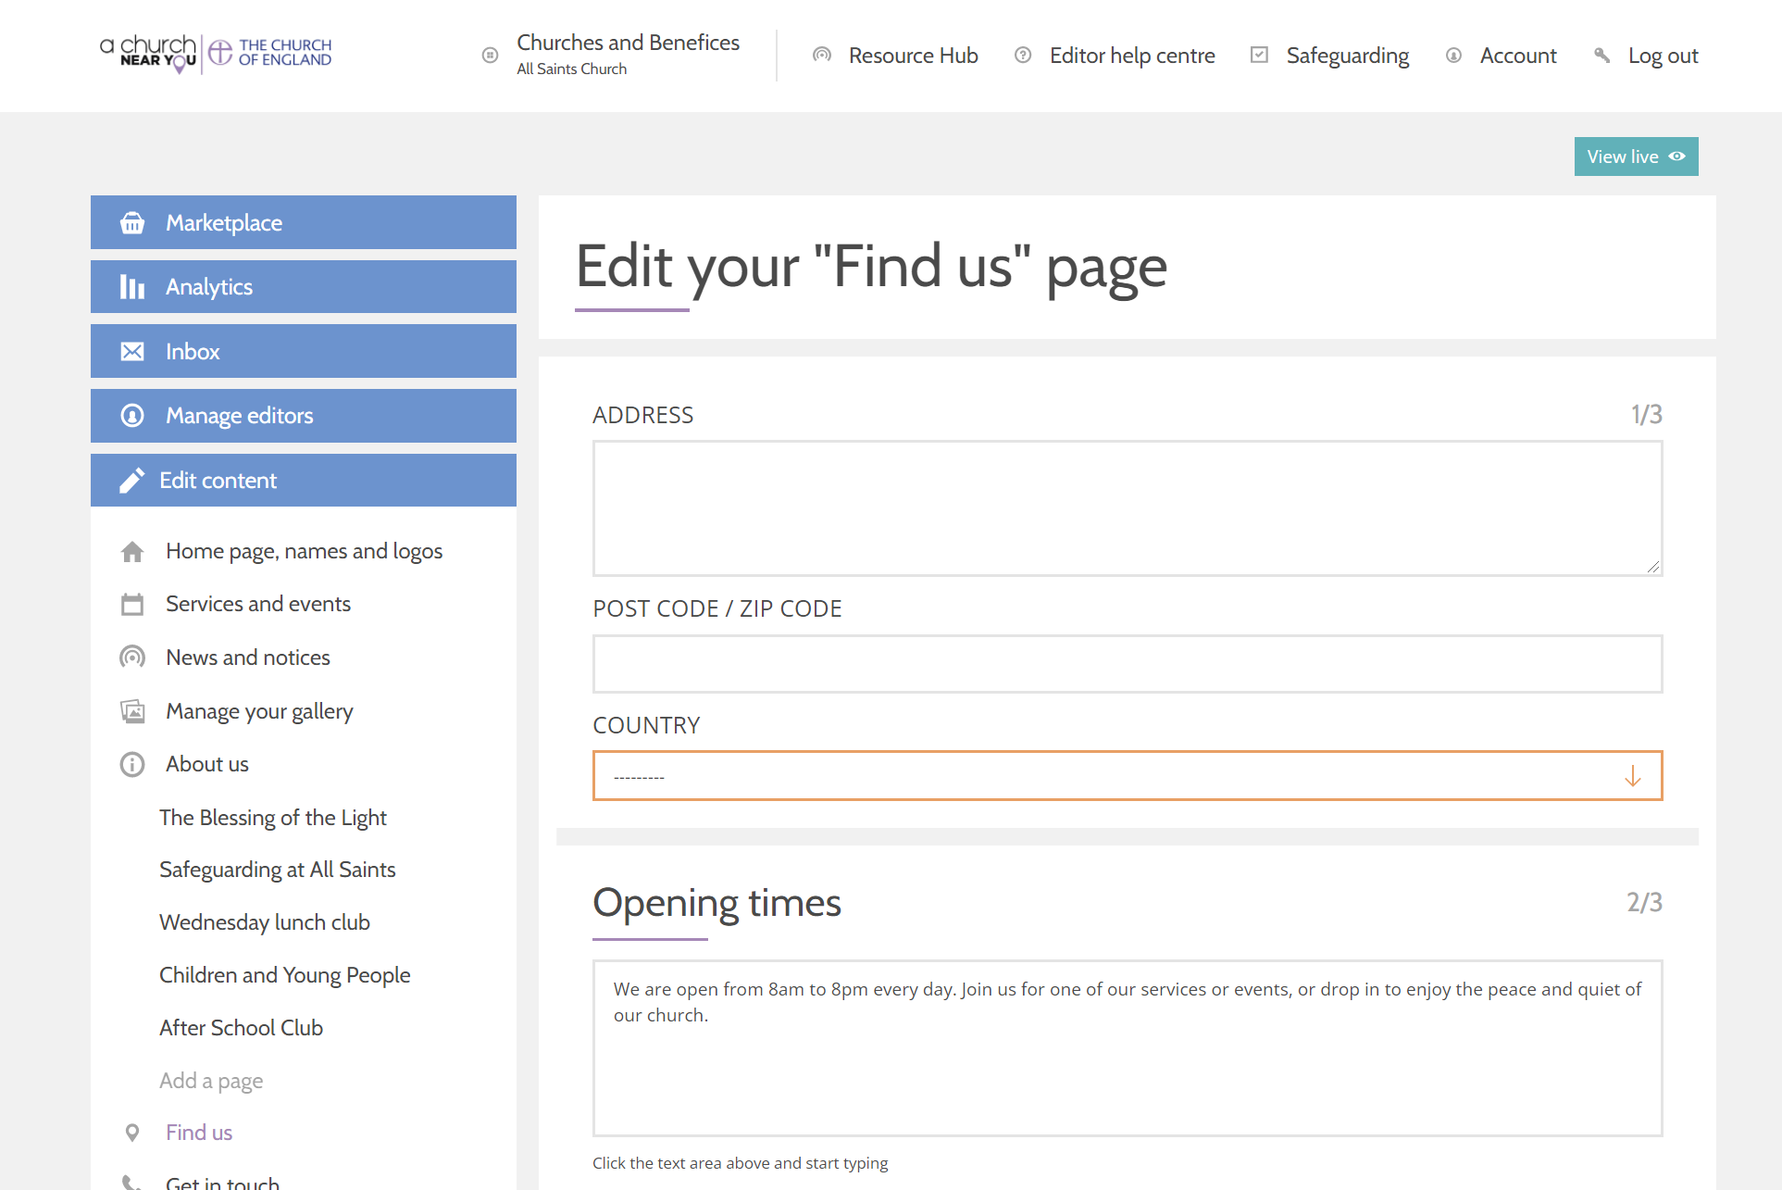
Edit find us information
💻 Find us > Getting here Include bus routes, train stations, car parks and access information

Slide 13
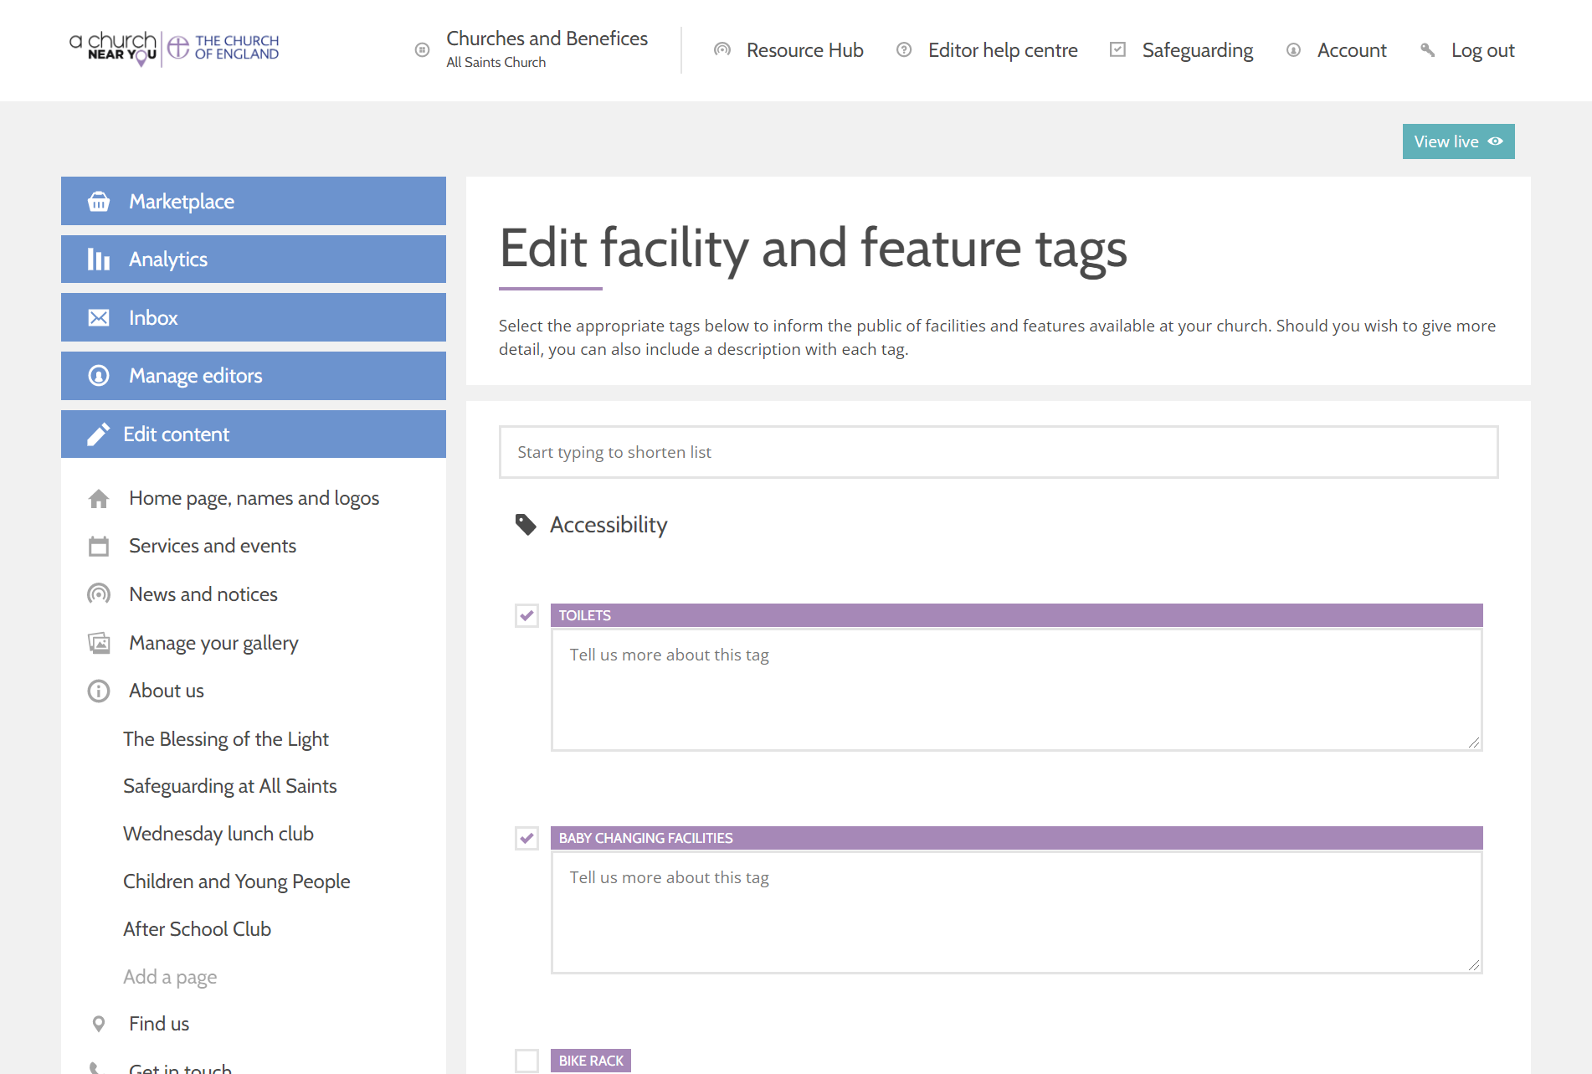
Include your features and facilities
Features and facilities tags help people find what they are looking for
Example: A local church with a ramped entrance
Tick the box beside every relevant tags
Include more information, if applicable
Notes:
Facilities don't need to be changed often
People feel more confident to come along known ing they know where to park, we use the schol carpark for example little things like that can really help people come along

Slide 14
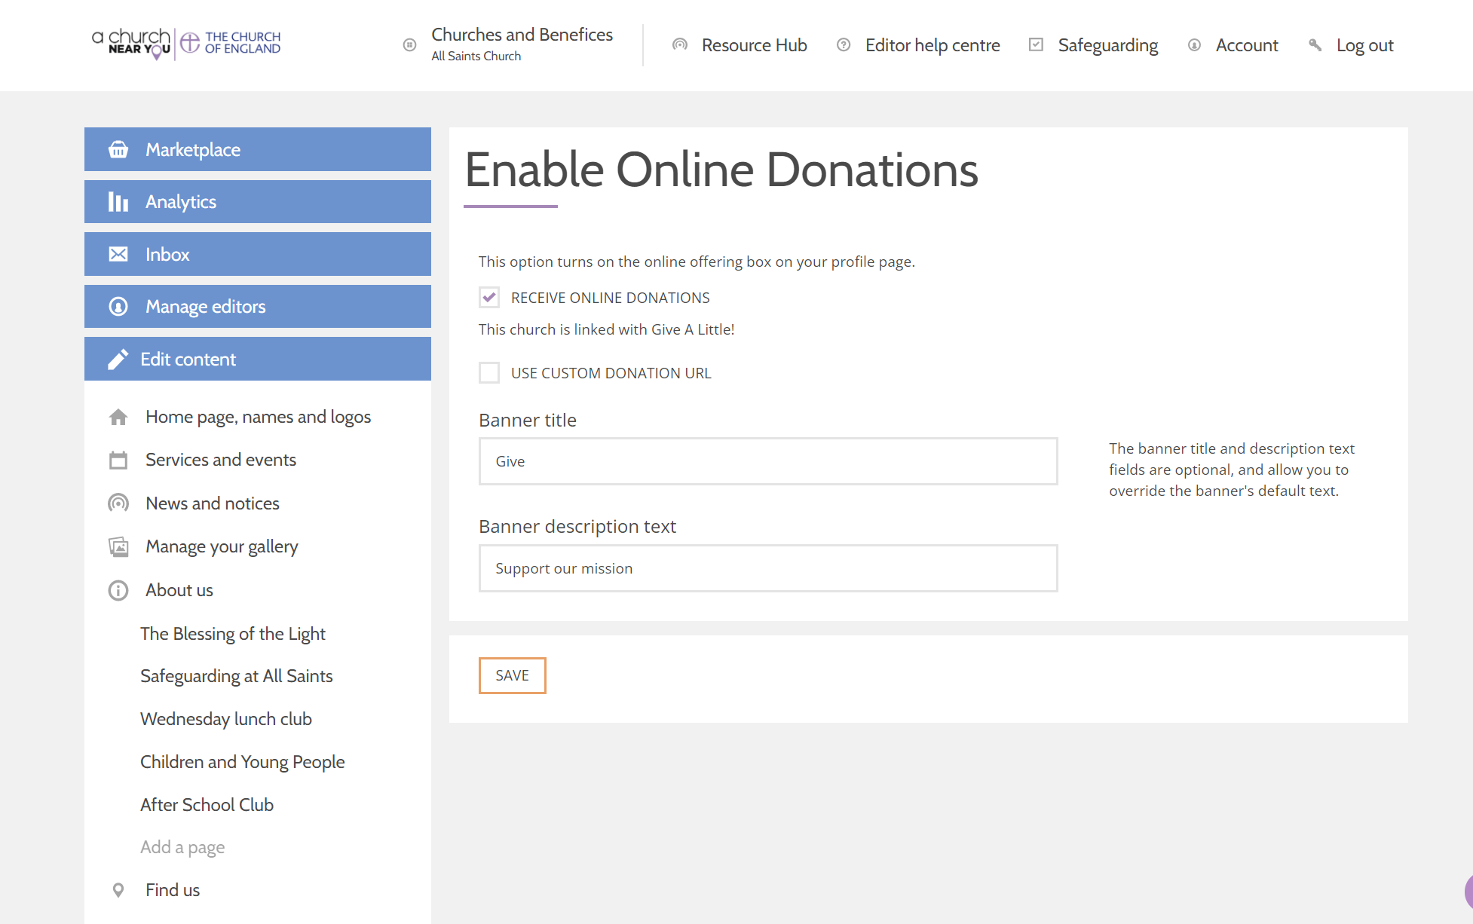
Add a donate button
💻 Marketplace
Turn on Online Giving
Press Configure options
Fill in all the requested details
Press Save
The button will now appear on your homepage

Slide 15
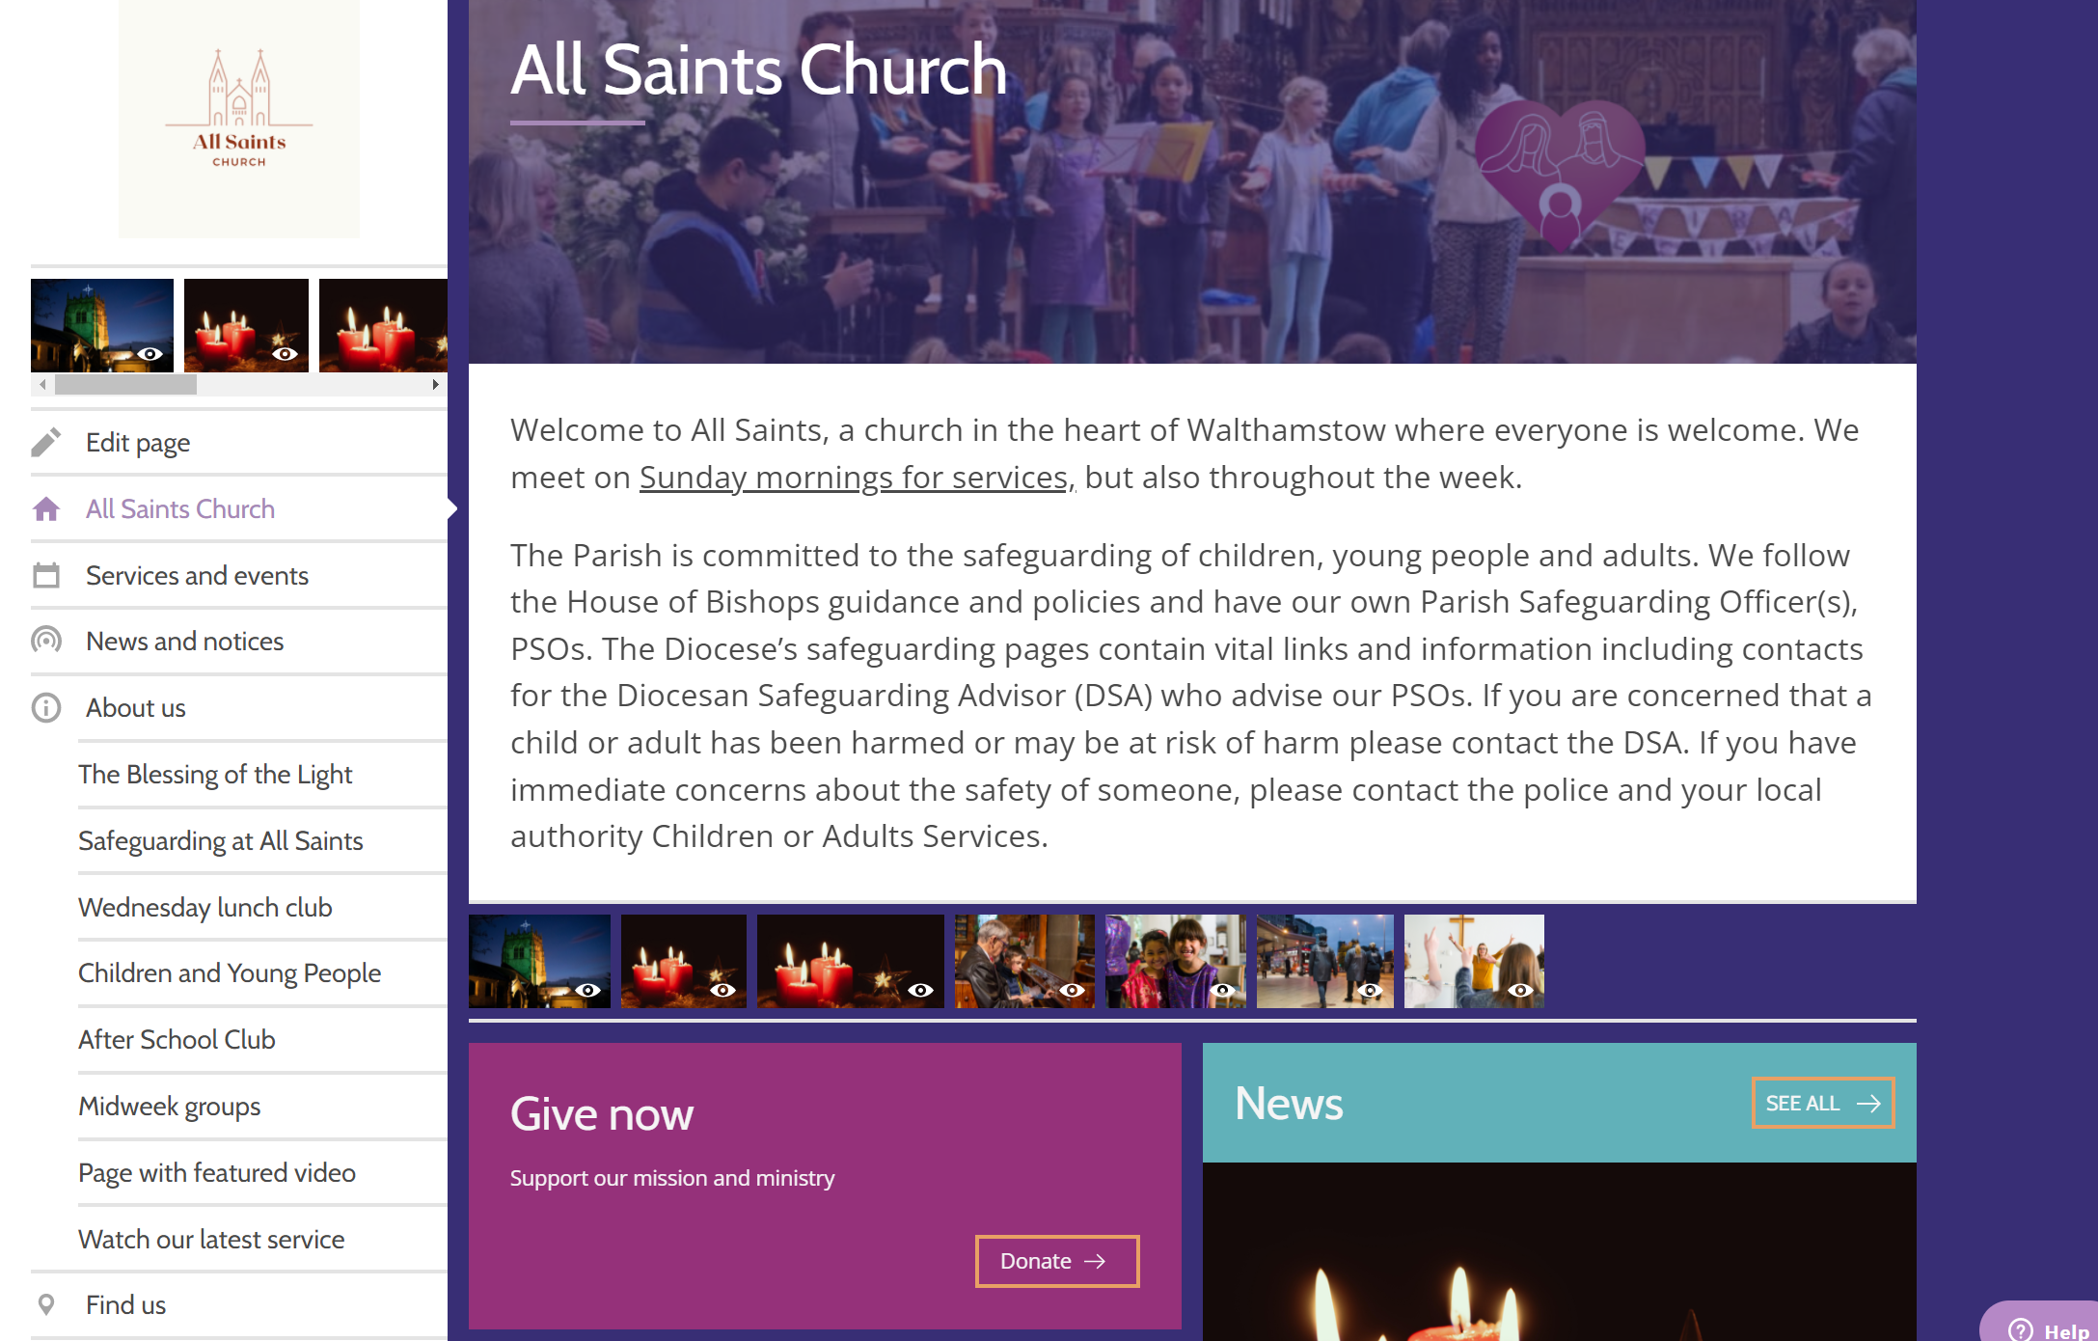
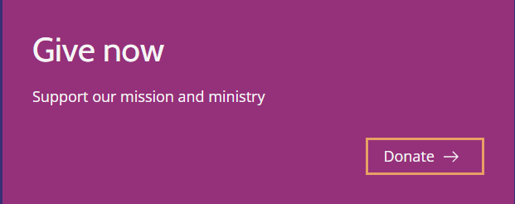
Add a donate button
If you do not use Give A Little, your button will be similar to this:

Slide 16
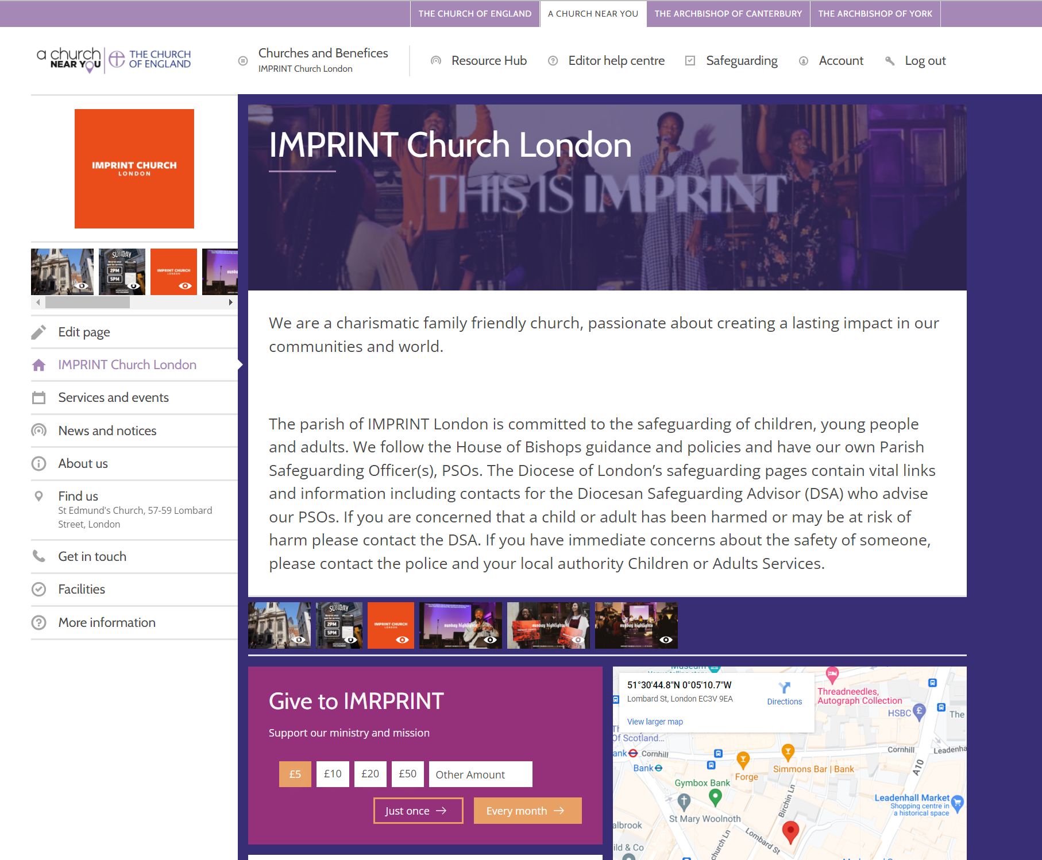
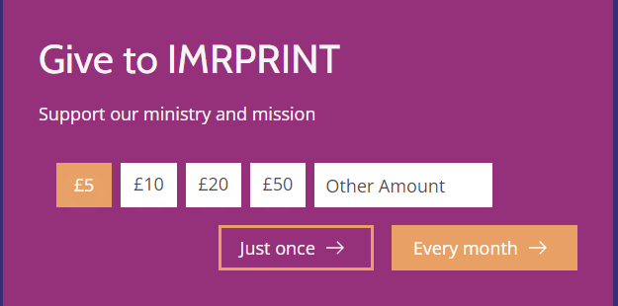
Add a donate button
If you use Give A Little, your button has more options:

Slide 17
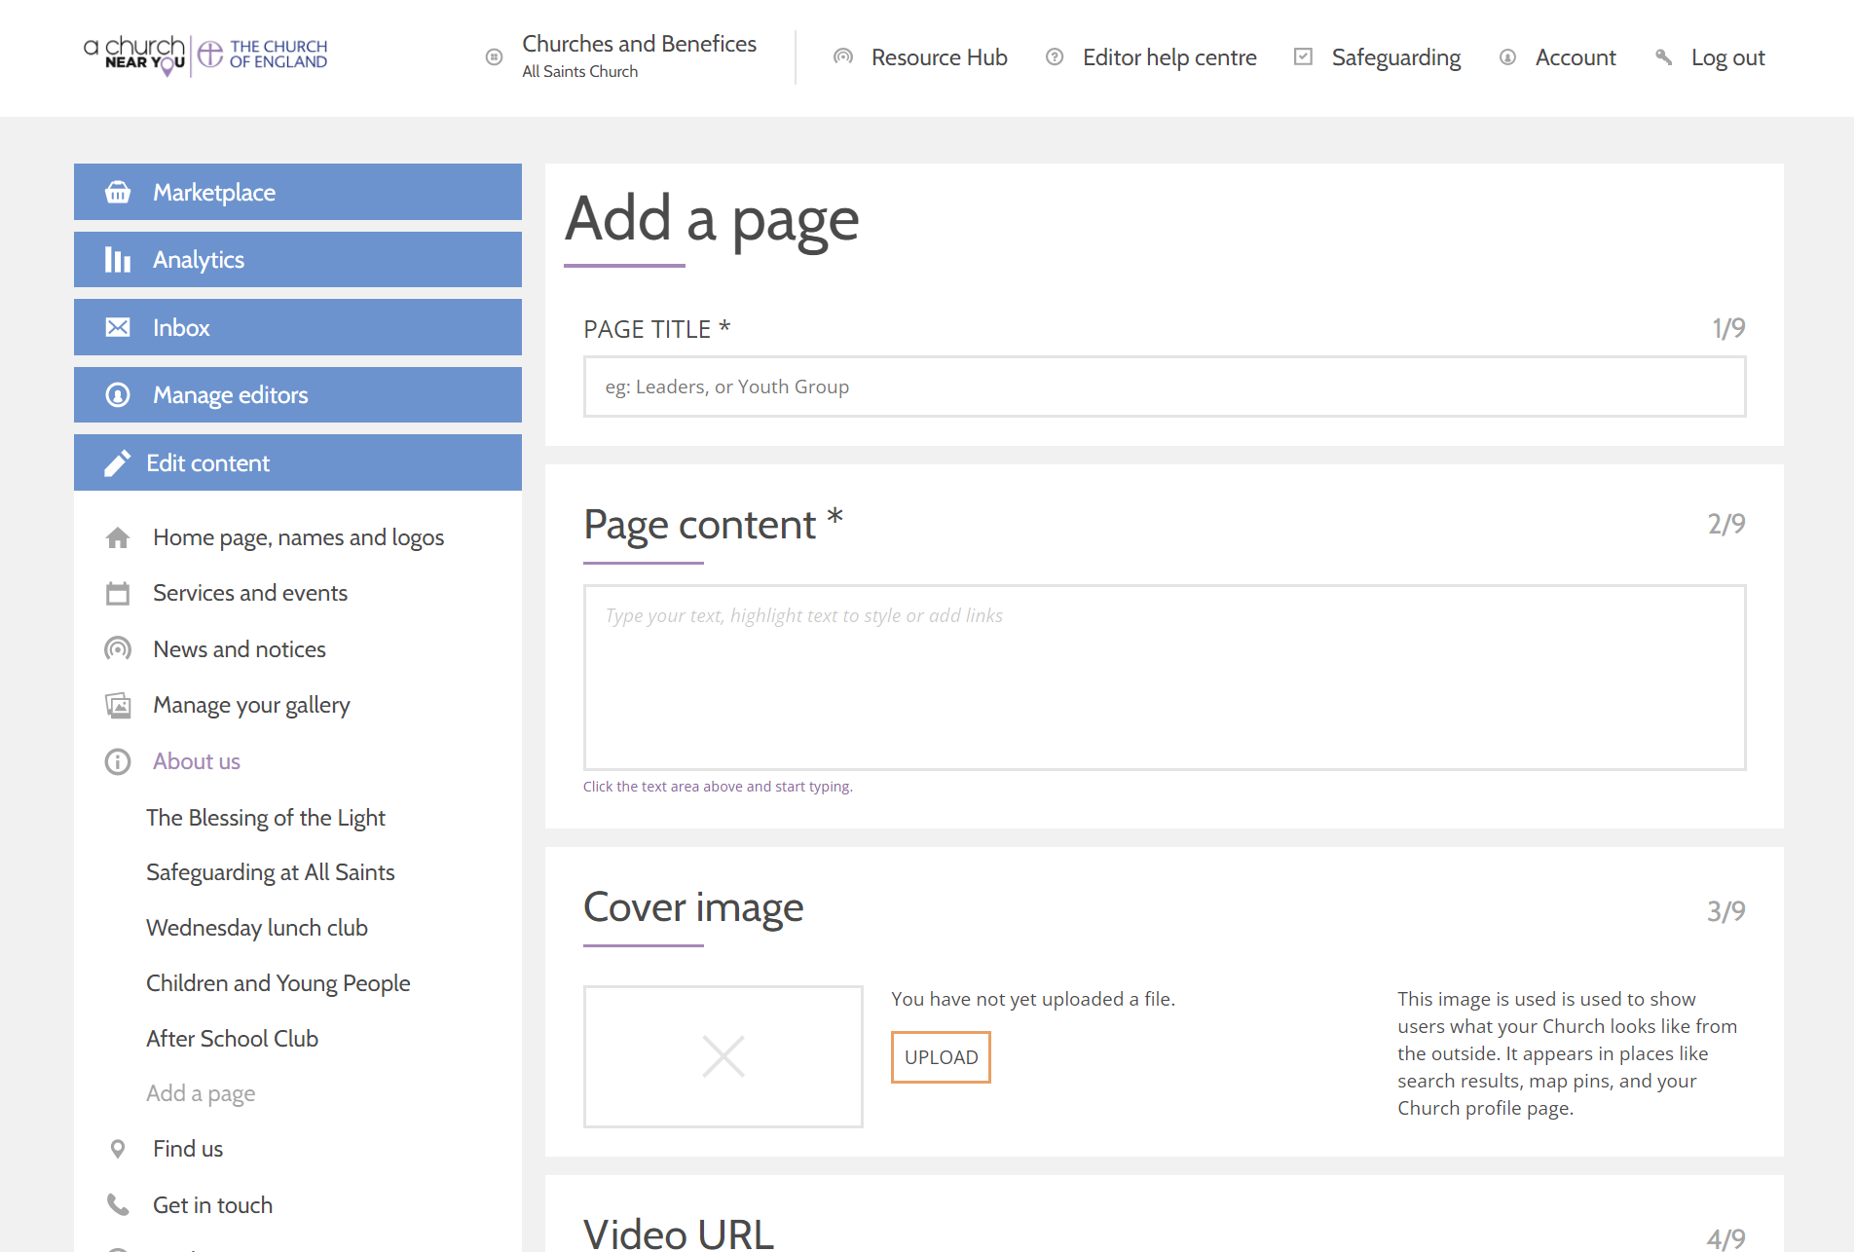
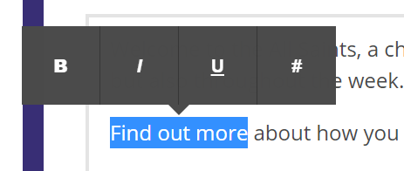
Add a page
Click on Add a page
Add title, content, cover image and video URL
Format the text by highlighting the text with the cursor and selecting an option.

Slide 18
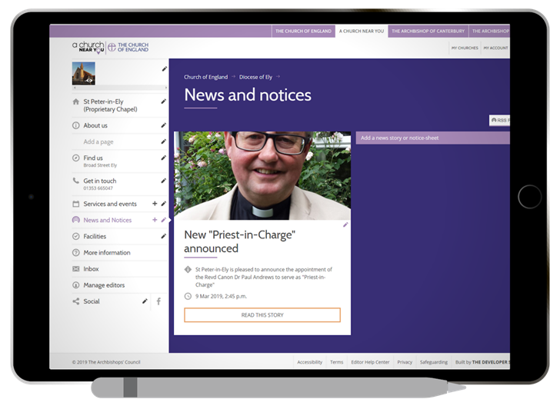
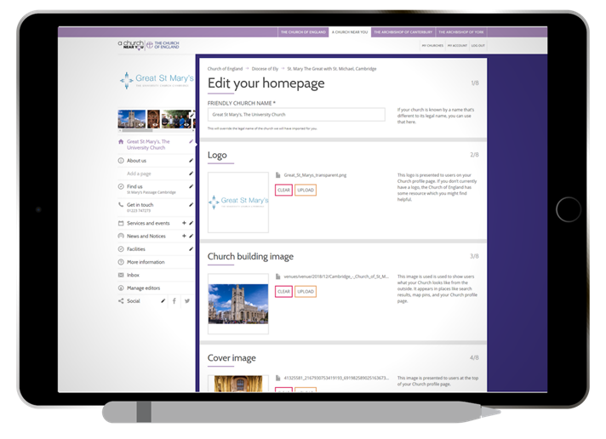
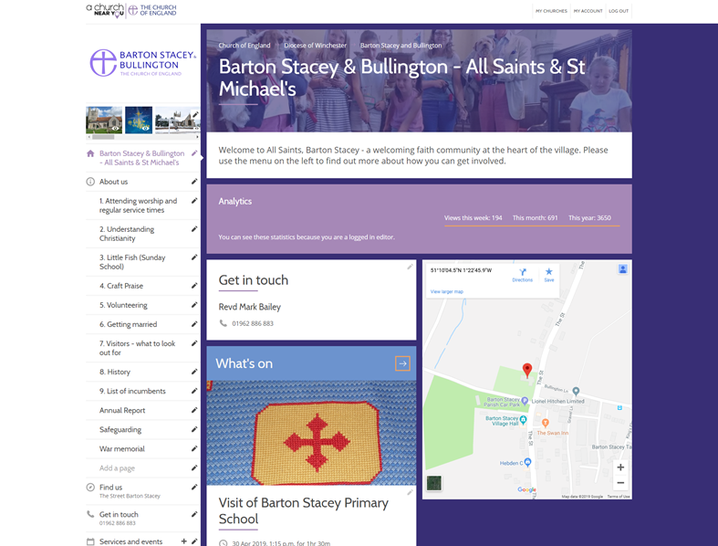
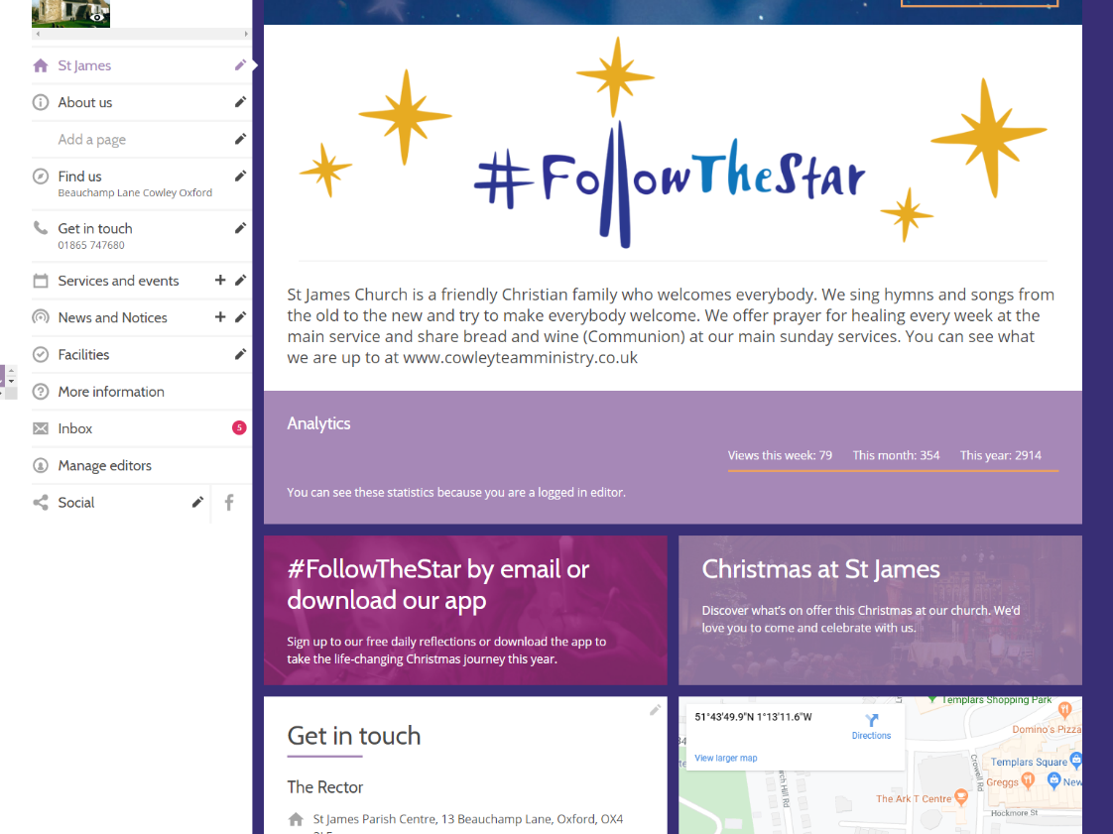
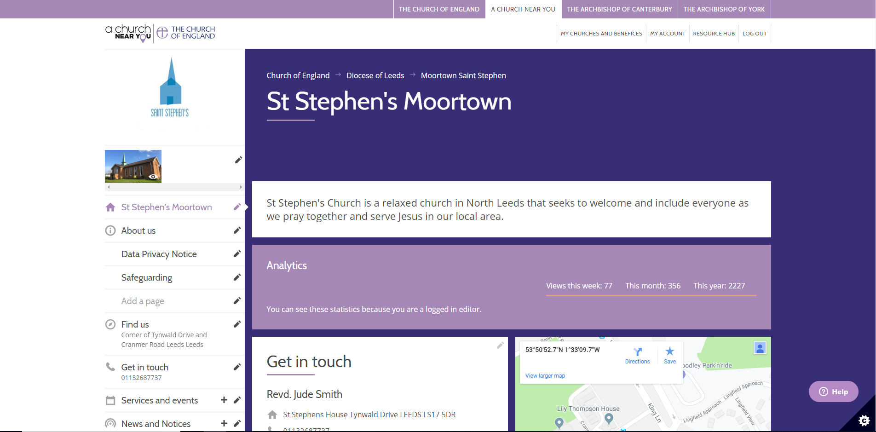
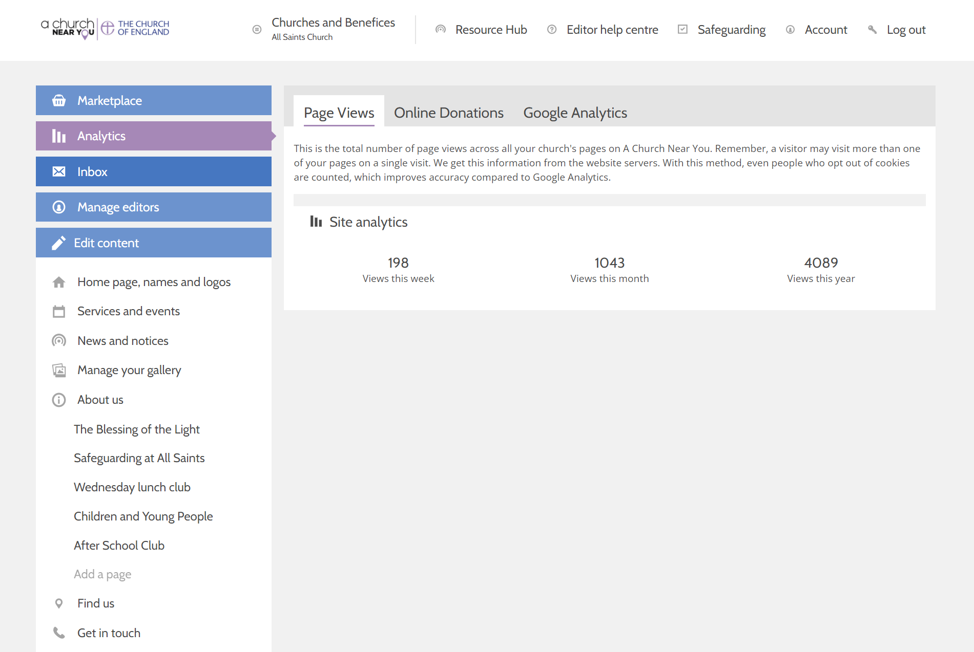
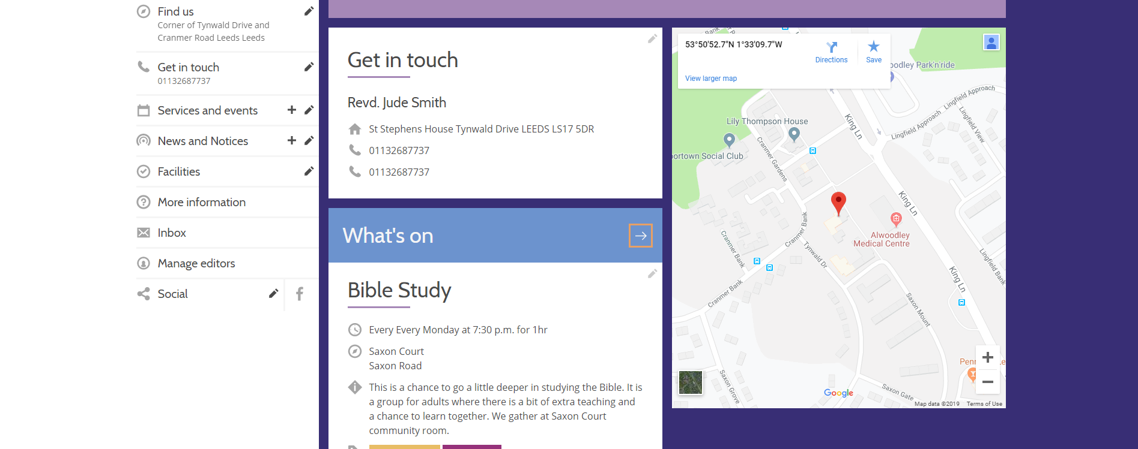
Check site analytics
Click on Analytics View page views, online donations and add a google analytics tracking code, if you wish
Notes:
They are better than google analytics because we don't ned people to accept cookies to say this page has had this many views
Most people it is more than enough
Others want to get behind the data
Separate site, need to set up a site with Google, need to set up a tracking code in this box and save it.

Slide 19
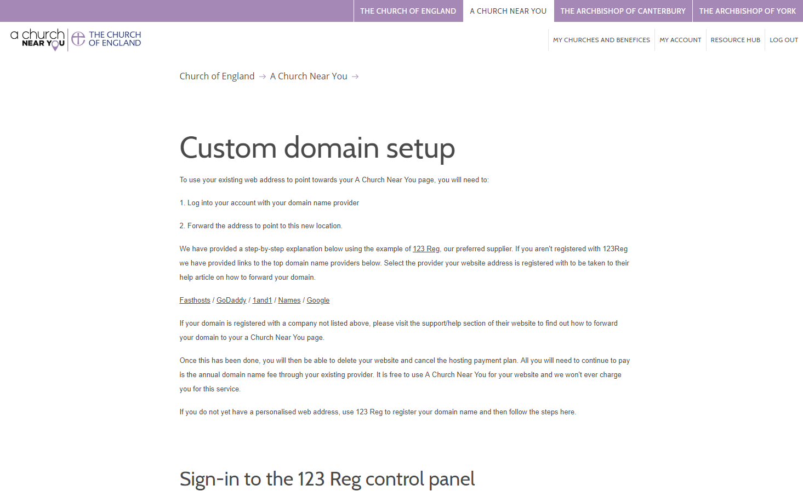
Set up your A Church Near You page as your main website by switching your domain
Use your own domain name
💻 Custom domain set up
www.achurchnearyou.com/custom-domain
Notes:
Hope helps use as main website
Loads of free features

Slide 20
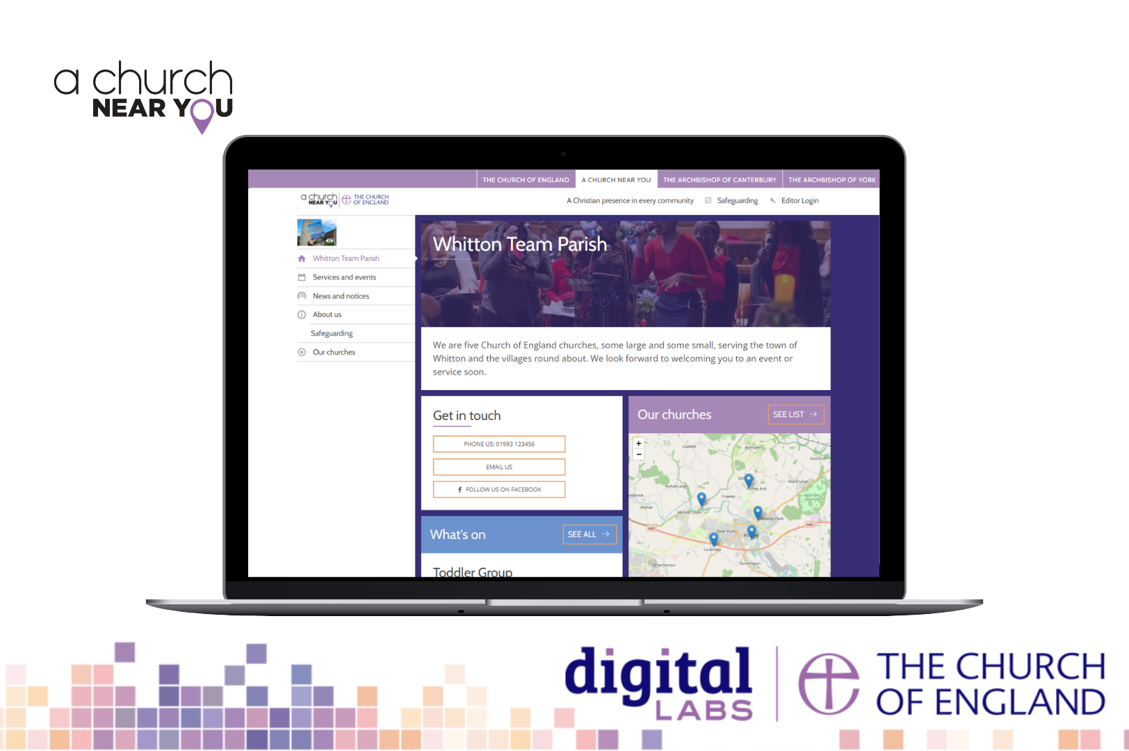
New Features: Benefice Functionality
Notes:
Introduce ourselves and welcome the attendees
Todays objectives
How to ask questions
Act as a parish website
Able to point domain name towards ACNY page
OR direct visitors to the main church website
Allow churches to host outward-facing information like events
Comes top in a google search
Responsive to mobile – meaning it will change dimensions and font size so its easy to see on a mobile phone. Websites that are not mobile responsive are now being pushed further down in a google search.
Quiz Are you an editor and how many churches?

Slide 21
Benefice features
Benefice homepages
List and manage services and events, news and notices and custom pages at benefice level, and choose which church site(s) they will also appear on
Option to swap out 'benefice' language, to suit what you use locally
Flexible options for linking to benefice sites from church sites
See: cofe.io/BeneficeFeaturesACNY

Slide 22
Becoming an editor
Notes:
Introduce ourselves and welcome the attendees
Todays objectives
How to ask questions
Act as a parish website
Able to point domain name towards ACNY page
OR direct visitors to the main church website
Allow churches to host outward-facing information like events
Comes top in a google search
Responsive to mobile – meaning it will change dimensions and font size so its easy to see on a mobile phone. Websites that are not mobile responsive are now being pushed further down in a google search.
Quiz Are you an editor and how many churches?

Slide 23
Becoming an editor: Summary
Step 1: Register
Step 2: Request to edit a church
Step 3: Approval
You get an email at each step.
When you become an approved editor for a church, you AUTOMATICALLY also get access to edit the corresponding benefice site.
Notes:
3 steps, register, request to edit and approval
Talk about how register
Then what to do if have a no Administrator
We have checks that we do and we will then be able to give you access
When you become an approved editor for a church, you AUTOMATICALLY also get access to edit the corresponding benefice site.
BUT you will not be given access to all the churches in the benefice at the same time. You need to request access to each church individually.

Slide 24
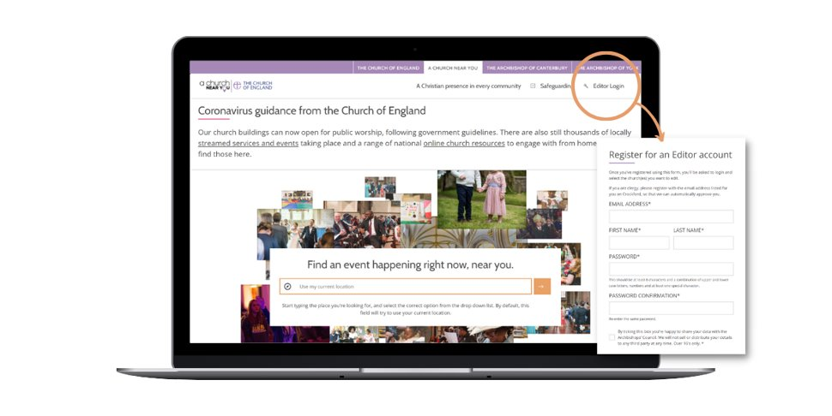
Step 1 Register
Go direct to the registration form: achurchnearyou.com/accounts/signup/
Or to navigate to the registration form:
Click 'Editor login' on the top menu
Under the login form, click where it says 'click here to register'
Notes:
Reminder about the editor help centre

Slide 25
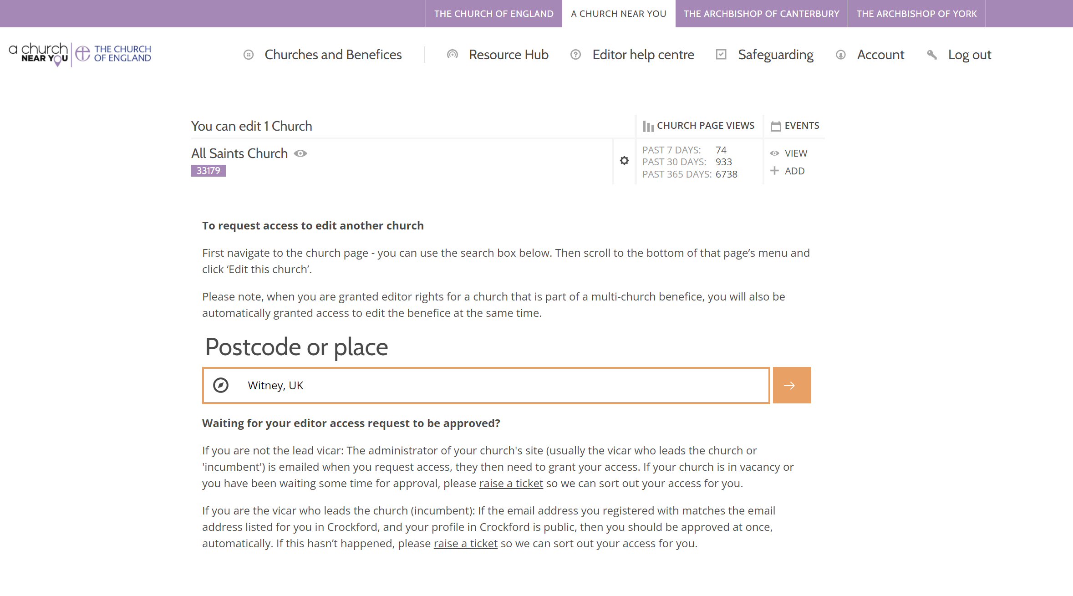
Step 2 Request to edit your church(es)
After you register you will be shown the login form. Go ahead and login.
After you login for the first time, you will be taken to the 'My churches and benefices' page automatically. If not, use this link:
achurchnearyou.com/my-churches/
Search for a church location
Notes:
Reminder about the editor help centre

Slide 26
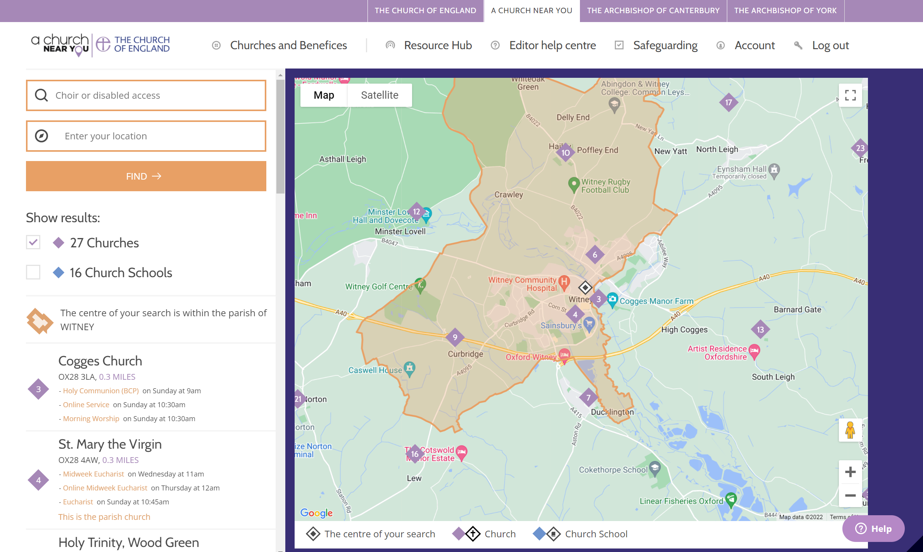
Step 2 Request to edit your church(es)
Select the church you want
Notes:
Reminder about the editor help centre

Slide 27
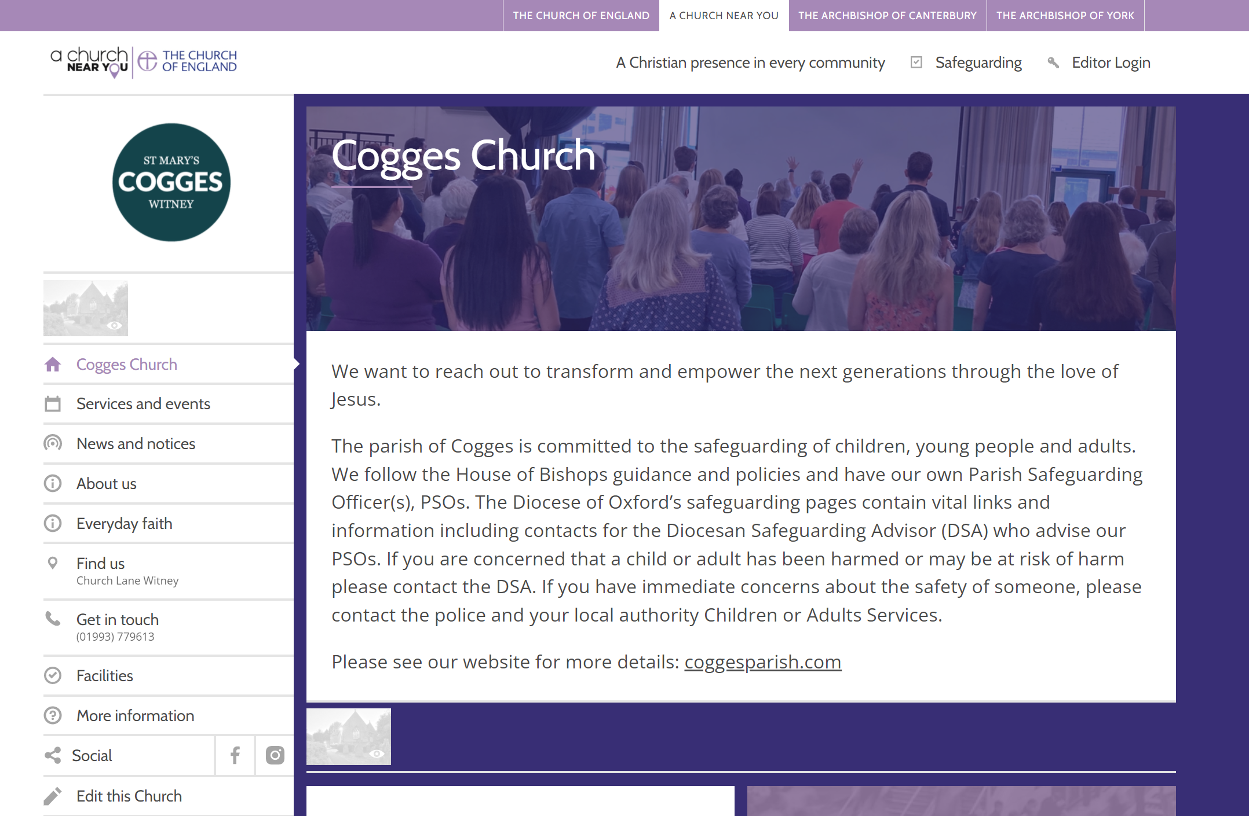
Step 2 Request to edit your church(es)
Choose 'Edit this church' - it's at the very bottom of the church's menu
Notes:
Reminder about the editor help centre
FIX THE BUTTON

Slide 28
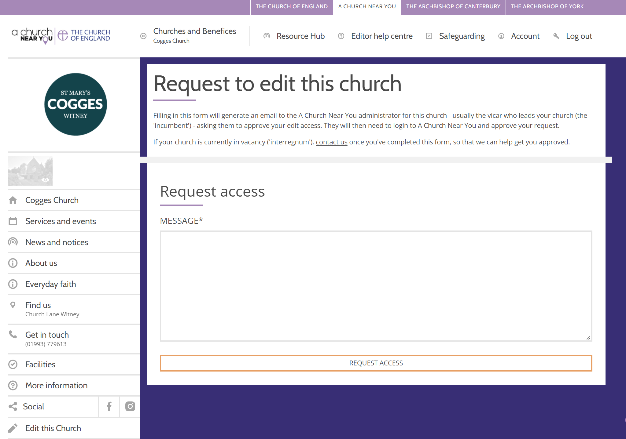
Becoming an editor
Fill out the form that appears and select 'Request access'
Repeat all of step 2 for each church you need access to.

Slide 29
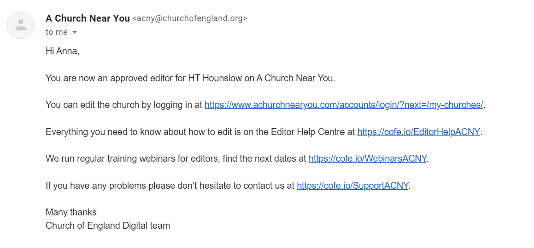
Step 3: Approval
Step 3: Approval

Slide 30
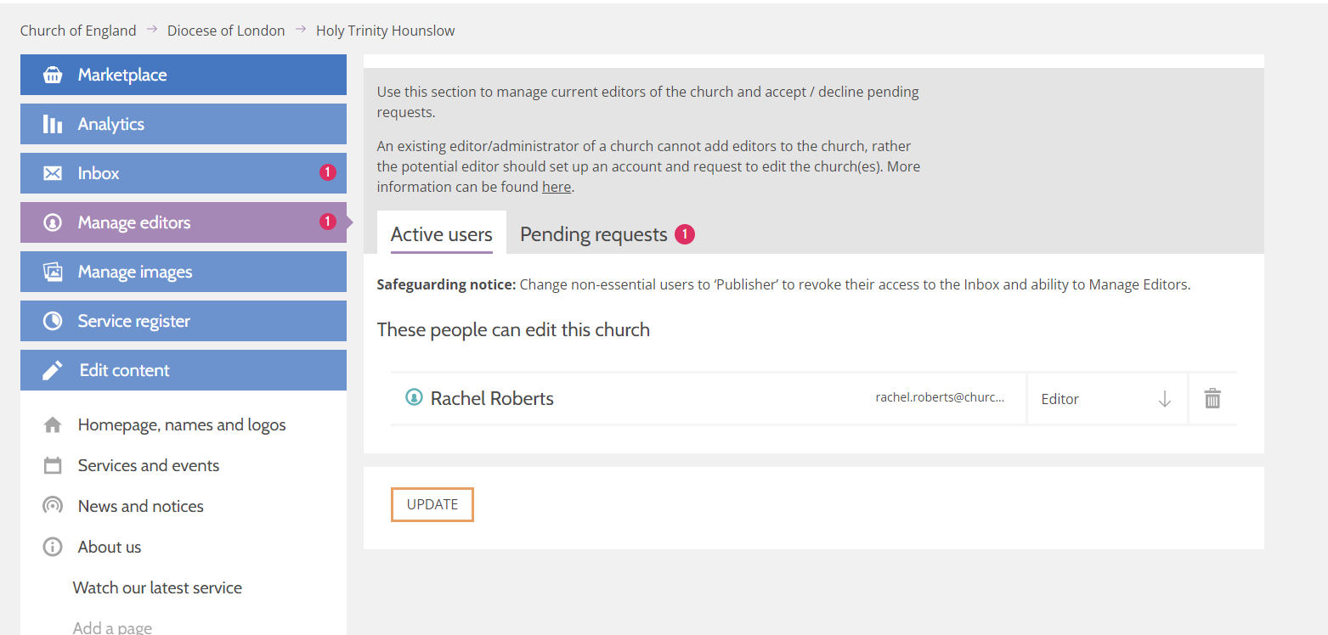
Approving requests
achurchnearyou.com/church/XXX/manage-editors/
Notes:
Reminder about the editor help centre

Slide 31
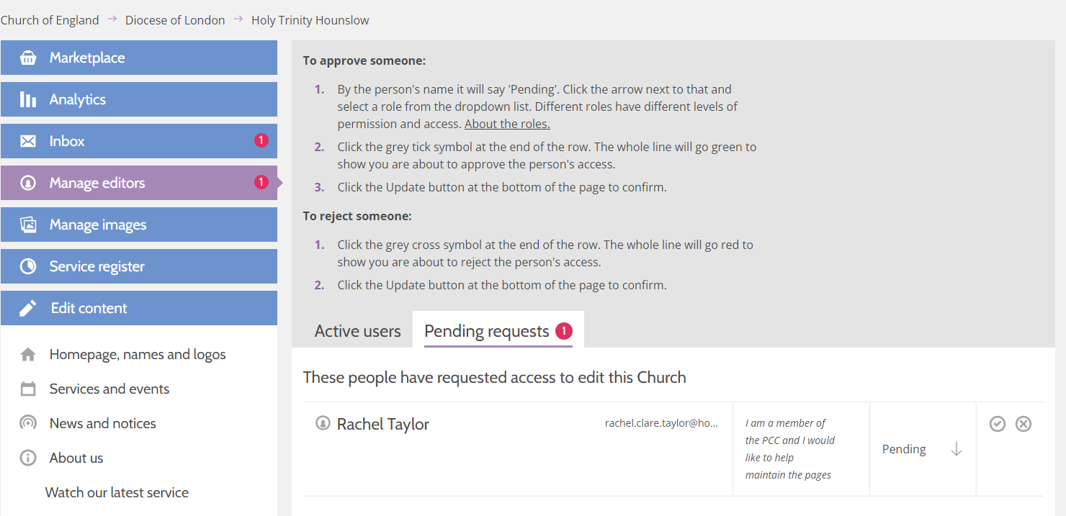
Notes:
Reminder about the editor help centre

Slide 32
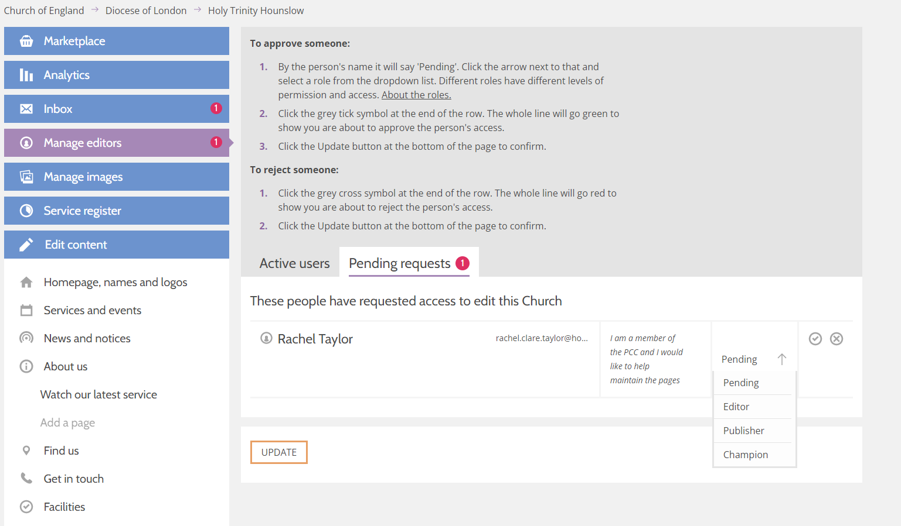
Notes:
Reminder about the editor help centre

Slide 33
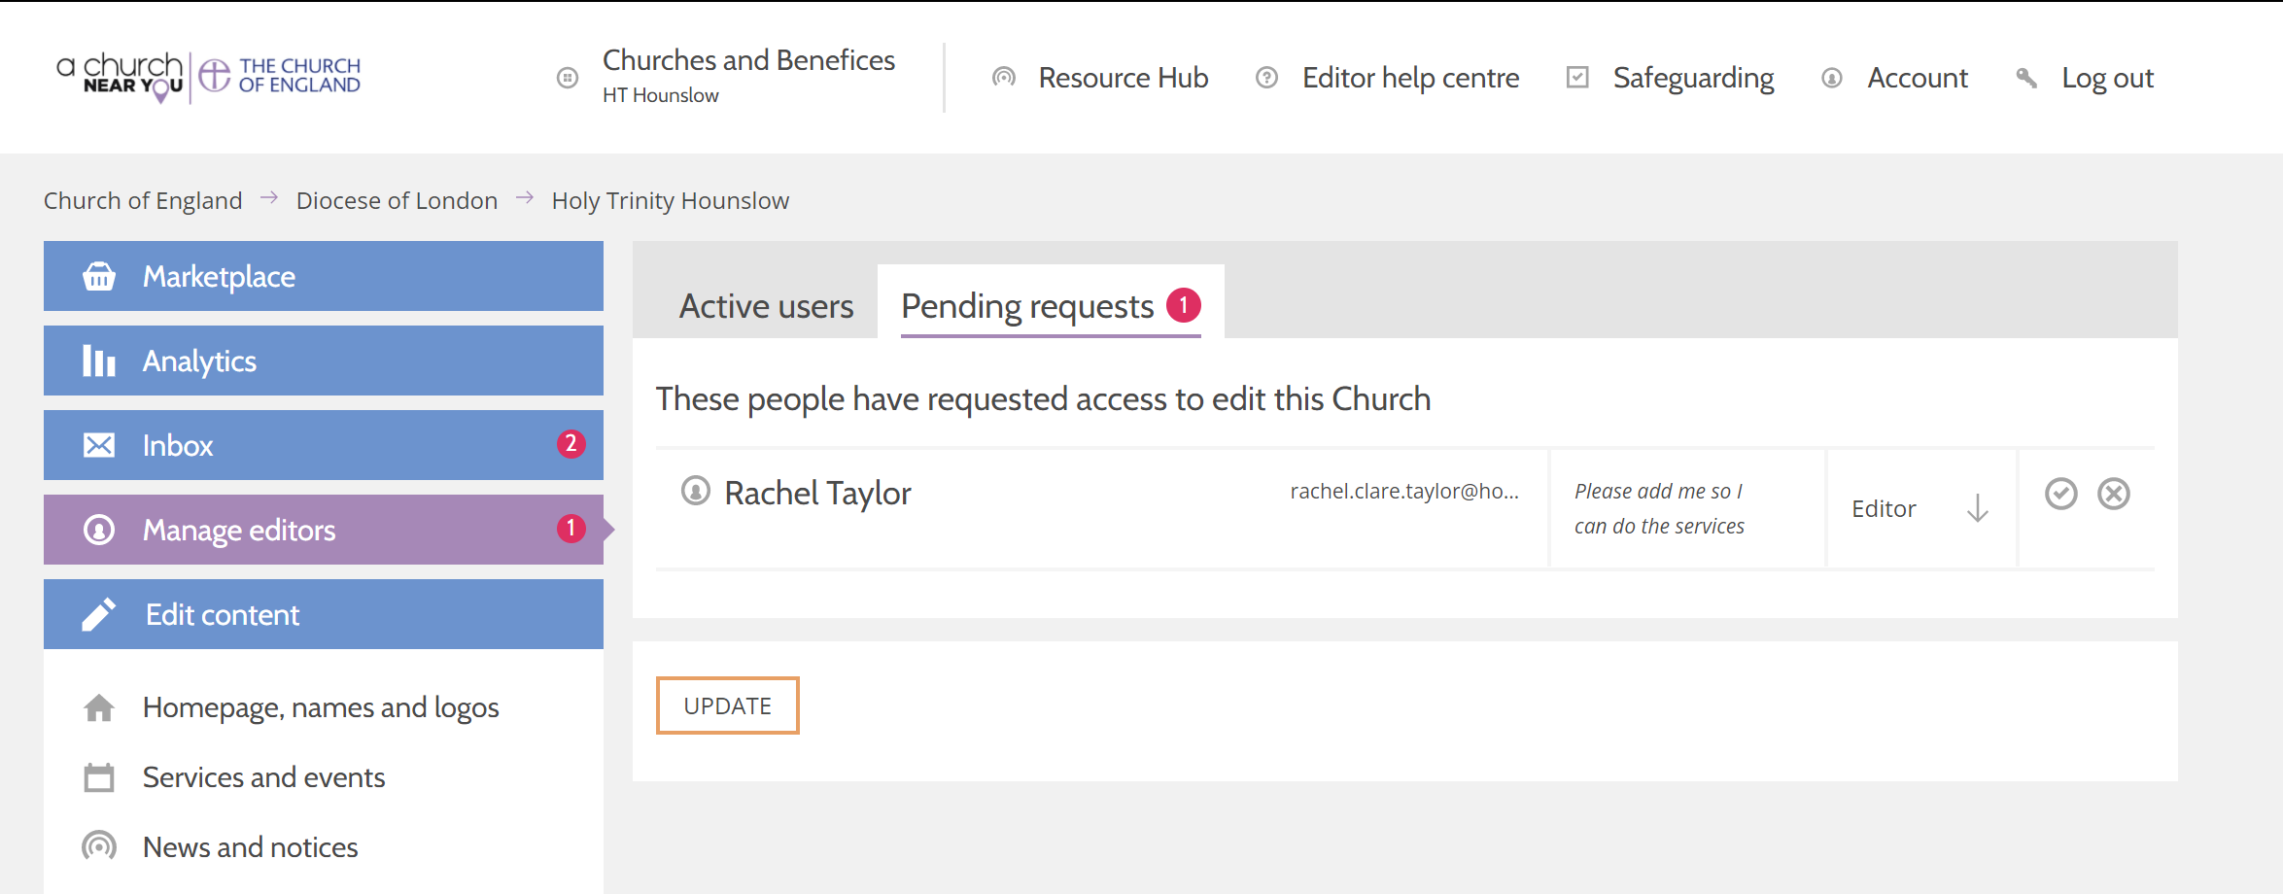
Approving requests
achurchnearyou.com/church/XXX/manage-editors/
Notes:
Reminder about the editor help centre

Slide 34
Approving requests
achurchnearyou.com/church/XXX/manage-editors/
Notes:
Reminder about the editor help centre

Slide 35
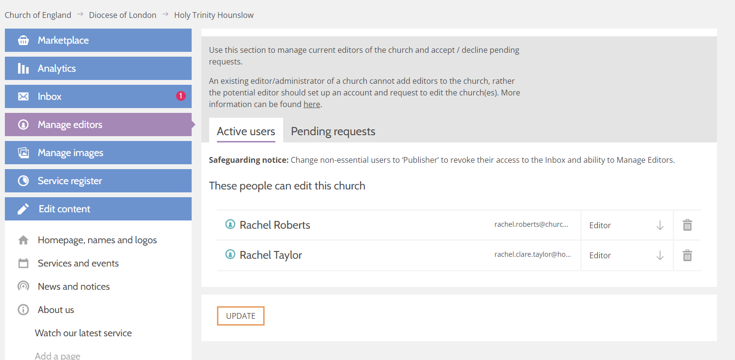
Notes:
Reminder about the editor help centre

Slide 36
Useful information and supporting materials.
Notes:
Introduce ourselves and welcome the attendees
Todays objectives
How to ask questions
Act as a parish website
Able to point domain name towards ACNY page
OR direct visitors to the main church website
Allow churches to host outward-facing information like events
Comes top in a google search
Responsive to mobile – meaning it will change dimensions and font size so its easy to see on a mobile phone. Websites that are not mobile responsive are now being pushed further down in a google search.
Quiz Are you an editor and how many churches?

Slide 37
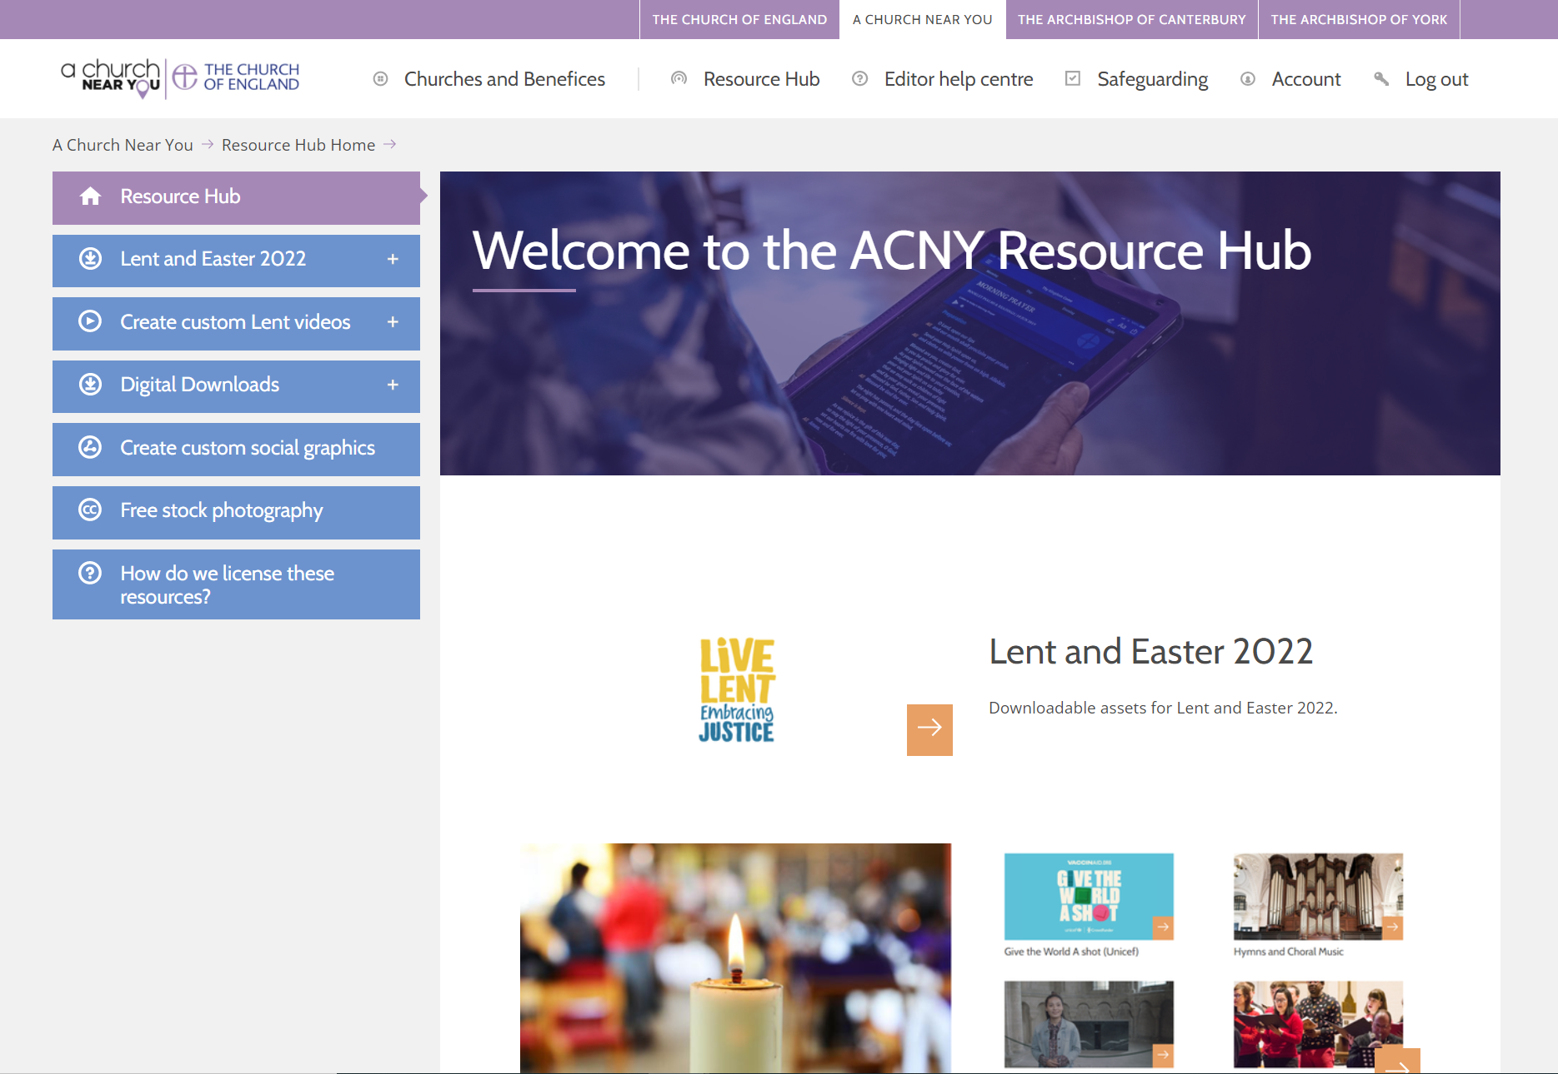
Features to try out
Video and social media generator - Resource Hub
Benefice home page – Click on Churches and benefices
Free stock photography - Resource Hub
Notes:
Reminder about the editor help centre

Slide 38
Language and tone
Be welcoming and inclusive with language, using descriptions where
necessary so that everyone feels included and welcome in the church community.
Evangelism
Mission
Anointing
Jargon
Words which may make sense to us, but without explanation, can be jargon to those unfamiliar with Christianity or Anglicanism
Benefice
Faculty
Fellowship
Lectionary
Journeying
Season
Collect
Episcopal
Welcoming language
Avoid phrases which may portray an
‘us’ and ‘them’ tone, such as:
‘Join us…’
‘If you are new…’
‘speak to Dave for more info’
Synod
Diocese
Deanery
Incumbent
Lay
Parochial
Notes:
Our language could be more transparent and inclusive
If people reading it don’t understand it, they won’t take the time to find out the answer, they’ll just move on

Slide 39
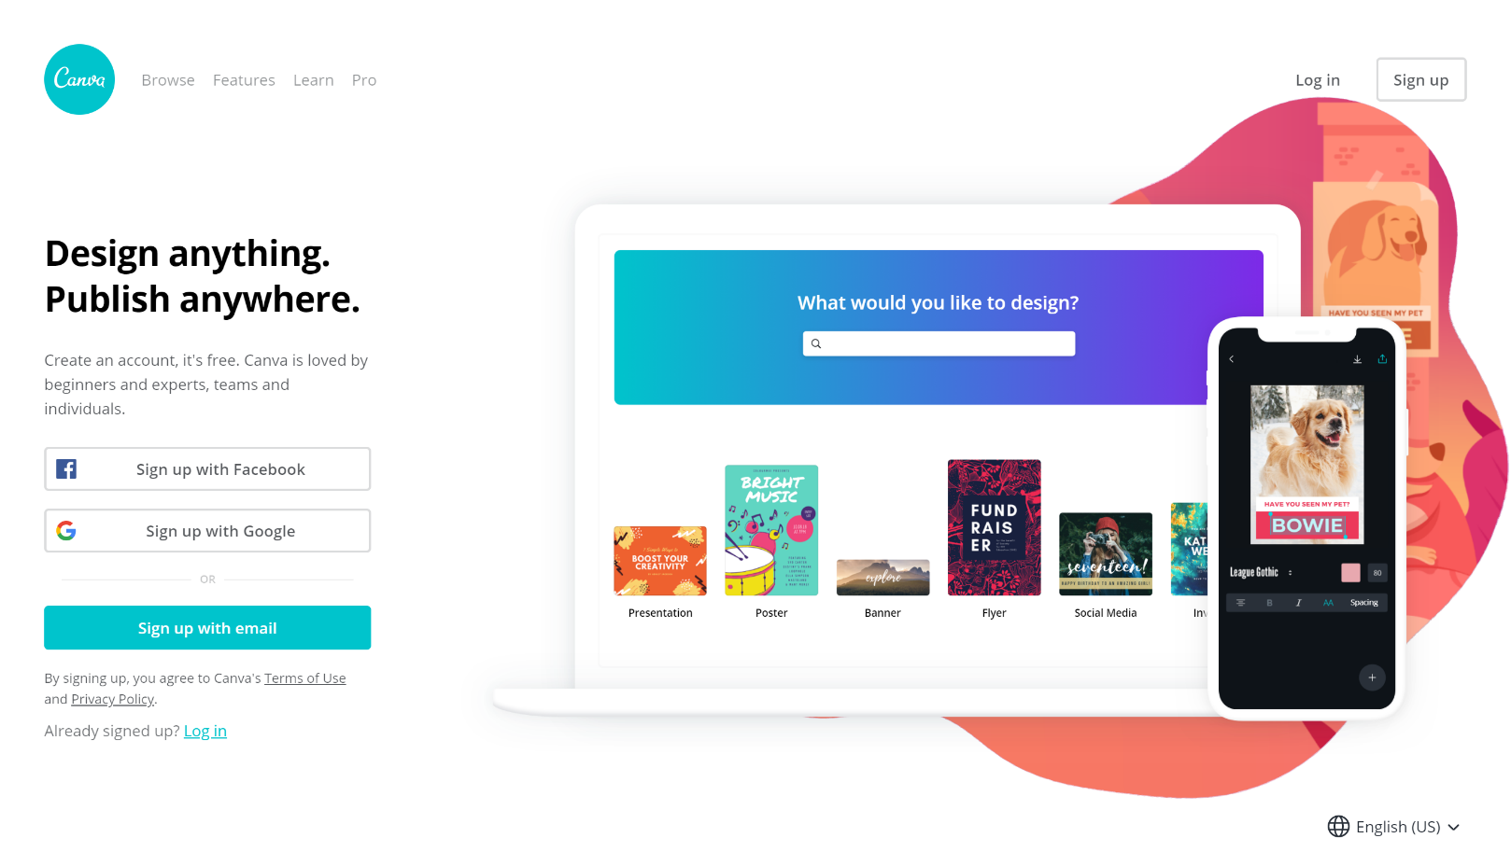
Useful tools – Photography and design
www.canva.com
www.spark.adobe.com
www.unsplash.com
www.pixabay.com
www.pexels.com
www.freepik.com
achurchnearyou.com/hub

Slide 40
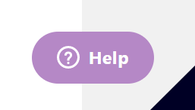
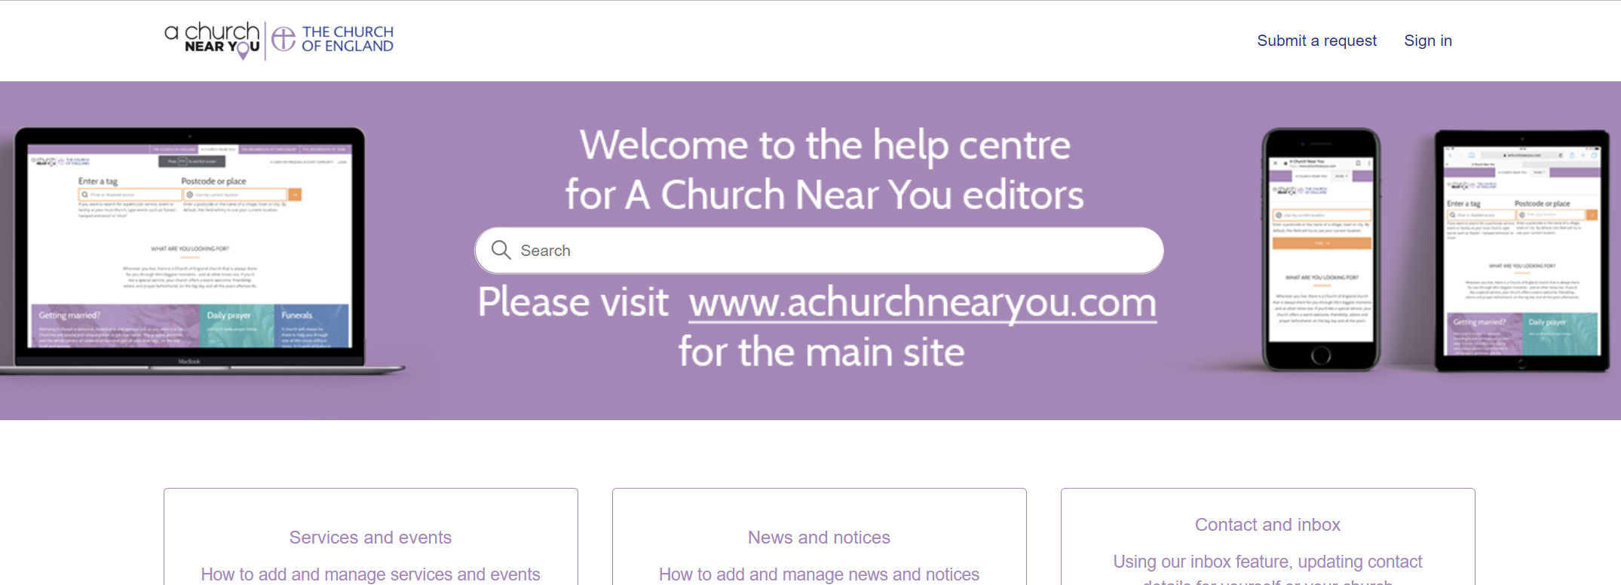
Ways to access help articles
Click on the floating help button at any time
Click ‘Editor help centre’ in the top menu
Go to cofe.io/EditorHelpACNY

Slide 41
How to contact us for more support
From the Editor help centre click ‘Submit a request’
Or go straight to the help form with this link: cofe.io/SupportACNY

Slide 42
Blogs Webinars Newsletter Conference
Discover the free resources for churches
Churchofengland.org/DigitalLabs

