Slide 1
Archbishops’ Commission on Families and Households
Impact of DELAY IN THE FAMILY COURT
Notes:
FJYPB members introduce themselves
(Name and how long they have been on the board)
Today we are going to talk to about the impact of delay in the family court.

Slide 2
Proud to be sponsored and supported by
Notes:
We are the Family Justice Young People’s Board and proud to be supported and sponsored by Cafcass.
There are 79 members from diverse backgrounds across England and Wales who have had a direct or an indirect experience of public and private law proceedings. Our members are aged between 7 – 25 years.
The FJYPB supports the work of the Family Justice Board. Representing children and young people to have their lived experiences considered in policy and the delivery of services.

Slide 3
Role of A FJYPB Member
.
To be able to express their views on the way in which the services within Family Justice are run and on the support they provide to children, young people and their families.
To be able to share their opinions and experiences in work carried out both within and on behalf of the Family Justice service, including at conferences, training events and responding to government consultations on request.
To be able to take part in interviewing new members of staff within the Family Justice system.
To be able to travel across England and Wales in order to attend FJYPB meetings, and targeted workshops.
Support the strategy, policy and practice development of our stakeholders ensuring that their work is promoting the best interests of children and young people.
Notes:
Read through the slide

Slide 4
Examples of who we work with
MOJ - Ministry of Justice
NACCC - National Association of Child Contact Centres
Judiciary
Cafcass Cymru
Family Justice Board
HMCTS - Her Majesty's Courts and Tribunal Service (Courts)
Local Authorities
Department for Education
Notes:
We work with stakeholders across Family Justice
Here are some examples:
MOJ - Ministry of Justice
NACCC - National Association of Child Contact Centres
Judiciary
Cafcass Cymru
Family Justice Board
HMCTS - Her Majesty's Courts and Tribunal Service (Courts)
Local Authorities
We are proud to say that Cafcass are our sponsors and they fund the support team for the FJYPB.

Slide 5
For your free copy you can contact us at:
fjypb@cafcass.gov.uk
Or you can download a free copy at:
www.cafcass/fjypb
Notes:
In Our Shoes – We released our debut book in January 2022. FJYPB members created this book including over 30 pieces written by members about their own personal and very challenging experiences, along with some key messages for professionals. In Our Shoes is a free resource and available to all professionals working with children and young people. We have now shared close to 1000 hard copies of the book and 3795 digital downloads.
You can request a free copy by contacting us at fjypb@cafcass.gov.uk or yu can download a free copy from the Cafcass website.

Slide 6
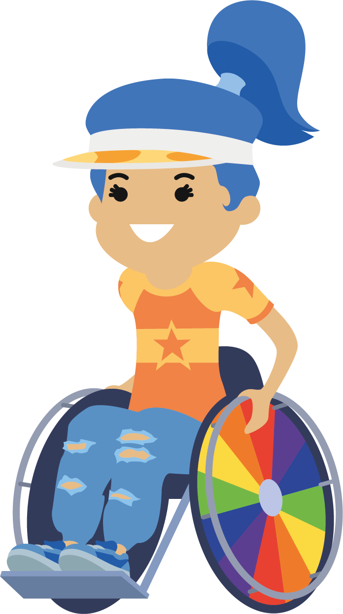
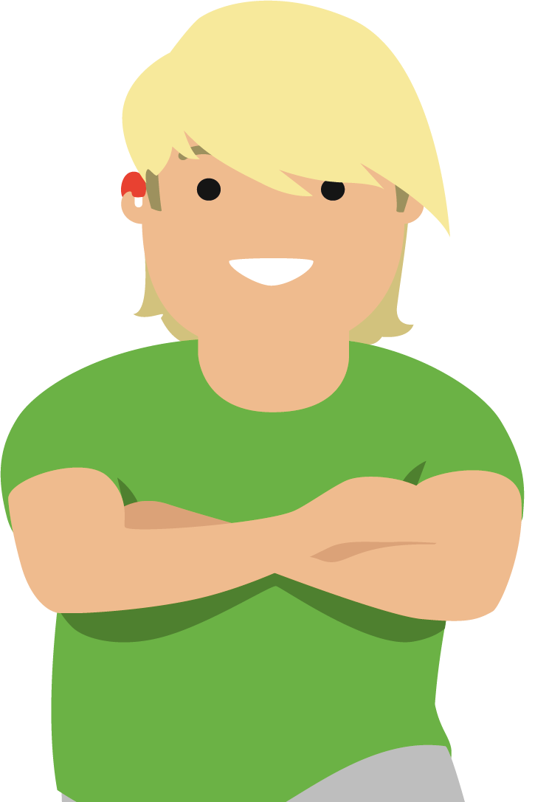
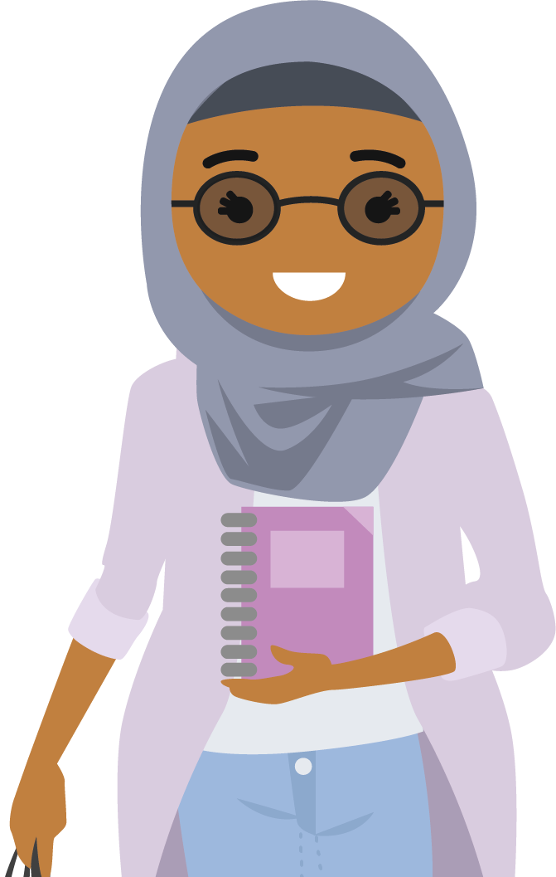
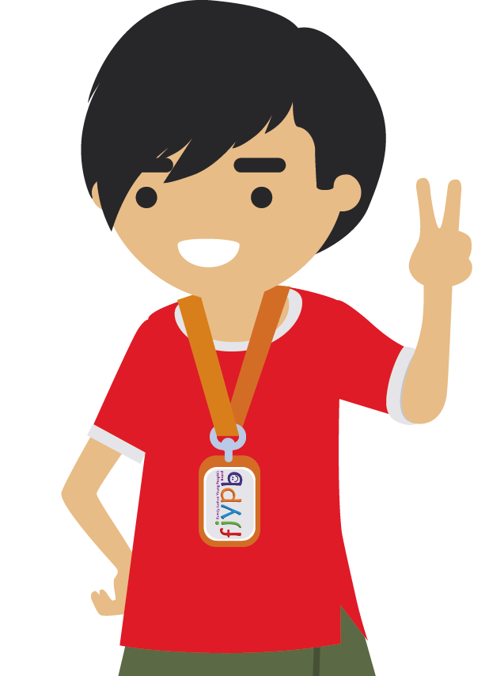
Supporting loving relationships throughout life

Slide 7
EPIC DAY
Notes:
We would like to play you a recording of one of our pieces titles Epic Day from our Book In Our Shoes
Audio will play when you click.

Slide 8
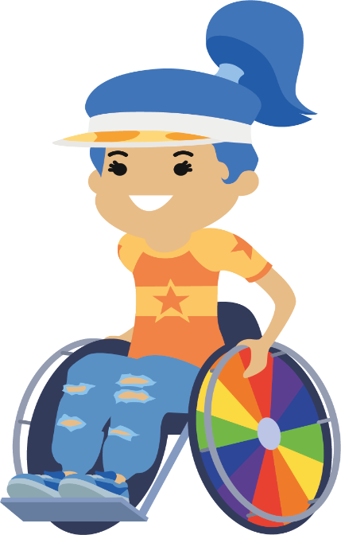
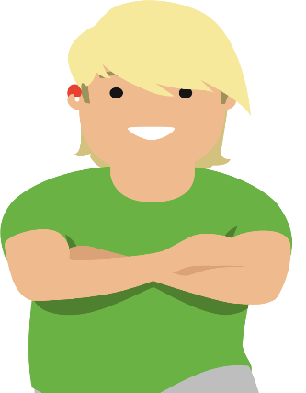
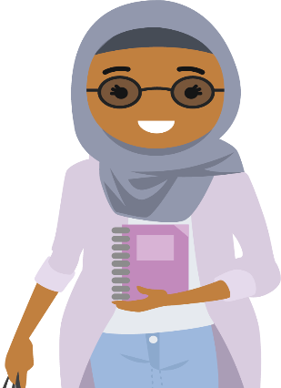
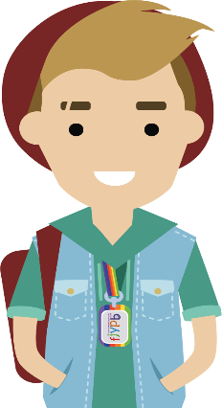
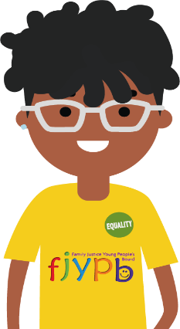
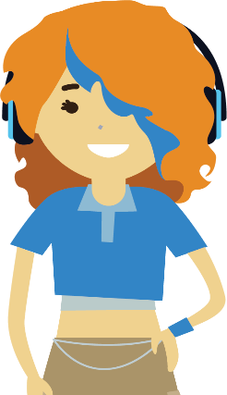
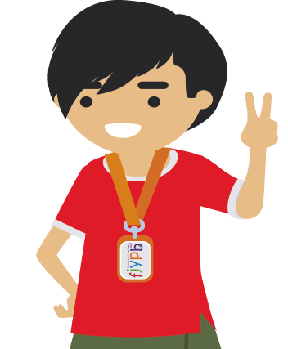
TOP TIPS
For Parents who are separated
Notes:
The FJYPB have developed our TOP TIPS for parents who are separated. WE have created these from our own experiences and would like to ask all professionals to share these with the parents you work with. You can download them from the FJYPB page on the Cafcass website.

Slide 9
1
Remember I have the right to see both of my parents as long as it is safe for me.
2
I can have a relationship with the partner of my other parent without this changing my love for you.
3
Try to have good communication with my other parent because it will help me. Speak to them nicely.
4
Keep my other parent updated about my needs and what is happening for me. I might need their help too.
5
Don’t say bad things about my other parent, especially if I can hear. Remember I can often overhear your conversations or see your social media comments.
6
Remember it is ok for me to love and have a relationship with my other parent.
7
Don’t make me feel guilty about spending time with my other parent.
8
Don’t make permanent decisions about my life based on how you feel at the moment. Think about how I feel now and how I might feel in the future. My wishes might change.

Slide 10
9
Be open to change, be flexible and compromise when agreeing arrangements for me.
10
Its ok with me if my parents don’t do things exactly the same. You are both different and that’s alright with me.
11
Don’t be possessive over me and the things that belong to me. Make it easy for me to take the things I need when I spend time with my other parent, such as school work, PE kits, clothes, books, games, phone etc. Let me choose what I want to take with me.
12
Keep me informed about any changes to my arrangements.
13
Try not to feel hurt if I choose to spend time with my friends instead of seeing you. I am growing up!
14
Remember that important dates (birthdays, celebrations, parents evening, sports day etc.) are special to you, me and my other parent. I may want to share my time on those dates with each of you.
15
Work out between you and my other parent who is responsible for the extra things I need, such as new school shoes and uniform, school trips, dinner money and the cost of my hobbies or after school activities. I don’t want to be involved in this.

Slide 11
16
Remember that I don’t expect you or my other parent to be perfect, so I don't want you to expect my other parent to be perfect either. Accept mistakes and move on.
17
Make sure I am not left out of key family events. Please compromise with my other parent so I can join in.
18
Please don’t stop me having contact with extended family members who are important to me. Ask me how I feel about them. Don’t assume my feelings are the same as yours.
19
Don’t use me as a messenger between you and my other parent.
20
Don’t use my relationship with my other parent against me, or them.
21
Don’t ask me to lie to my other parent or other family members.
22
Don’t ask me to lie to professionals, or to say what you want me to say.
23
Remember that I might want something different to my brother or sister.
24
Don’t worry about how others see you or what they think. I am what matters.

Slide 12
Empowering young people

Slide 13
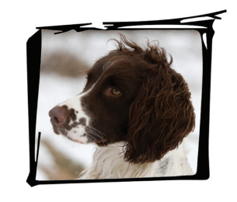
A family who love me
Notes:
We would like to play you another one of our recordings from our book. Titled a Family Who Loved me
Audio will play when you click.

Slide 14
REMINDERS

Slide 15
It is easier to build up a child than it is to repair an adult.
Your words and actions have power in a child’s life. Use them wisely.

Slide 16
Every child and young person should be able to understand what is said or written about them in their file.
“
My file should tell my story and capture this significant and life changing chapter in my life. Think of me reading my file later in life as you add to it. Ask yourself will what I add make sense to me and it accurately reflects what happened?
“

Slide 17
MIND YOUR LANGUAGE
FJYPB members have identified a number of words or phrases that they have heard spoken or written about them during their proceedings that they want to change.
Available at www.cafcass/fjypb
Notes:
Good communication is also about thinking about the language you use.

Slide 18
A FEW EXAMPLES
I am not a CASE or a number. I am a person, so please don't talk about how many cases you have or about your case plan. Talk about how many children and young people you are helping.
Looked After Child (LAC). This makes me feel patronised and as though I am different. I am a child like any other.
Please don’t label me.
I am not a subject child or an object. I would like to be referred to by my name.
The proceedings are about my life. The only thing worse than being referred to as a subject child is a non-subject child. Please think about how you talk about the people involved in family law proceedings.
Notes:
Give examples:
Language is not only about how you speak to a child or young person. It is also about how you share information that is in writing about the child. This should be clear and understandable. Everyone benefits from clear language not matter your role in family court proceedings.

Slide 19
All children and young people are capable of extraordinary things!
The potential for happiness and great things lies in all of us.
We can’t change the things that has happened to us. What we need is the skills so any challenging times don’t break us!
Resilience is being able to bounce back from stress, challenge and trauma.
When we and other children and young people are resilient, we are braver, more curious and more adaptable.

