Slide 1
Primary School Collective Worship

Slide 2
Gathering
The grace of our Lord Jesus Christ, the love of God and the fellowship of the Holy Spirit be with you.
And also with you.

Slide 3
Gathering
I wonder what you think of when you hear the word ‘king’?
What do you think it means to be a ‘good’ king?

Slide 4
Words of Jesus
Blessed are those who hunger and thirst for righteousness…
Blessed are the merciful…
Blessed are the pure in heart…
Blessed are the peacemakers…
(Matthew 5: 6-9 – New International Version)
I wonder…why do you think Jesus wanted to share these words with those who were with him?
Jesus was inviting those with him to think not only of their ‘to do’ list, but also their ‘to be’ list: be merciful; be pure in heart; be a peacemaker, and hunger and thirst for righteousness.

Slide 5
Words of Jesus
“You are the light of the world. A town built on a hill cannot be hidden. Neither do people light a lamp and put it under a bowl. Instead they put it on its stand, and it gives light to everyone in the house. In the same way, let your light shine before others, that they may see your good deeds and glorify your Father in heaven.”
Matthew 5: 14-16 – New International Version

Slide 6
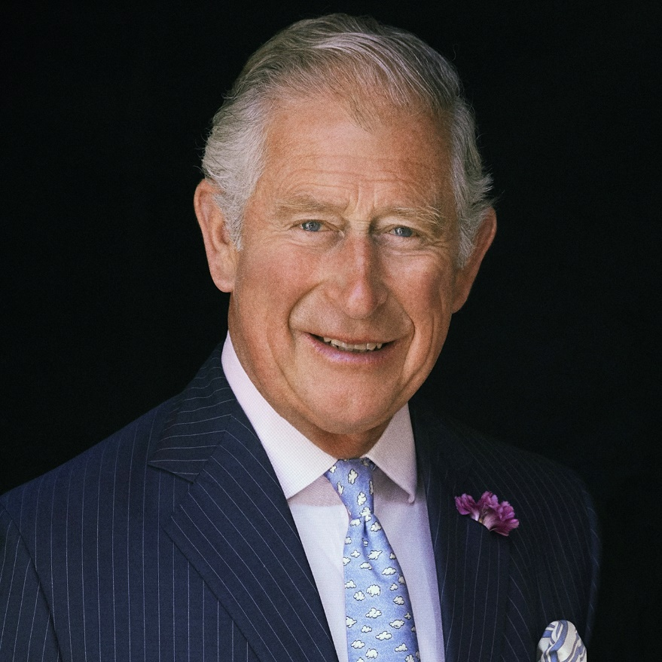
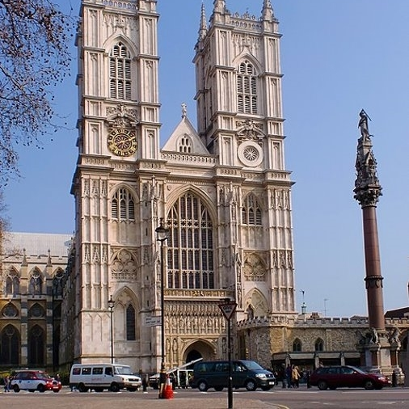
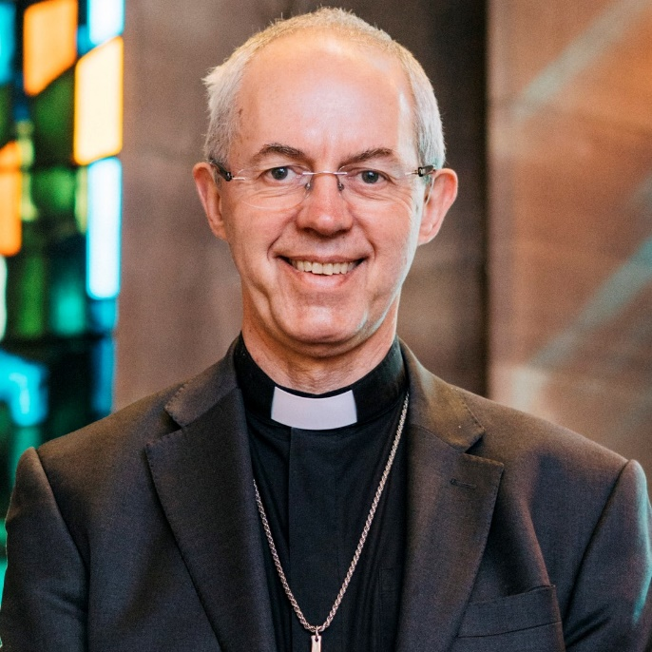
The Coronation of King Charles III

Slide 7
Head of the Commonwealth
The King is also the Head of the Commonwealth, a voluntary organisation of 54 independent and equal countries across the world. These countries work together towards common goals and values.

Slide 8
The Coronation Service
The recognition
King Charles will be presented to those gathered in the Abbey by the Archbishop of Canterbury. The congregation will shout ‘God save King Charles!’ and trumpets will sound.
The oath
The King will then make a Coronation Oath. The exact words of this promise – to people and to God – has changed over the centuries. Queen Elizabeth II swore to rule with justice and mercy.
I wonder what you commit to doing in your words and actions?

Slide 9
The Coronation Service
The anointing
After the oath, the King sits in the Coronation Chair. The Archbishop of Canterbury will anoint the King with holy oil and bless him.
This anointing with oil goes back to the practices described in the Old Testament of setting something apart as special for God’s purposes. A gold cloth has traditionally been held over and around the chair to conceal this sacred event.
Why do you think the anointing has been done privately?

Slide 10
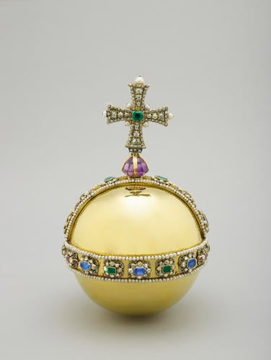
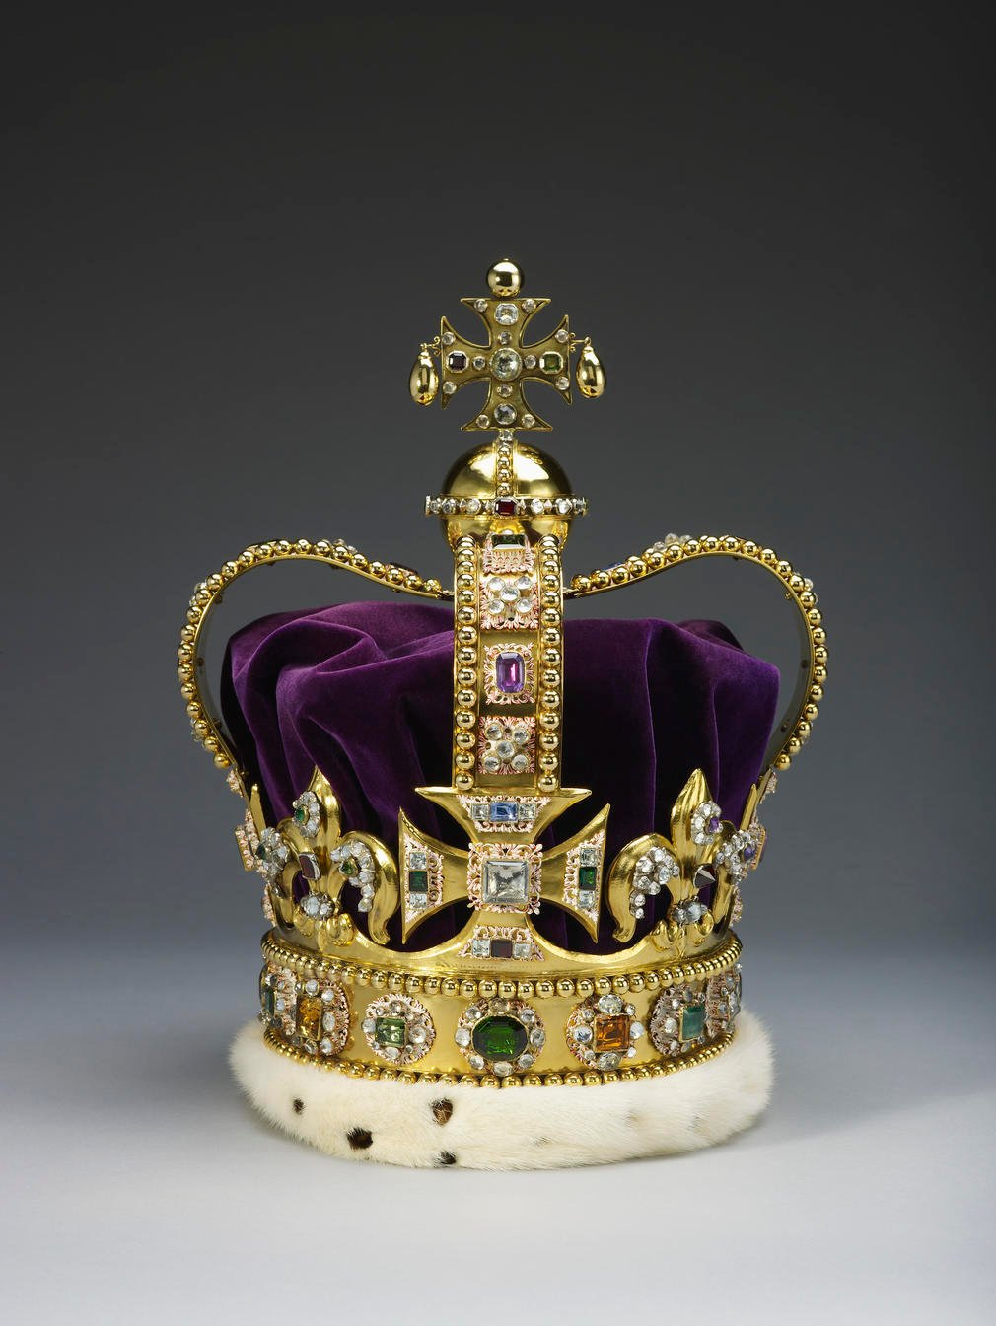
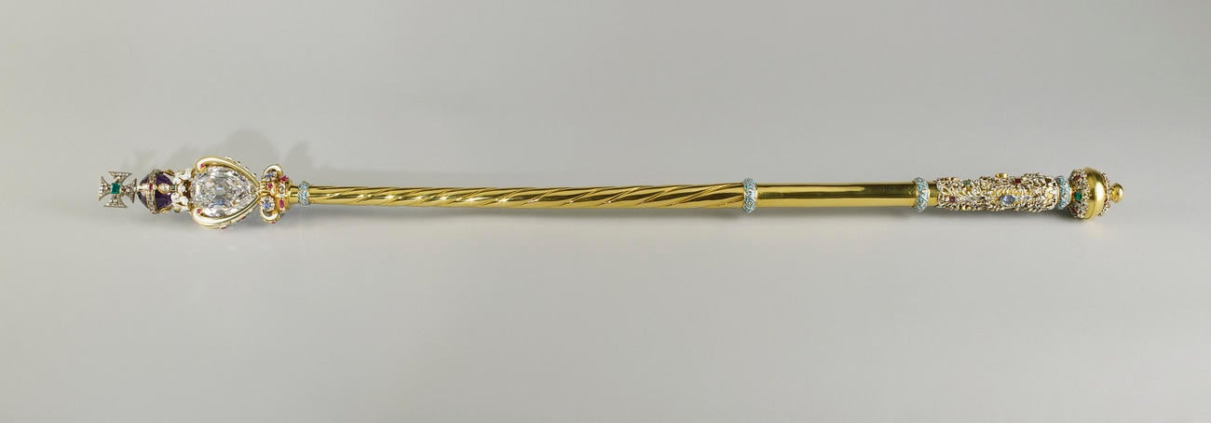
The Coronation Service The Investiture
Why do you think these symbols are so important to the King?
The Sovereign’s Orb
St. Edward’s Crown
The Sovereign's Sceptre

Slide 11
The Coronation Service
The enthronement and homage
King Charles III will then move from the Coronation Chair to the throne. Those gathered will kneel before the sovereign to pay respect and special honour to the King.
We can see within the Coronation the ways in which the King will express the ways he wishes to follow Jesus’ teaching and example as given in the Beatitudes: be merciful; be pure in heart; be a peacemaker, and hunger and thirst for righteousness. ​
​
Through the Coronation, the King will express what he wants ‘to do’ and who he wants ‘to be’ as he rules.

Slide 12
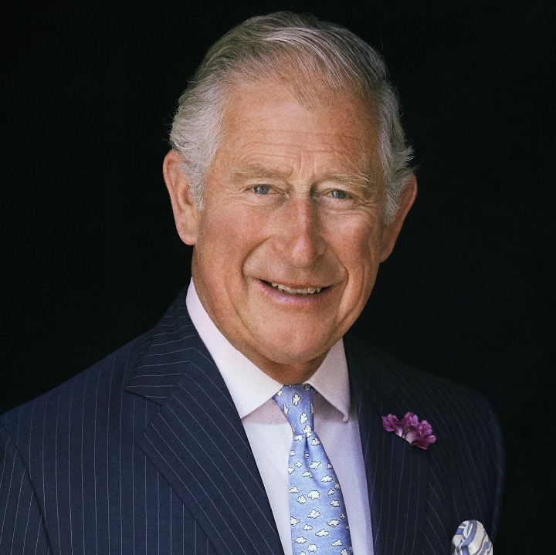
Response
The King’s Christmas Message
In his first Christmas message the new King talked about his and his mother’s belief in the power of everlasting light of Jesus:
“It is a belief in the extraordinary ability of each person to touch, with goodness and compassion, the lives of others, and to shine a light in the world around them. This is the essence of our community and the very foundation of our society.”
How can we play our part in creating the kind of world God wants alongside the King?
How can we all ‘touch the world with goodness and compassion’ today and beyond?

Slide 13
Response
As well as being important for the King, the Coronation offers an opportunity for us to reflect on our own ‘to be’ and ‘to do’ list.
I wonder what you would put on your list? Is there anything you feel called ‘to be’?​
​
I wonder why you have chosen these? How might they help you (and us as a school community) ‘shine as a light’ in the world?
To be:
A peacemaker? Loving?
Merciful? Patient?
Pure in heart? Wise?
Hungry and thirsty for righteousness? Courageous?
Something else?

Slide 14
Prayerful Reflection
Dear God,
We thank you for your teaching and example through Jesus.
We pray for the King as he prepares for his Coronation.
May you help him to be a peacemaker, pure in heart, merciful and hungry for righteousness.
We pray that you will also help us to shine brightly in the world around us, and ‘be’ who you have called us to be as we all work together for a hopeful future in which all creation can flourish.
Amen

Slide 15
Sending
We’ve thought deeply in this act of worship on what is on the King’s – and our – to do and be list.
Let us continue thinking over the Coronation weekend:
How can we play our part in creating the kind of world God wants alongside the King?
How can we all ‘touch the world with goodness and compassion’ today and beyond?

Slide 16
Practical ways to explore the themes of this collective worship

Slide 17
Design an Emblem

Slide 18
Song
OUR KING
Verse 1
It’s a day of celebration
For our country’s coronation
From every corner of the nation
We’ll celebrate our King!
Verse 2
It’s a day to come together
It’s a day we’ll all remember
From every corner of the nation
We’ll celebrate our King
Chorus
Together we sing, God save the King!
May he have wisdom every day
In every decision that he makes
Together we sing, God save the King!
From every street and every town
All of our voices will sing out, God save the King!
Verse 3
It’s a day of jubilation
As we mark this great occasion
From every corner of the nation
We’ll celebrate our King
Verse 4
So we’re praying for a blessing
May he grow to be a great King
As he serves us God be with him
Now and every day
Bridge
God bless the King,
Long live the King
Oh let us sing!
God bless this coronation day (repeat)
© 2023 Worship for Everyone. CCLI 7215038
Writers: Becky Drake, Nick Drake, Alex Hart.
songsforschool.com
https://www.youtube.com/watch?v=JcIAZd8p5fQ

Slide 19
Examen Prayer
GIVE THANKS
ASK FOR HELP
REFLECT
SAY SORRY
DECIDE

Slide 20
Conversations which connect communities
[I share a belief] in the extraordinary ability of each person to touch, with goodness and compassion, the lives of others, and to shine a light in the world around them. This is the essence of our community and the very foundation of our society.”
What do you think are the most pressing issues in the world today?
In what ways could/should/must we ‘shine as lights in the world’ for a hopeful future?
How useful do you think it is to have a ‘to be’ list as well as a ‘to do’ list?
How could we work together as a United Kingdom, Commonwealth and more widely as humankind to bring about a hopeful future?
What does Jesus call ‘to shine as a light in the world’ mean to you?

