Slide 1
Secondary School Collective Worship

Slide 2
Bible Story
Matthew 20: 25-27
Jesus called them together and said, “You know that the rulers of the Gentiles lord it over them, and their high officials exercise authority over them. Not so with you. Instead, whoever wants to become great among you must be your servant, and whoever wants to be first must be your slave— just as the Son of Man did not come to be served, but to serve, and to give his life as a ransom for many.”
(New International Version)

Slide 3
Gathering
For where two or three gather in my name, there am I with them.
- Jesus in Matthew 18:20
https://youtu.be/wwZmHYaBnes

Slide 4
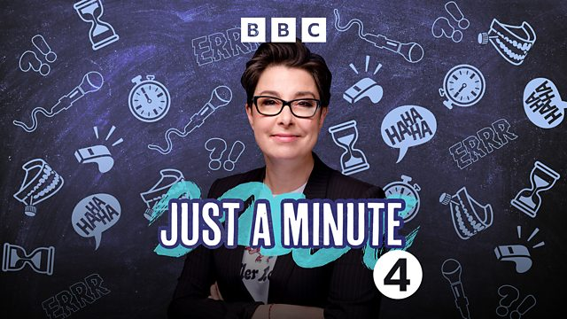
Just a Minute
https://youtu.be/CH50zuS8DD0
Picture citation
https://www.bbc.co.uk/programmes/b006s5dp

Slide 5
A Different Kind of King
New International Version
https://www.biblegateway.com/passage/?search=matthew+20%3A20-28&version=NIV
The Message Version
https://www.biblegateway.com/passage/?search=matthew+20%3A20-28&version=MSG

Slide 6
A Different Kind of King
Privilege
Power
Pain

Slide 7
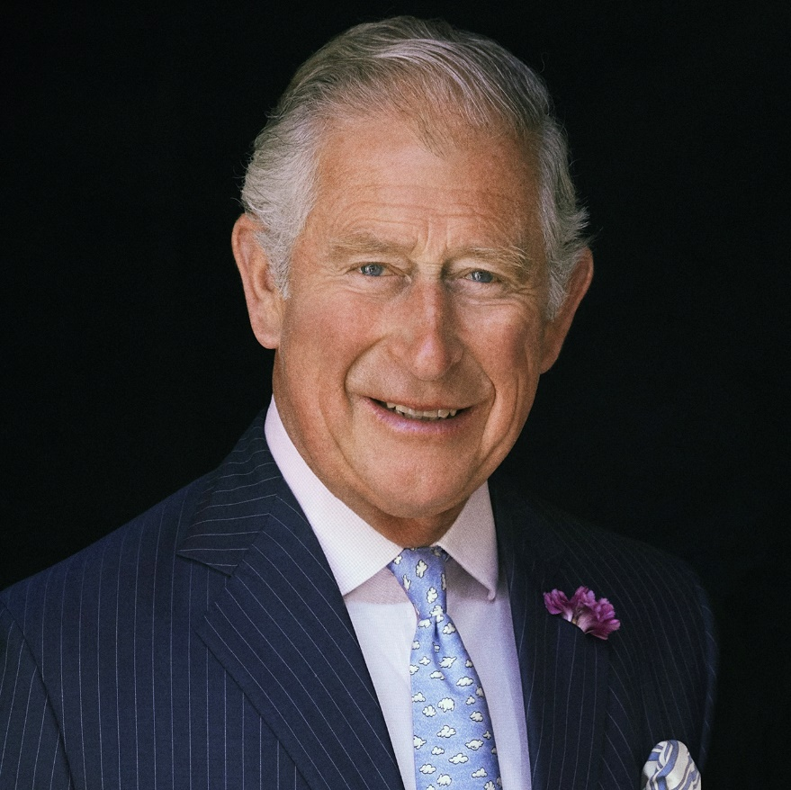
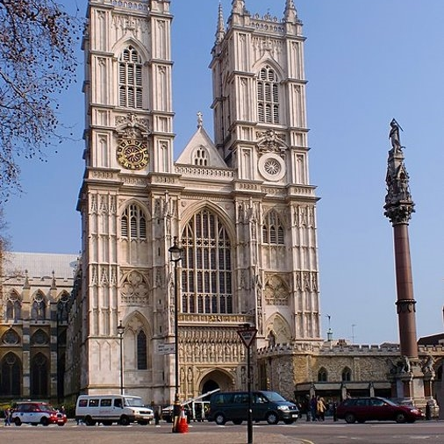
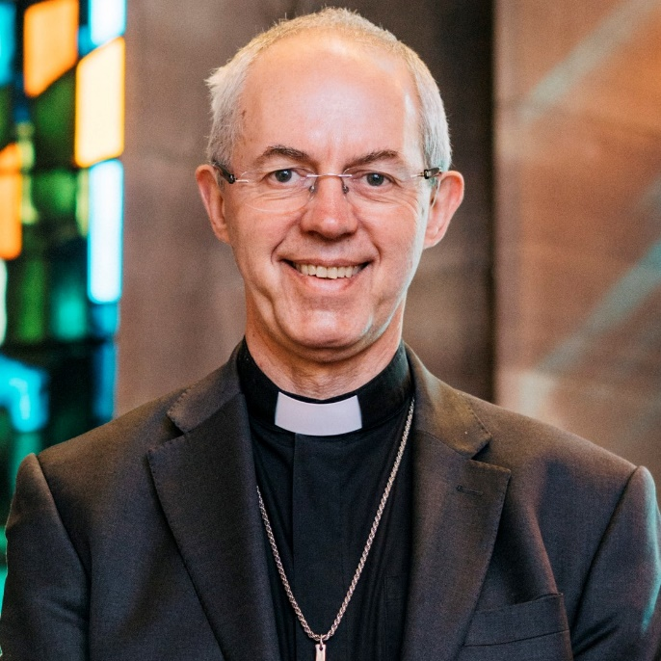
The Coronation of King Charles III

Slide 8
Head of the Commonwealth
The King is also the Head of the Commonwealth, a voluntary organisation of 54 independent and equal countries across the world. These countries work together towards common goals and values.

Slide 9
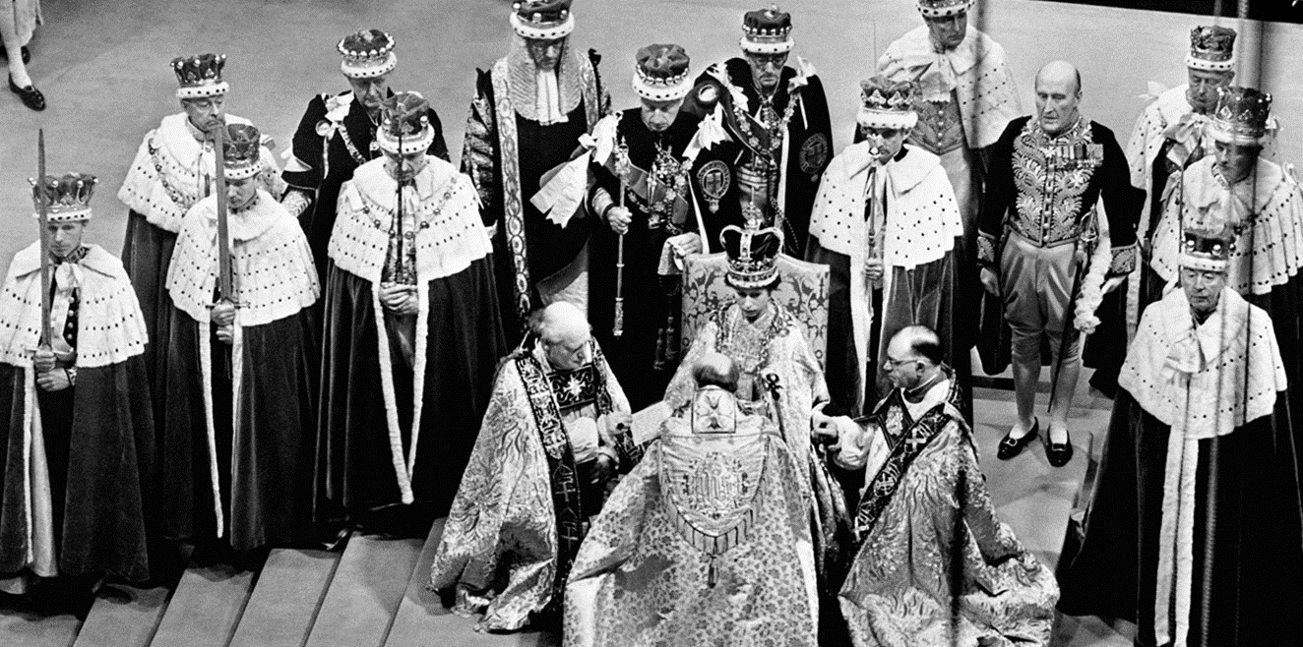
The Coronation Service
Picture citation
https://www.royal.uk/50-facts-about-queens-coronation-0

Slide 10
The Coronation Service The Recognition
Spiritual Significance
Right from the start of the service it is recognised that the King is under the authority of God. Trumpets in the Bible are used at significant festivals, to call people to gather, or to assemble for battle.
Question for me
Whose authority do I fall under? Think widely. Am I happy under their authority? Do I make their job an easy or a difficult one?

Slide 11
The Coronation Service The Oath
Spiritual Significance
The Bible details many promises made between God and man (covenants). Some of these are private, however they always have a significance for the wider community. For example, the Abrahamic Covenant where God promised to provide protection and land for Abraham and God’s people, if they followed His path. The oath here is very public and the signing of an oath to serve people is only seen at the Coronation service and nowhere else.
A Question for me
When I make a promise, do I make them seriously and with the right heart? Am I a person of integrity in my words and actions?

Slide 12
The Coronation Service The Anointing
Spiritual Significance
We see anointing with oil in the Old Testament of the Bible, when people are ‘set apart’ by God for a particular task. This is a sacramental act and an important and powerful moment that has similarities with when Christians are baptised, confirmed or ordained.
A Question for me
Considering my gifts, talents and abilities, how am I ‘set aside’ by God? What are my spheres of influence and places where only I can make a difference?

Slide 13
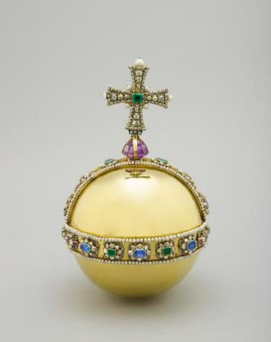
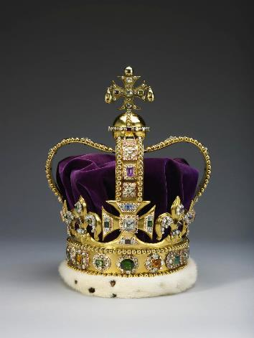
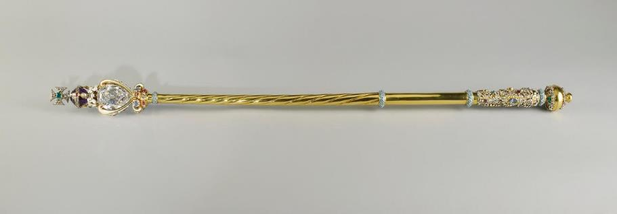
The Coronation Service The Investiture
The Sovereign’s Orb
St. Edward’s Crown
The Sovereign's Sceptre

Slide 14
The Coronation Service The Investiture
Spiritual Significance
These three items contain a cross. They signify elements of the reign of a King – his power, influence and responsibility. Yet the cross – the most important symbol in Christianity – features on them. King Charles is not on his own in his power, influence and responsibility. Ultimately the earth is God’s and God will help King Charles in his duties.
A question for me
If there was a symbol above my head, the most important thing in my life that shapes my intentions, my thoughts and my actions, what would it be?

Slide 15
The Coronation Service The Enthronement and Homage
Spiritual Significance
Kneeling is a common act in Christianity and symbolises making ourselves low, so that God can be honoured and metaphorically lifted up. It symbolises coming under authority and humility.
A question for me
Who or what do I swear allegiance to? Is this a helpful thing and if not, perhaps ask God to help you shift perspective and priorities.

Slide 16
Response
https://www.youtube.com/watch?v=JcIAZd8p5fQ

Slide 17
Response
OUR KING
Verse 1
It’s a day of celebration
For our country’s coronation
From every corner of the nation
We’ll celebrate our King!
Verse 2
It’s a day to come together
It’s a day we’ll all remember
From every corner of the nation
We’ll celebrate our King
Chorus
Together we sing, God save the King!
May he have wisdom every day
In every decision that he makes
Together we sing, God save the King!
From every street and every town
All of our voices will sing out, God save the King!
Verse 3
It’s a day of jubilation
As we mark this great occasion
From every corner of the nation
We’ll celebrate our King
Verse 4
So we’re praying for a blessing
May he grow to be a great King
As he serves us God be with him
Now and every day
Bridge
God bless the King,
Long live the King
Oh let us sing!
God bless this coronation day (repeat)
© 2023 Worship for Everyone. CCLI 7215038
Writers: Becky Drake, Nick Drake, Alex Hart.
songsforschool.com

Slide 18
Prayerful Reflection
Father God, thank You for King Charles. For his life and service to this day and going forwards from his coronation as King.
Thank You that you know him inside and out and say that he is fearfully and wonderfully made. You created him, and us, with a purpose and You are the one who gives us good gifts and talents to be nourished and built up to serve and bless others.
Help him, by your Holy Spirit, to serve wholeheartedly and with joy. Help him to make good decisions and to guide and protect those he serves.
As we have thought about his coronation and all that this signifies, help us to recognise our own gifts, calls upon our lives and our spheres of influence. Might we always be seeking the good of not only ourselves but those around us, and might we have servant hearts, like Jesus, so that we think of the others’ needs, amplify the voices of those weakest in society, and see the Kingdom of God lived out in our every day.
We pray in Jesus’ name, Amen.

Slide 19
Sending
The Oath
The Recognition
The
Investiture
The
Anointing
The enthronement
and homage

Slide 20
Practical ways to explore the themes of this collective worship

Slide 21
Design an Emblem

Slide 22
Examen Prayer
GIVE THANKS
ASK FOR HELP
REFLECT
SAY SORRY
DECIDE

Slide 23
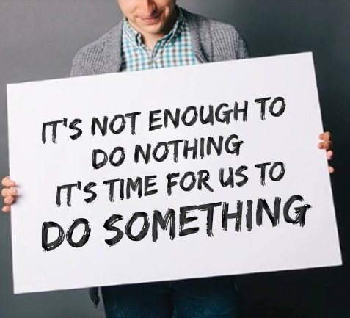
Do Something!
https://www.youtube.com/watch?v=b_RjndG0IX8

