Slide 1
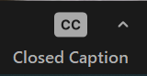
How to edit a video for your church’s social media and website
Turn on automatic subtitles by clicking on
Closed Captions in your Zoom menu

Slide 2
You’ll learn:
The simple video editing tools on Canva.com
How to choose the right video format for your platform
Gain confidence cropping and editing your video
How to add text or graphics
How to download your video ready to post online.

Slide 3
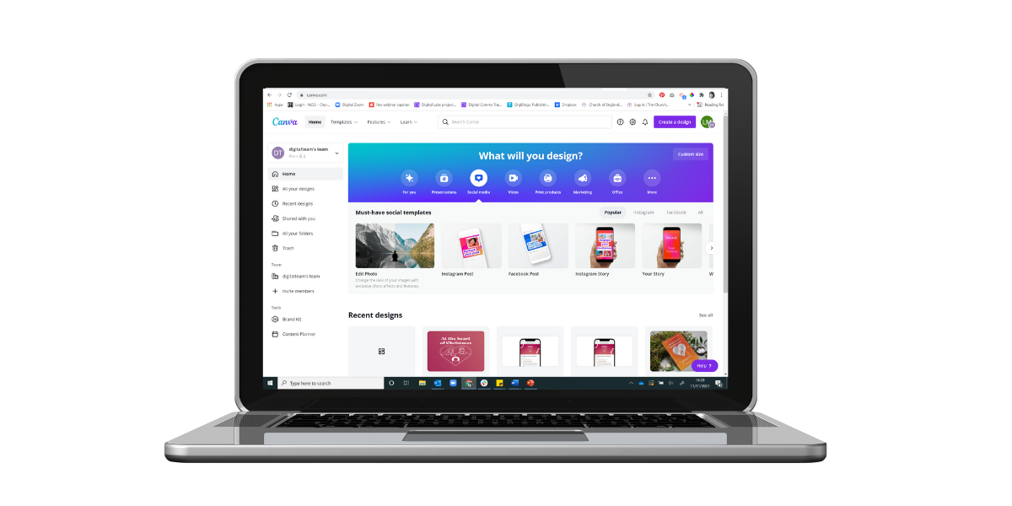
Open a free Canva.com account
Create a Canva account https://www.canva.com/signup
Canva for non-profits https://www.canva.com/canva-for-nonprofits/
Canva for church Facebook group
https://www.facebook.com/groups/CanvaForChurch

Slide 4
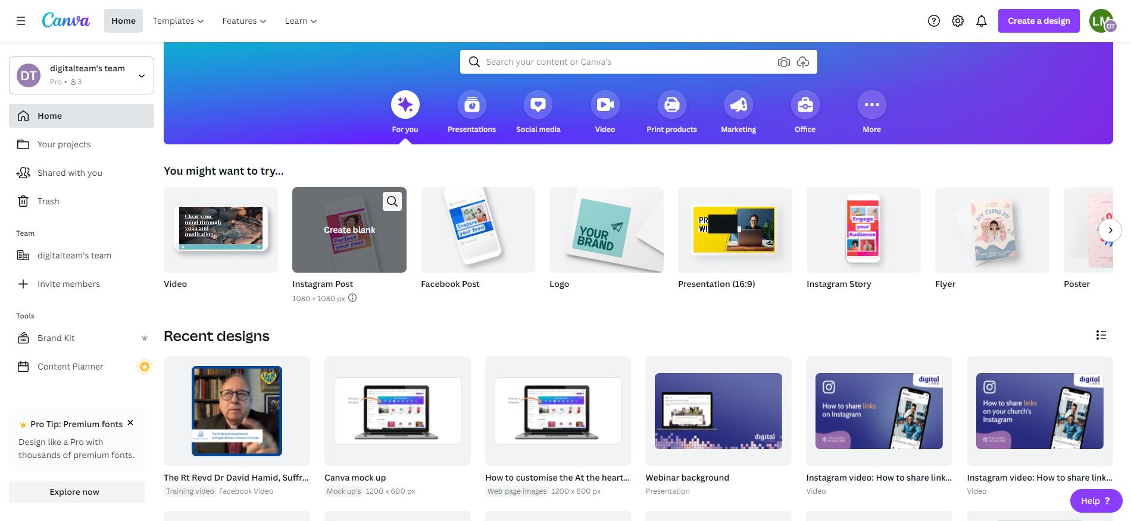
Click on video to find video templates
Find your way around Canva.com
The home screen shows your recent designs and Canva templates to create something new.
Designs are automatically saved in Your Projects and Recent designs

Slide 5
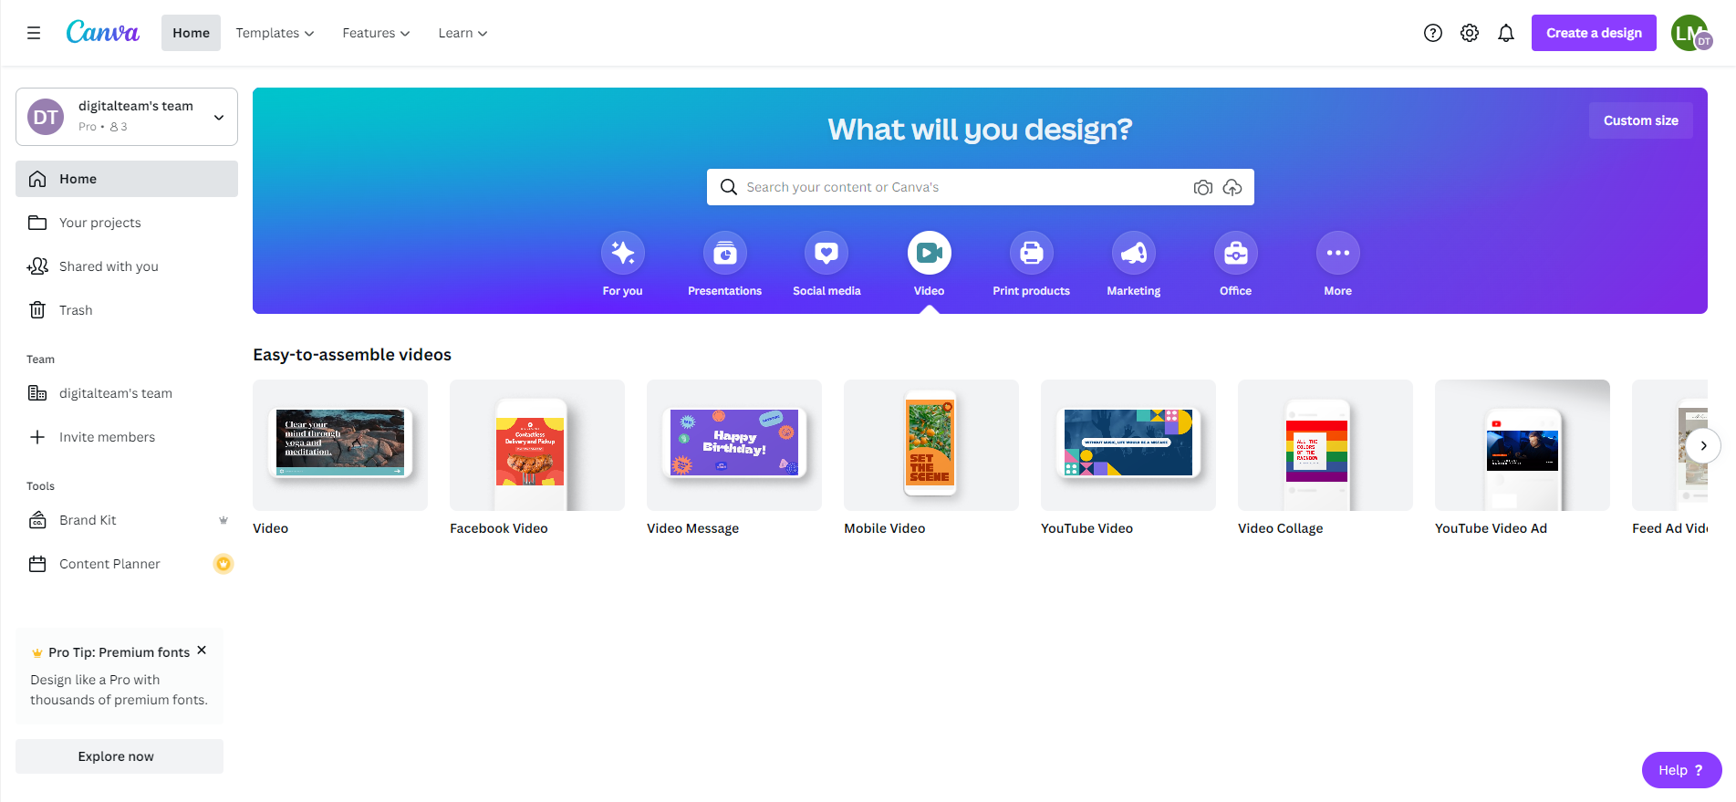
Click on video to find video templates
Choose the video template which matches where your video will be shared

Slide 15
Video tips
Viewers on social media take less than two seconds to decide to watch a video – keep introductions short to keep their interest
Find a quiet spot without background noise
Use a window for natural light
Videos less than 2 minutes long on Facebook get the most engagement
Average video length on YouTube is 8.4 minutes (for non-entertainment videos).

Slide 16
More tips
If adding text over images or video, increase readability by adding a box behind the text
Add subtitles when you upload to social media. All social media platforms have tools to add automatic subtitles.

Slide 17
Blogs Webinars Newsletter Conference
Discover the free resources for churches
Churchofengland.org/DigitalLabs

