Slide 1
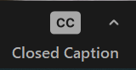
How to use Facebook Groups for your mid-week communities
Turn on automatic subtitles by clicking on
Closed Captions in your Zoom menu
Notes:
Welcome
Church of England websites and Social media channels
Our goals are to help grow people's faith, bring people to faith, and share the good work of the church
When the team was formed 2 years ago we recognised…
We'll talk about analytics, engagement, content, etc today but all with the purpose of equipping you to understand it better so you can be MORE effective at reaching your community wherever they are

Slide 2
Facebook groups
Creating a group
Choosing the right settings
Being a moderator and your tools
Keeping the group engaged
Safeguarding and dealing with negativity
Notes:
85% of internet users say they have a Facebook account
Highest engagement rates with live video
Popular across generations, although it’s important to note Millennials and above checking daily, Gen Z are checking their FB account much less than this.

Slide 3
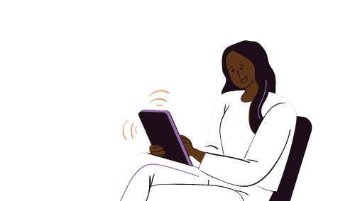
Profiles, pages and groups
Profile
Your personal presence and log-in
Friends only!
Page
A mini website for
your church
Anyone can view the page
Group
A place to share interests and community mid-week
Like a church foyer or small group
Conversations visible to those
in the group
Pages and groups have different purposes
Notes:
Profile
Personal profile is what we all have as individuals.
For our personal updates!
Page
Like a mini website for your church on Facebook
Space to write about you, add a call to action and see insights on your page
Add page administrators – help you manage the page
Only admins can post to your page
Groups
Community forum – groups are great for building smaller communities around demographics i.e. families, or topics i.e.

Slide 4
Who will you make a group for?
Book club members
Local support group
Toddler group parents
Demographic
Eco church
Bible study group
Families
Groups work best when there is a focus
Notes:
Profile
Personal profile is what we all have as individuals.
For our personal updates!
Page
Like a mini website for your church on Facebook
Space to write about you, add a call to action and see insights on your page
Add page administrators – help you manage the page
Only admins can post to your page
Groups
Community forum – groups are great for building smaller communities around demographics i.e. families, or topics i.e.

Slide 5
How to set up your group
Enter the group name and choose the privacy settings
Click Create
Create a group linked to your church’s Facebook page:
Log in to your church’s Facebook page
Select Groups from the left hand menu
Click on Create New Group
Notes:
What do you want your first impression to be?
There are two things that influence the first impression
Words
Images
When someone finds your page one of the first things they’ll see are these two images - are they communicating what you would like them to?

Slide 6
Choosing the right settings
Go to your group then click on Group settings in left hand menu
Change the name of your group
Add a description and define who the group is for
Location – show that you are local
Customise your group’s web address
Set how people can join the group and who can approve requests
Decide who can post to the group
Notes:
LiveSlide https://www.facebook.com/pg/HullMinster/about/?ref=page_internal

Slide 7
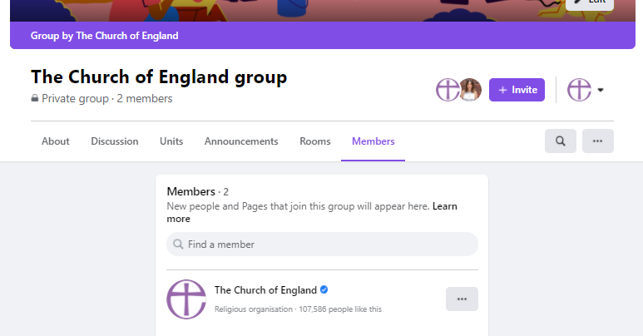
Add other admins or moderators
Moderators do not have to be admins of the linked Facebook Page
Add moderators by:
Go to Members tab
Click on three dots beside the members name
Select Invite as admin or Moderator
Admins = Edit the settings of the group,
moderate posts and members
Moderator = Moderate posts and members

Slide 8
Guides can help plan bible studies and courses
1. Enable Guides in Add features, scrolling down to Other features, and clicking Add beside guides
2. Go to Guides in the top menu to create and view
Useful for organising a bible study, course or kids weekly activities

Slide 9
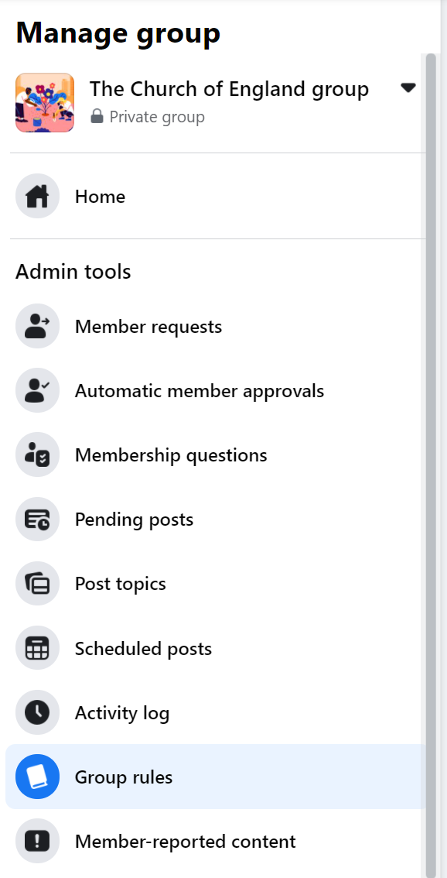
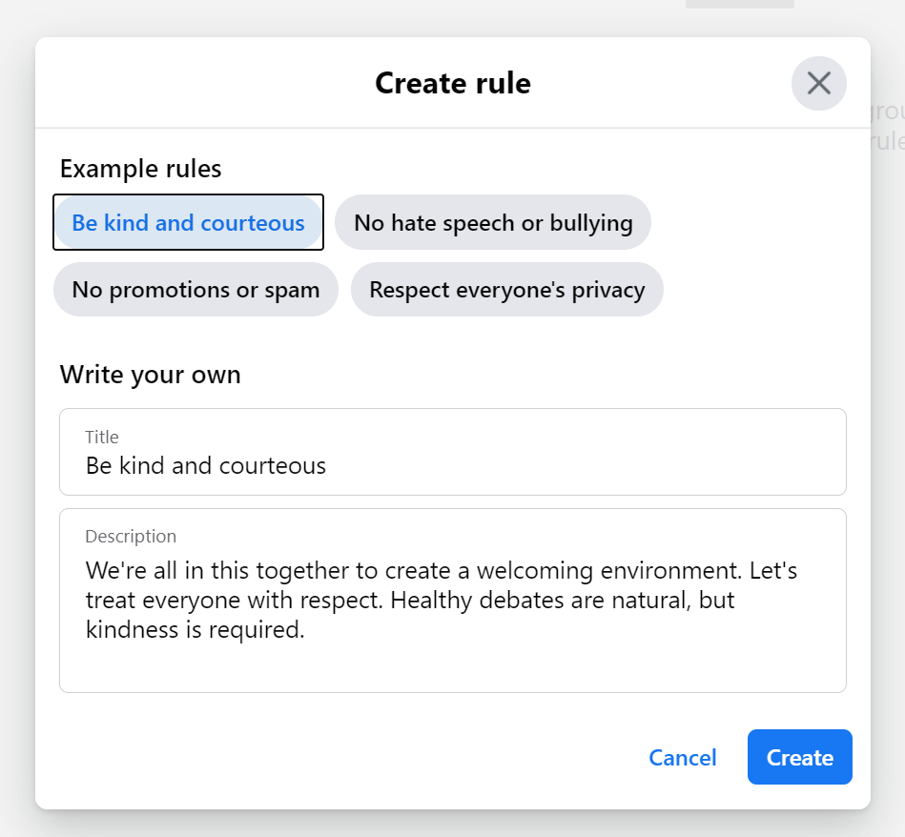
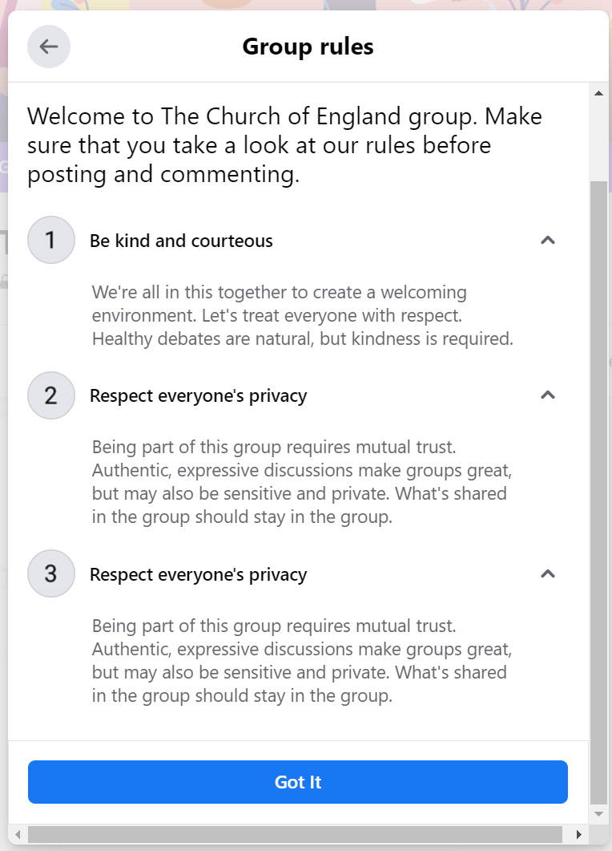
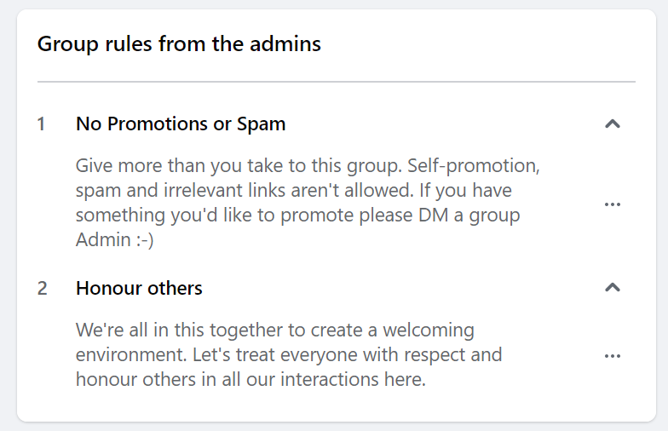
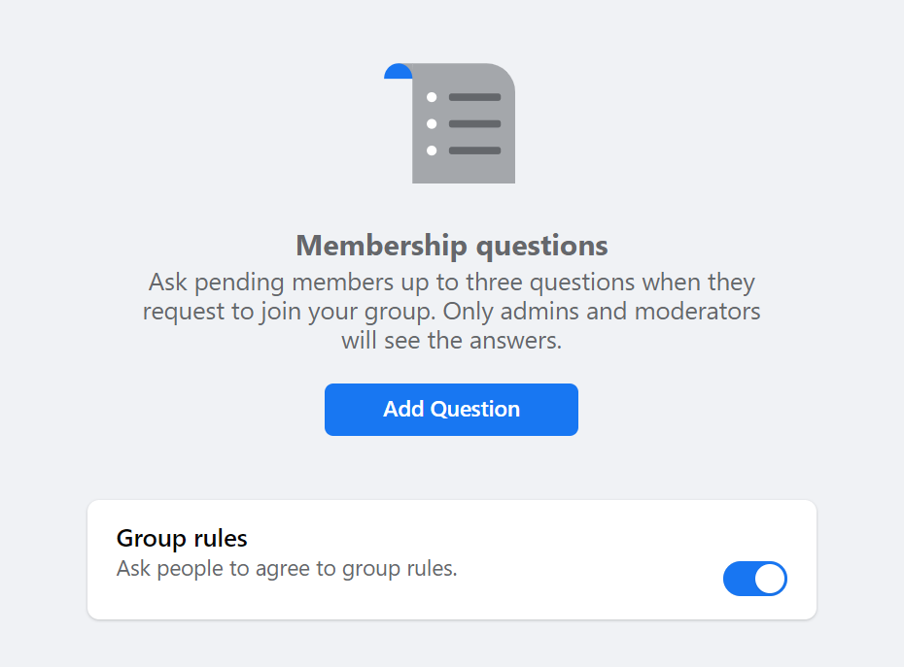
Dealing with negativity: moderator tools
Have at least two moderators
Define the group's purpose to keep on topic
Create rules
Ask membership questions

Slide 10
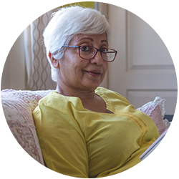
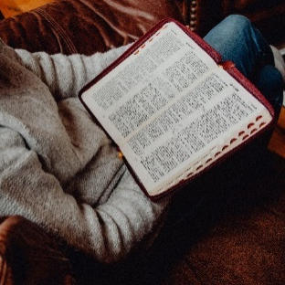
Keeping your group engaged
Be clear on the purpose from the beginning
Keep on topic so your group continues to add value to the members
Be social and lead the way with your interactions
Ask questions (and answer questions)
Try a variety of post types
Post regularly, especially at the start
Ask others to help you post and keep the group active
Don’t create too many groups and spread yourself thinly
Notes:
Profile
Personal profile is what we all have as individuals.
For our personal updates!
Page
Like a mini website for your church on Facebook
Space to write about you, add a call to action and see insights on your page
Add page administrators – help you manage the page
Only admins can post to your page
Groups
Community forum – groups are great for building smaller communities around demographics i.e. families, or topics i.e.

Slide 11
Dealing with negativity: moderator tools
Click on the three dots above a post
Turn off commenting on a post
Remove post
Mute author (temporarily turns off their ability to post or comment)
Delete post and remove author
Notes:
Hide: Currently you can hide comments on Facebook. Twitter will be trialling ‘Hide replies’ so you can remove negative or irrelevant replies
Report: On all platforms – when comments are offensive. Slide left on the comment on Instagram. Or click on the … next to the comment.
Ban: On all platforms. When someone is being persistently trolling.
FB - Settings > people and other pages > search for person and then click on the cog.
Twitter – click on their profile > … > Block
Instagram – profile > … >Block

Slide 12
Safeguarding: What is our responsibility?
A disclosure can be made to you in any way!
Work within your church’s safeguarding policy so you know what to do.
Know how to contact your Diocesan Safeguarding Officer.
Avoid messaging under 18s privately.
Do not befriend under 18’s on your personal profiles.
Have two or three admins / moderators on all your church accounts or groups.
Include safeguarding information on your home page of your website.

Slide 13
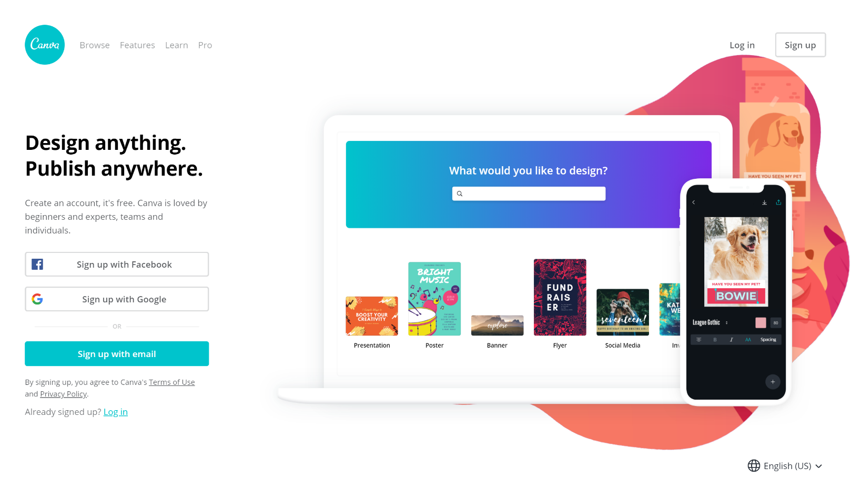
Useful tools – Photography and design
www.canva.com
www.spark.adobe.com
www.unsplash.com
www.pixabay.com
www.pexels.com
www.freepik.com
achurchnearyou.com/hub

Slide 15
This year’s Christmas theme - Follow the Star: Join the Song - highlights how singing can help us draw closer to God and each other through the journey from Advent to Epiphany.
Join the Song includes an invitation to all choirs and singing groups to sing a new version of ‘The First Nowell’.

Slide 16
RESOURCES:
Free resources to help choirs of all ages and stages learn and perform the carol
Daily Advent and Christmas reflections
Our first printed Follow the Star Advent Calendar for families - with stickers!
Join the Song campaign logo pack
Brand and design guidelines
Music, social media graphics, PowerPoint assets, posters and other free tools and resources from A Church Near You
Digital promo planner, blogs and bitesize videos to support churches in using the digital resources available

Slide 17
WEBINARS:
Explore Join the Song resources to support your church: Tues 19 September, 11am
Using Join the Song with under 18s: Weds 27 September, 10am
Digital Labs interactive session: Christmas 2023's digital resources unwrapped: Weds 11 Oct, 3pm

Slide 18
Sneak peek of the carol!
Resources for Churches overview
AChurchNearYou.com Resource Hub -
Follow the Star: Join the Song resources

Slide 19
Blogs Webinars Newsletter Conference
Discover the free resources for churches
Churchofengland.org/DigitalLabs

