Slide 1



Slide 2







What we offer
Webinars
Monthly newsletter
Weekly blog
On-demand training
Training for Dioceses
Training for ordinands
Notes:
3

Slide 3
The story
“The shepherds went back,
singing praises to God
for all they had heard and seen;
it had been just as the angel had told them.”
Luke 2.20 (GNB)
Notes:
3

Slide 4
Key campaign elements
  An invitation to all to sing a new version of The First Nowell
  Special commission from world-renowned composer Bob Chilcott
  Free resources – sheet music, learning and backing tracks
  Supporting resources for schools including collective worship sessions
  Daily Advent reflections which work with our very first …
  Printed Follow The Star Advent Calendar – with stickers!
  Daily Christmas reflections by Richard Carter from 24 Dec to 5 Jan
  Plus ACNY tools, resources, Digital Labs webinars and more

Slide 5
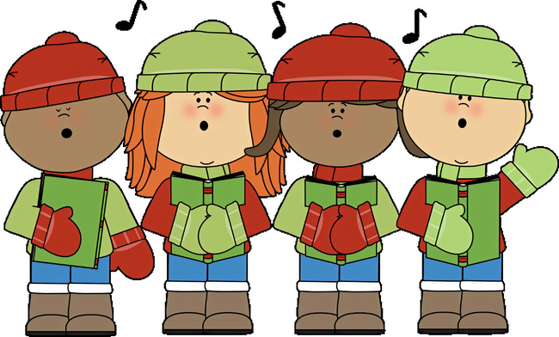
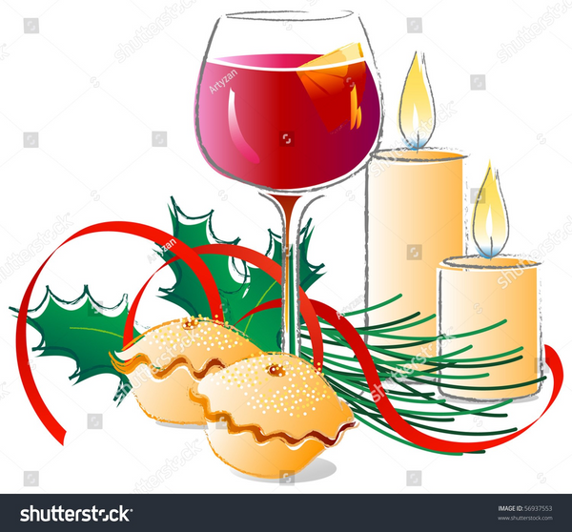
Ideas for your churches this Christmas
  Key season of invitation
    Encourage your congregation to invite friends and family to the various services happening - ensure that services are accessible, with familiar carols/hymns and a suitable length!
    Parish Magazine- poll of ‘my favourite carol’ or tell people about the 'prayer angel' that they can hang on the tree (at any time) and use social media as a form of invitation
    Carol Services - offer hospitality: mince pies and mulled wine work well!
    Use the new song in Christmas services - you could also sing carols around the Christmas tree or sing in the local pub, care home or other community spaces – and then invite people along

Slide 6
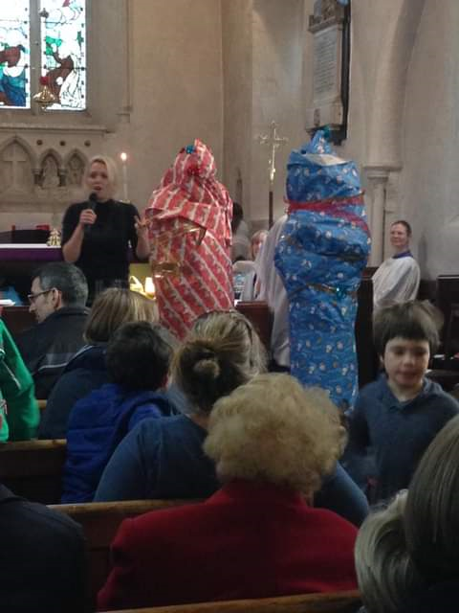
Children, Families and Young people
    Use the new 'Join the Song' resources: the Advent calendar is brilliant and you might want to think about doing a nativity trail in your town/village
    Make sure your services are accessible, joyful and not too long
    Engage local groups - Guides, Messy Church, toddler groups, school choirs in what you are doing
    Christingle services, Puppet nativity, scratch nativity
    Nostalgia can play a big part at Christmas -can you help create a new tradition in your church?

Slide 7
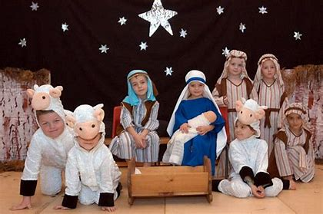
Children, Families and Young people
    Get your Toddler Group to perform the nativity in church on a Sunday before Christmas.
    You are never too old for a Christingle service!
    Social action - Encourage your young people to help in at a foodbank, visit a care home or get involved in a shoe box appeal
    And what can you invite them to next?

Slide 8
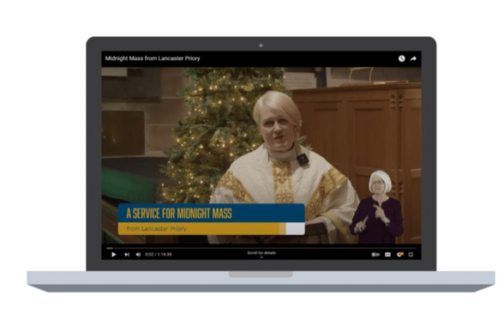
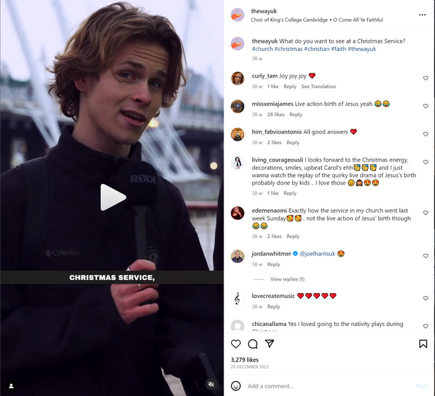
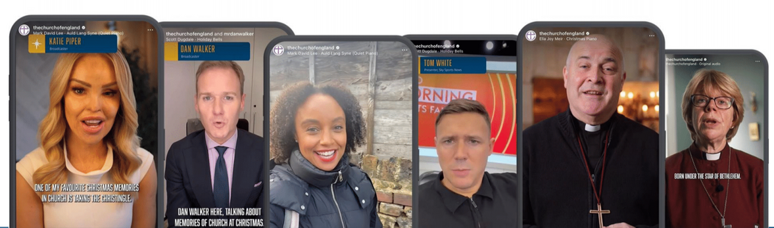
Our social media channels
  Explainer content to help those new to church or exploring faith
  Content for families
  Adverts to encourage people to find local Advent and Christmas services and events to attend via AChurchNearYou.com
  Video content from dioceses across the Church of England exploring the themes of our daily reflections
  Carol-based content encouraging people to #JoinTheSong
  National online services across Advent and Christmas from churches across the Church of England with subtitles and BSL interpretation - last year these received more than 2.37 million views.
Encourage the young people in your community to check out content on The Way UK’s Instagram, YouTube and TikTok channels ​
Notes:
16

Slide 9
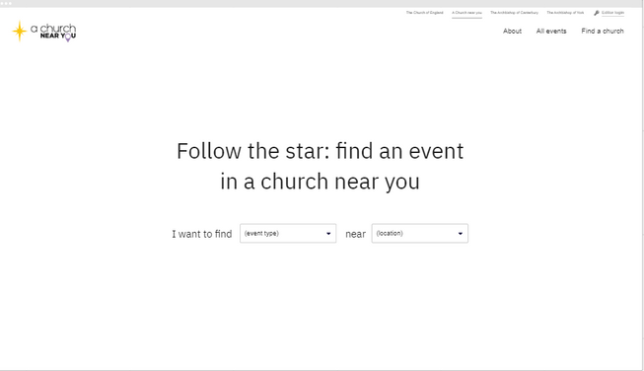
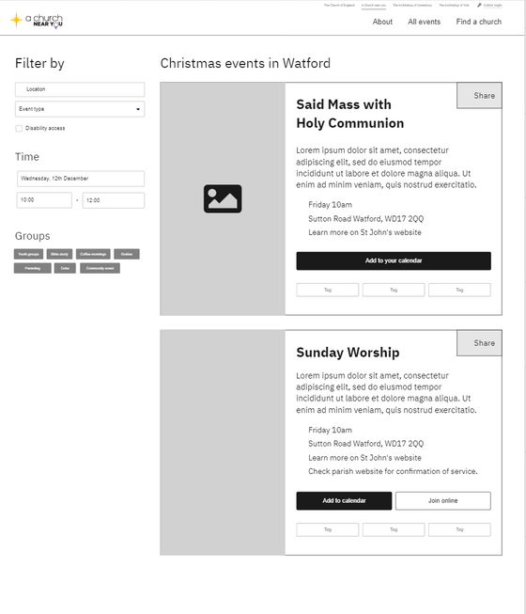
AChurchNearYou.com
  Throughout Advent and Christmas 2022, traffic to our Christmas landing page was up 40% on the previous year.
  All our public-facing advertising will drive people to find your services and events.
  National campaign activities will bring people to a dedicated Christmas landing page on ACNY. We're making it quicker for the public to find a local church service to attend with fewer clicks.
  We'll be encouraging people to 'add to calendar' and 'share' links to the services and events.
  List your Advent and Christmas services and events with an Advent or Christmas tag and add The First Nowell tag if you are singing the carol.
Notes:
17

Slide 10
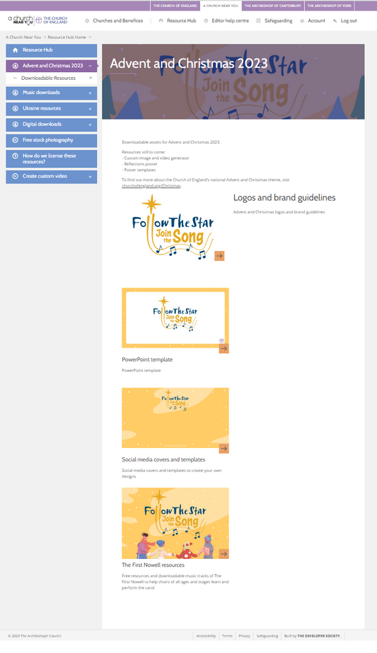
AChurchNearYou.com
Available on the Resource Hub now:
    Logos and a brand pack for your design work
    Posters
    Social media templates
    Customisable assets
    Tracks to help your choir or congregation learn the carol
    PowerPoint template
    For help with your church or benefice’s AChurchNearYou.com pages, visit cofe.io/EditorHelpACNY
Notes:
18

Slide 11

Live Demo
  Digital Promo Planner
  How to download the resources and upload into Canva ready for you to edit
  How to add the branding into your Canva brand hub

Slide 12
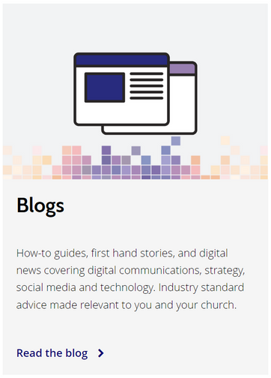
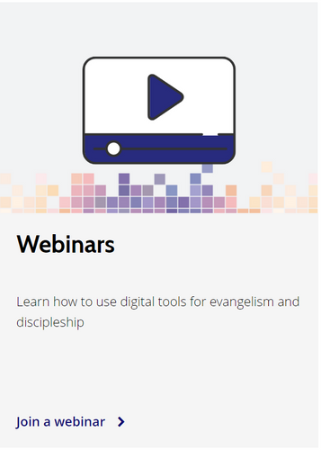
Digital Labs resources for
Advent and Christmas
  Digital Content Planner to help you think about the kind of social media posts your church could share in the run-up to Advent and Christmas – find suggestions for posts, timing that could work, how to encourage user-generated content and what to do with it – and more
  Blogs to give step-by-step advice for using this year’s free resources – practical advice on using the assets for your church and customising them to work in your local community
  Bitesize videos to help you run your digital platforms to reach more people in your community this Christmas

Slide 13
Five things to consider this Christmas
  What would you consider as your ultimate goal this Christmas? E.g. ‘We want to see at least 20 young people at our services & events.’
  Pick one key audience you want to reach
  Pick two or three platforms you want to reach them on
  Keep it simple and focus only on your chosen platforms
  Make a plan of when you will create content and who you will commission to help you

Slide 14
In your groups:
Make a list of the new groups of people you want to reach
this Christmas

Slide 15
Over to you!
Ask us your questions
Feel free to ask your questions in the chat or raise your hand.

Slide 16
Reminder:
Daily content from 1 December
  Daily Advent themes, Bible readings, prayers and challenges for all ages
  Written by Clare Williams, Head of Schools at Norwich Cathedral
  Online Advent Calendar for families cofe.io/AdventCalendar
  Daily video-based social posts from around the dioceses
  Daily campaign app/smart speaker content from 1 December
  Daily email reflections from 24 December
  Plus new bedtime audio content for children and families

Slide 17
cofe.io/Christmas

