Slide 1
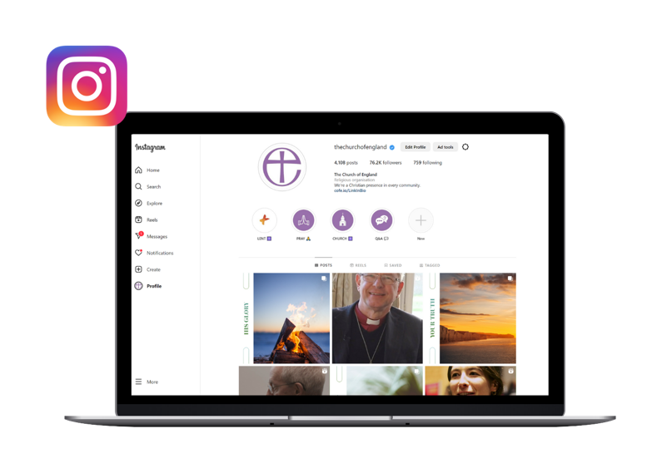
How to use Instagram for your church
Notes:
Introduction
Captions
Recording
Going to give lots of tips and show you how to use your Instagram profile
Q&A box

Slide 2
This year’s Christmas theme - Follow the Star: Join the Song - highlights how singing can help us draw closer to God and each other through the journey from Advent to Epiphany.
Join the Song includes an invitation to all choirs and singing groups to sing a new version of ‘The First Nowell’.

Slide 3
RESOURCES:
Free resources to help choirs of all ages and stages learn and perform the carol
Daily Advent and Christmas reflections
Our first printed Follow the Star Advent Calendar for families - with stickers!
Join the Song campaign logo pack
Brand and design guidelines
Music, social media graphics, PowerPoint assets, posters and other free tools and resources from A Church Near You
Digital promo planner, blogs and bitesize videos to support churches in using the digital resources available

Slide 4
What you’ll learn
What is Instagram?
How to create an account for your church
How to customise your profile
How to post photos, videos and stories
Simple post and story ideas
Quick guide to hashtags
Notes:
Key learnings
You’re likely here today because you run the Instagram profile for your church, or you’re thinking about setting one up! We’re going to be talking about:
What is Instagram?
How to create an account for your church
How to customise your profile
How to post photos, videos and stories
And if we have time, we’ll cover…
Simple post and story ideas
Quick guide to hashtags
If we run out of time, all that information will be sent to you in the slides after the webinar.

Slide 5
Why Instagram for your church?
2 billion active monthly users
18 – 34 year olds make up 60% of worldwide users
Can make your community more relatable
Hashtags can help you reach new people
Statista | Sprout Social 2022
Notes:
Why Instagram for your Church?
Well, it is one of the largest social media platforms in the world, with over 2 billion active monthly users.
Most of those users, 60% are 18-34, so you’re reaching a different age group compared to places like Facebook.
It helps make your community more relatable through things like stories
Using hashtags can help you reach new people
Acknowledge lack of time for clergy and encourage them to think about their audience before committing time to any social media platform

Slide 6
What is it?
Instagram is a photo and video sharing app owned by Meta.
It’s free, and anyone over 13yrs can create an account.
Share photos and video, or interact with other profiles, by using the app or in your browser.
You can follow accounts and others can follow you.
Your newsfeed will show content from accounts you follow, and suggestions of who to follow.
Notes:
What is Instagram?
It’s a free photo and video sharing app owned by Meta, who also own Facebook
It’s available to anyone over the age of 13, so we’re finding a lot of teens on there
You use it to share photos and videos, or interact with other profiles, using either the app (the easier way to use it) or in your browser
You can follow other accounts, and people can follow you
Your newsfeed shows you content from accounts you follow, and can give you suggestions for accounts you might like to start following
Poll after this slide – does your church already have an Instagram profile?

Slide 7
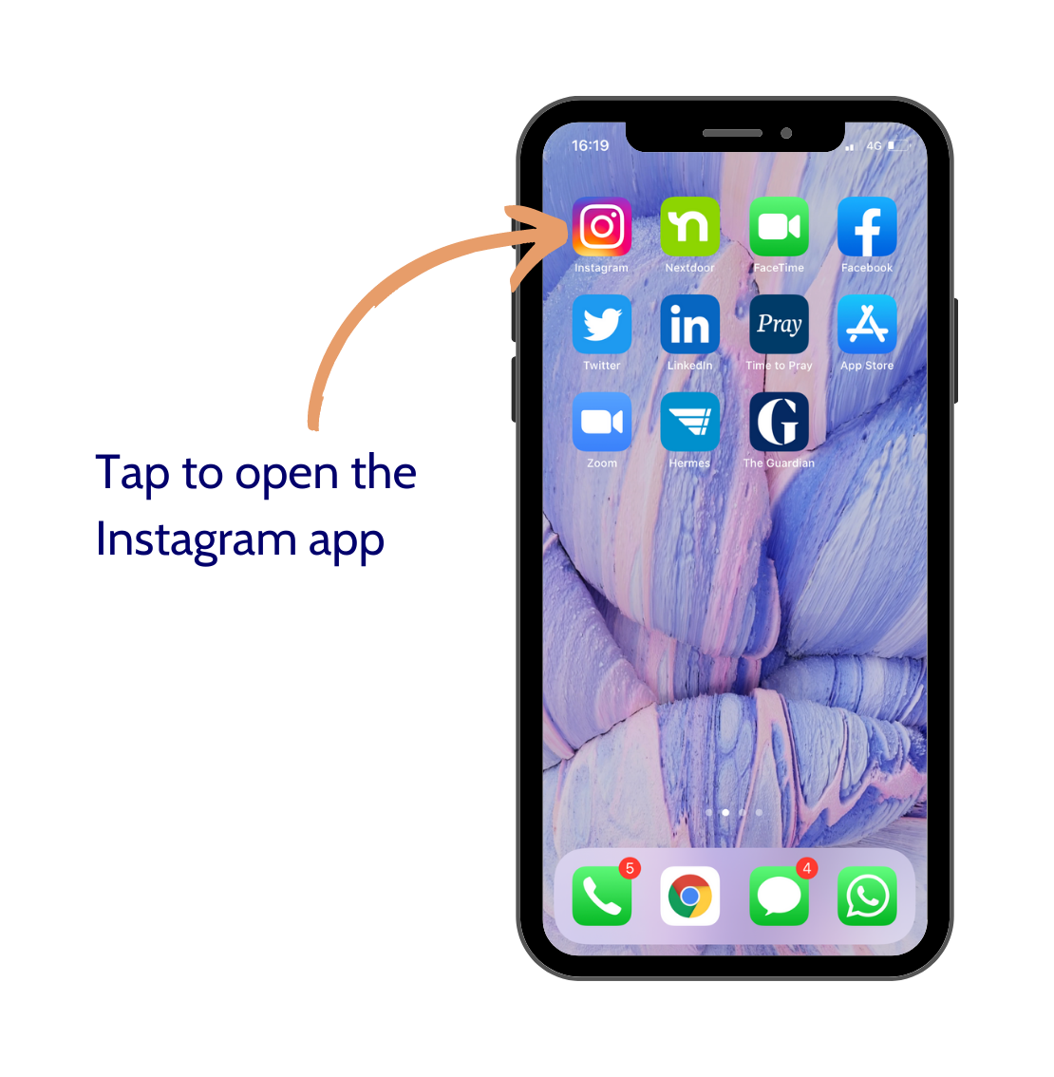
How to create an account for your church
Notes:
Slides for this section (judge whether you need to talk this through based on results of the poll)

Slide 8
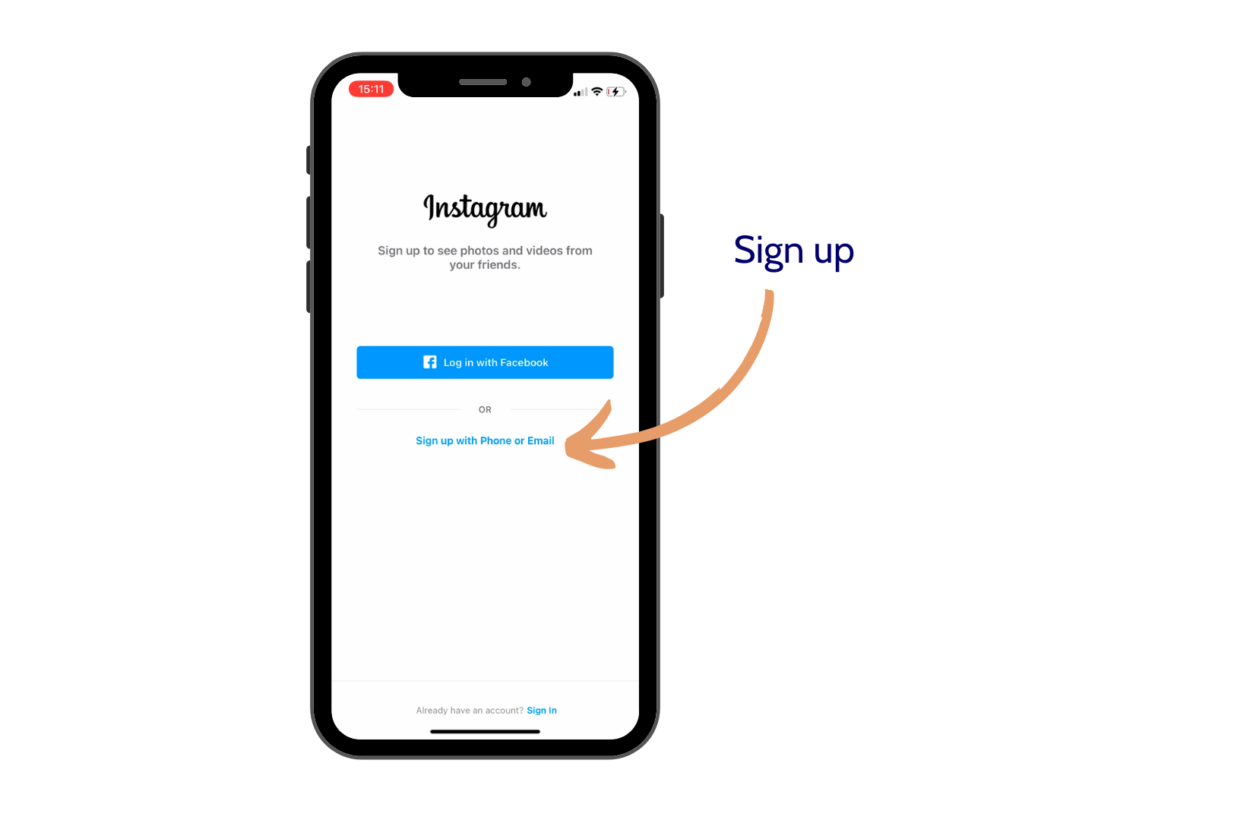

Slide 9
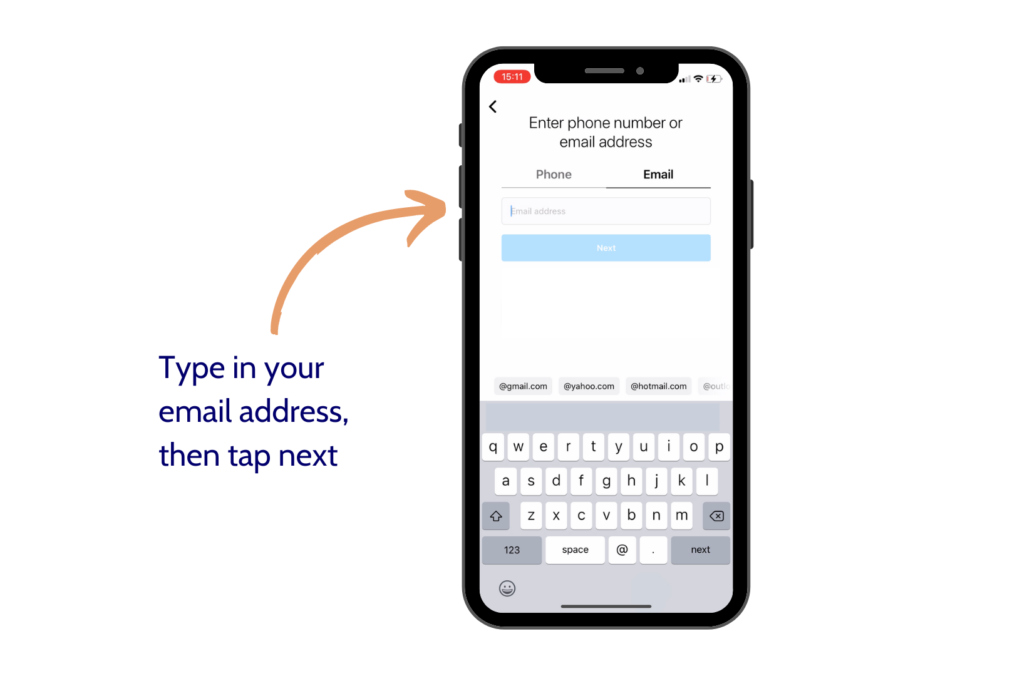

Slide 10
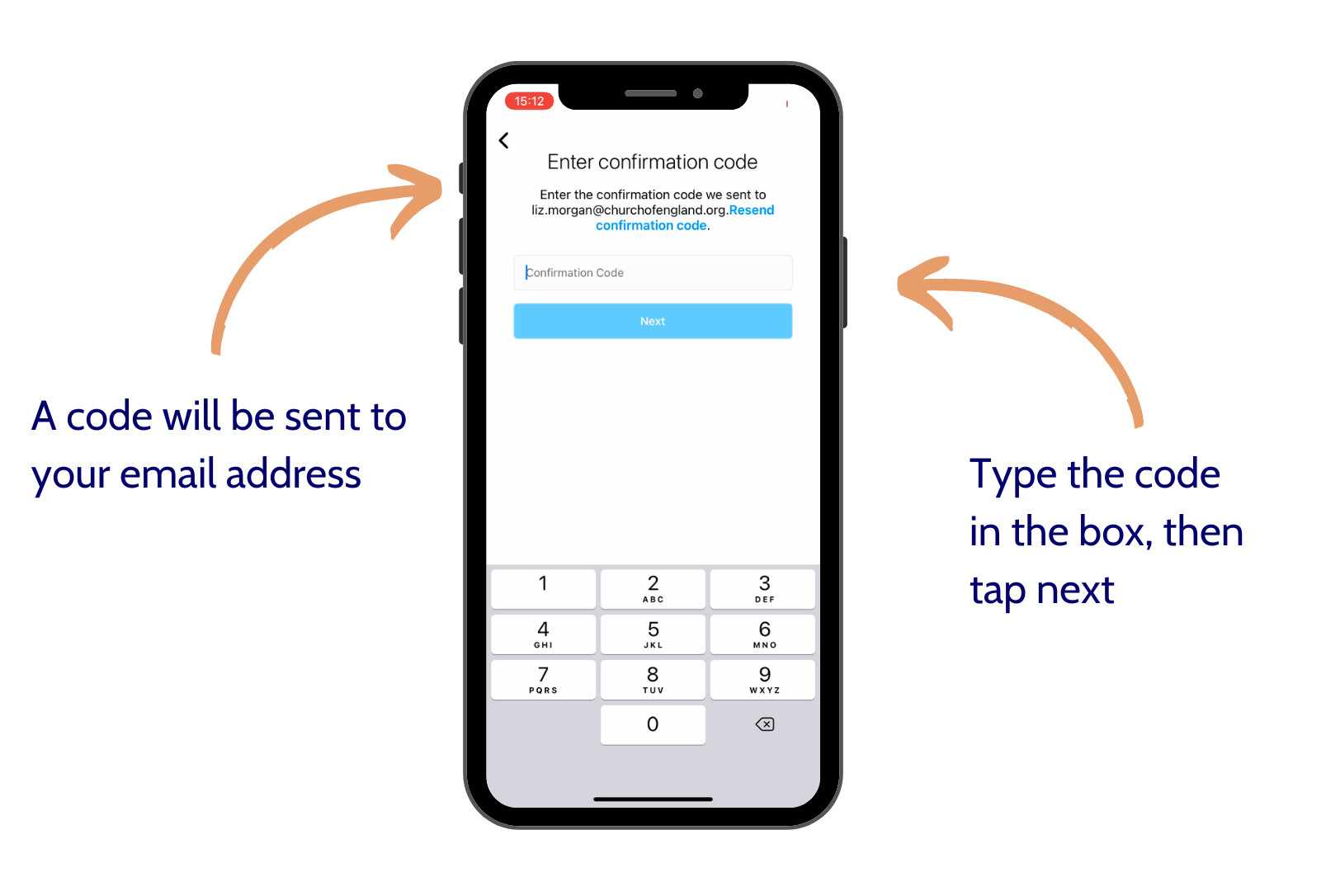

Slide 11
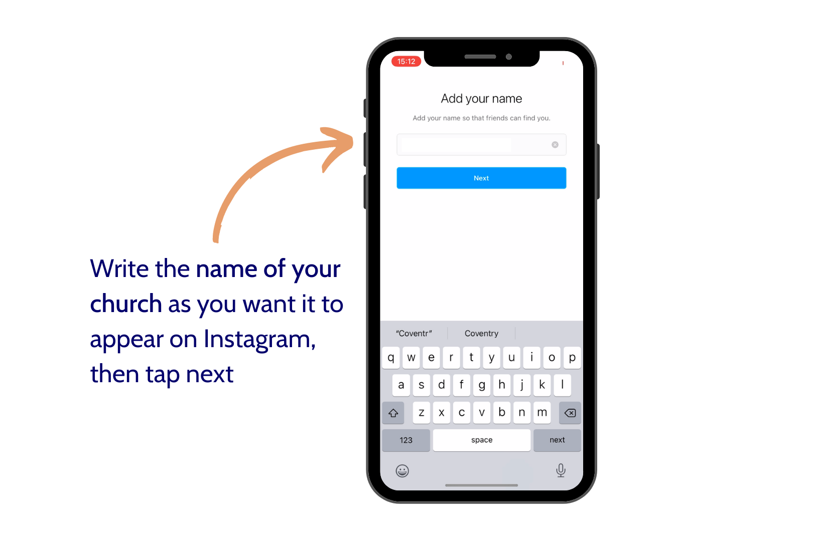

Slide 12
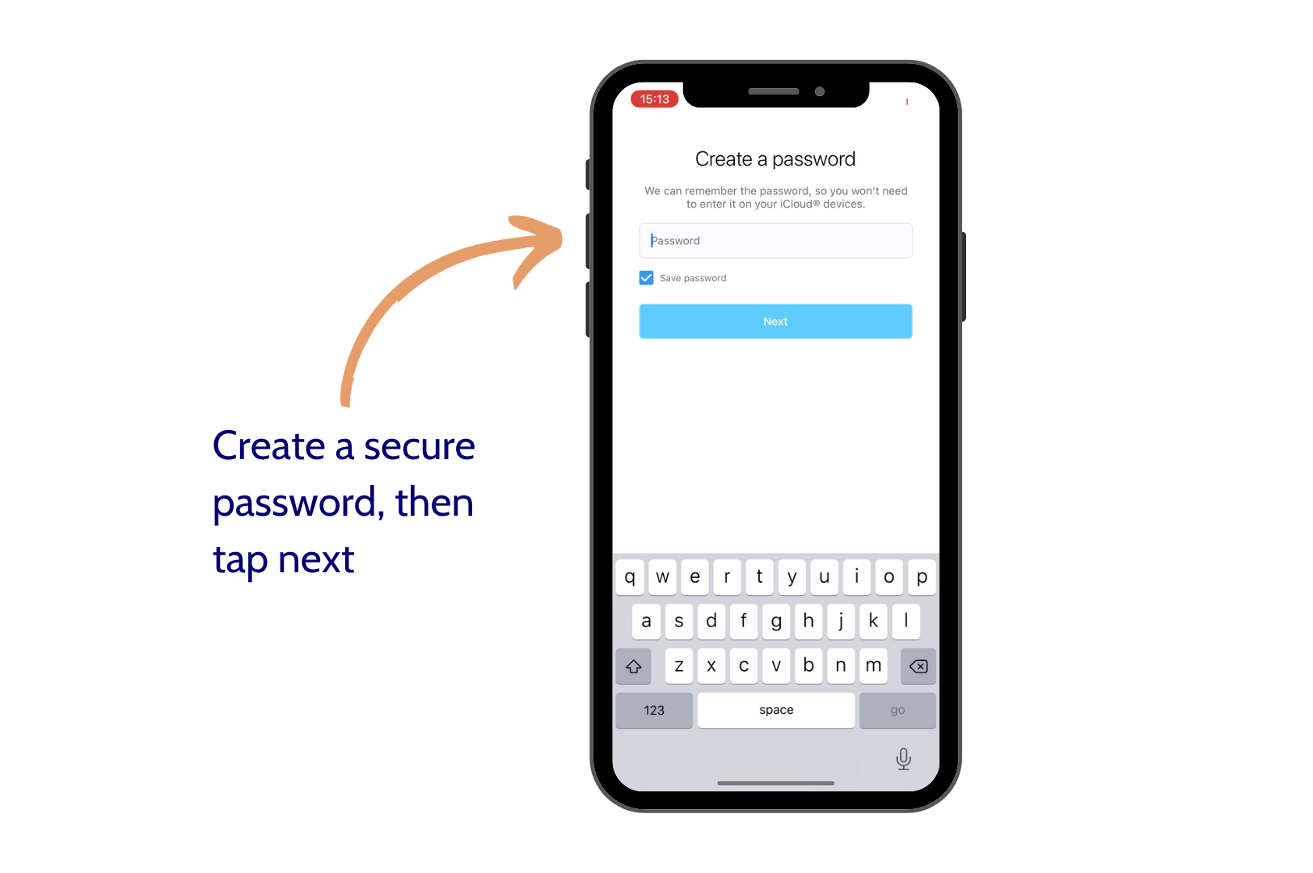

Slide 13
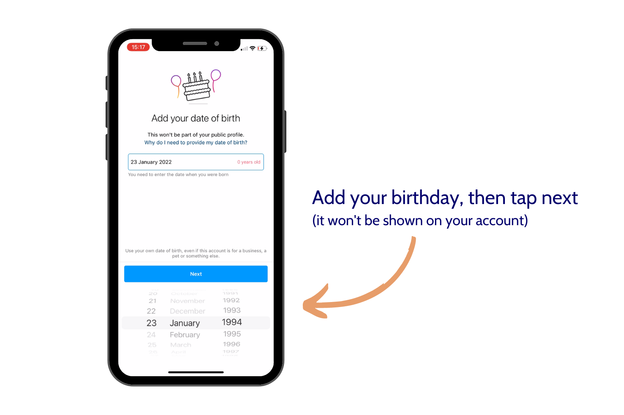

Slide 14
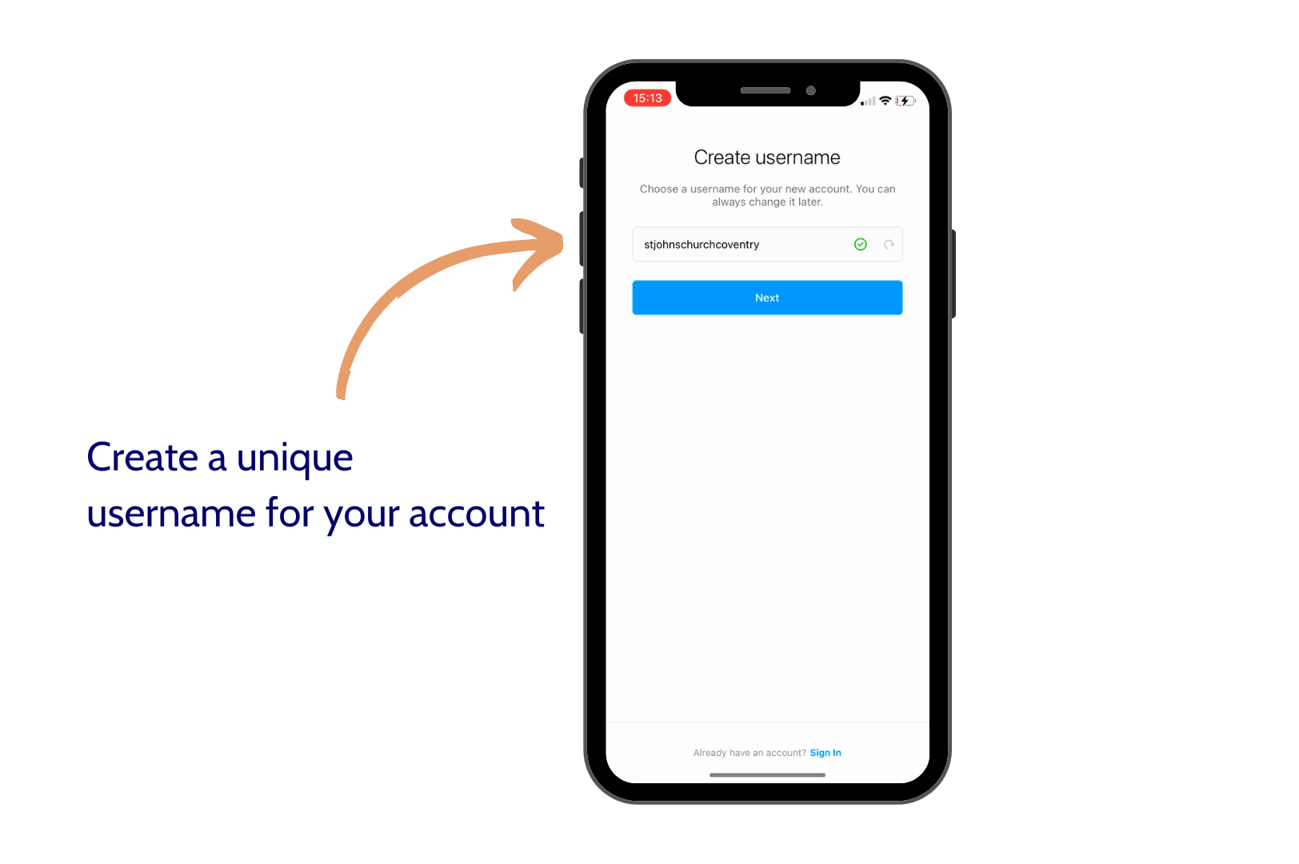

Slide 15
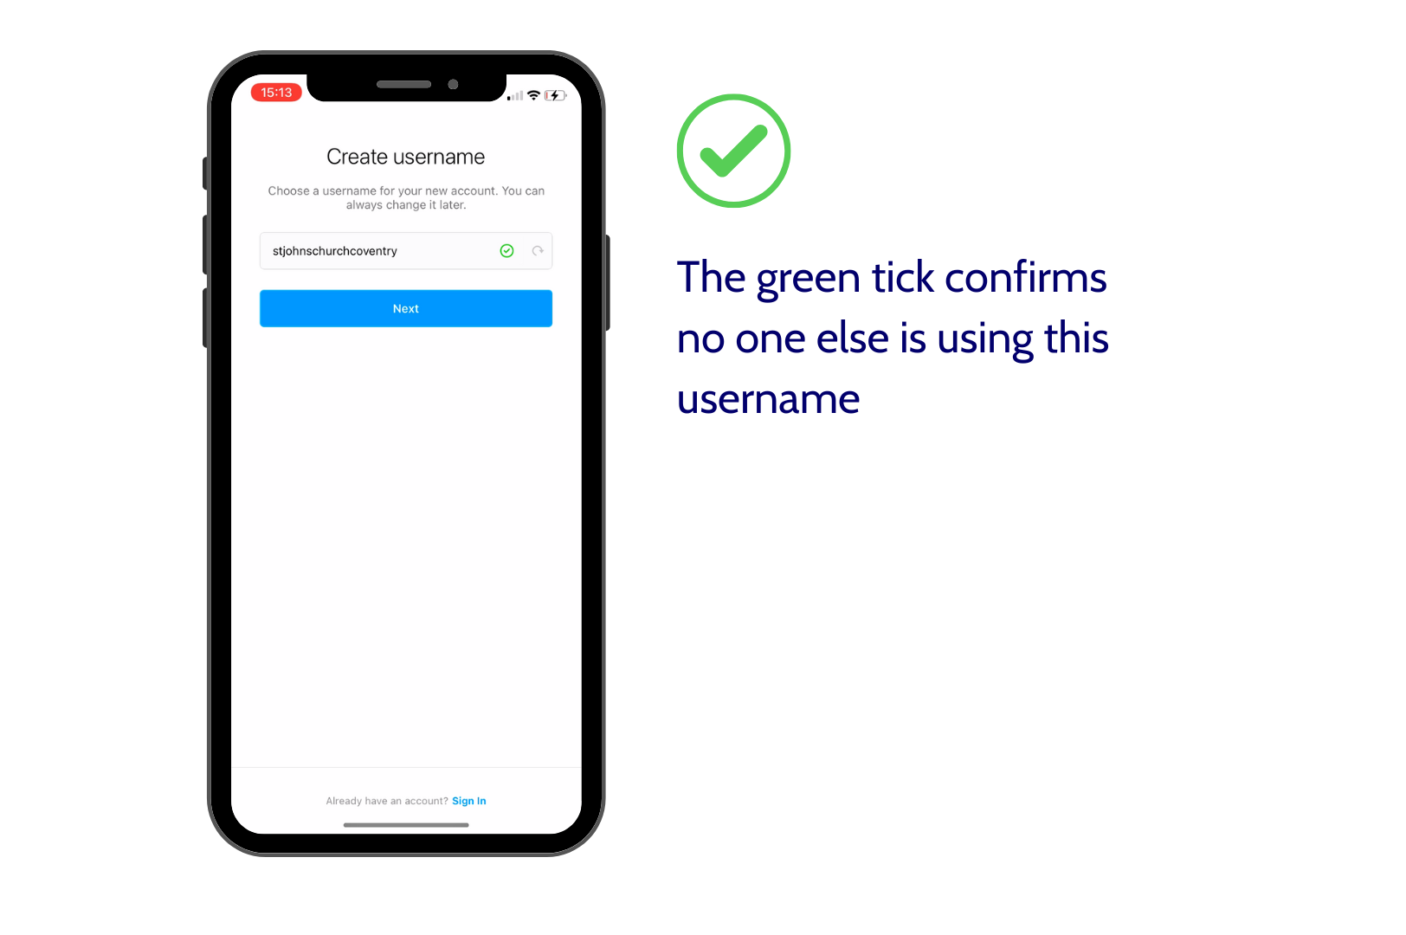

Slide 16
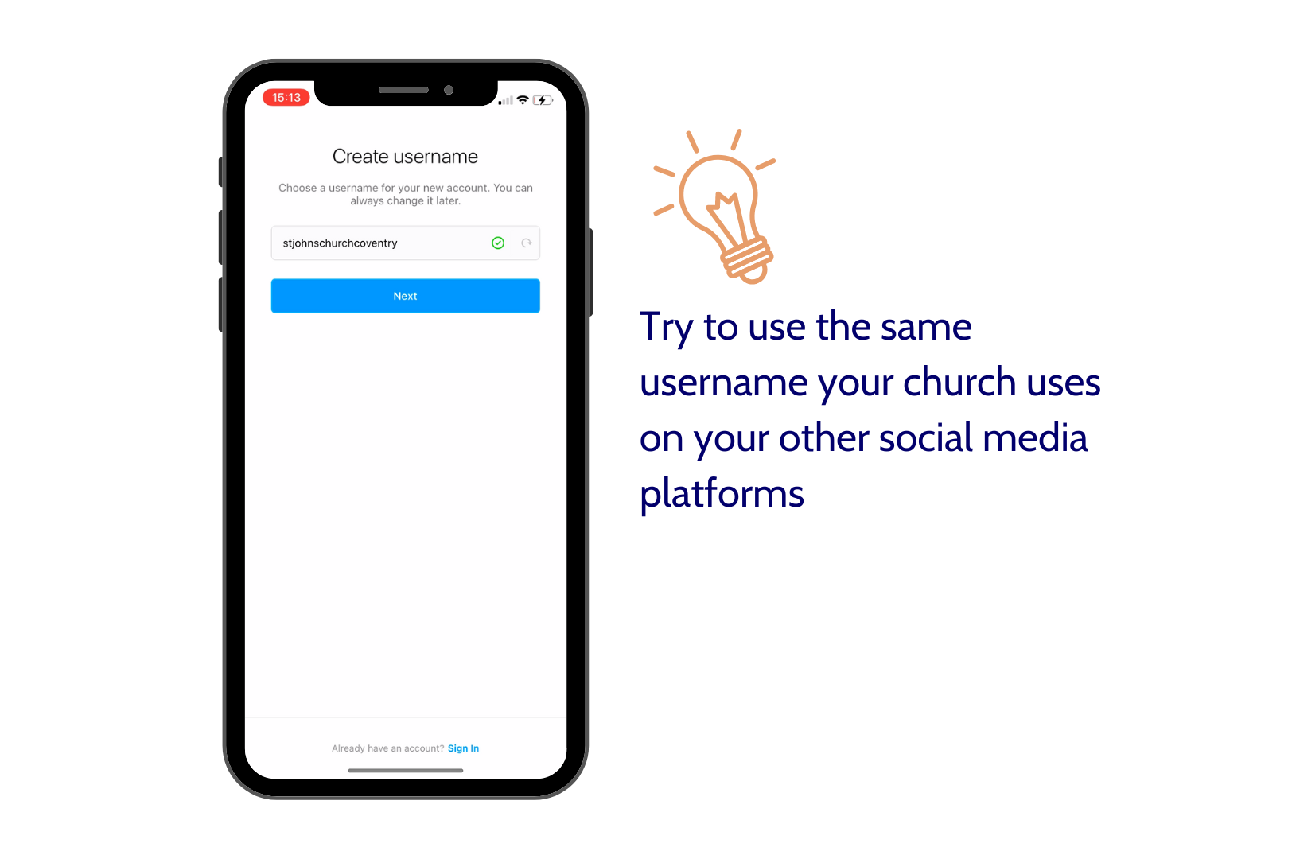

Slide 17
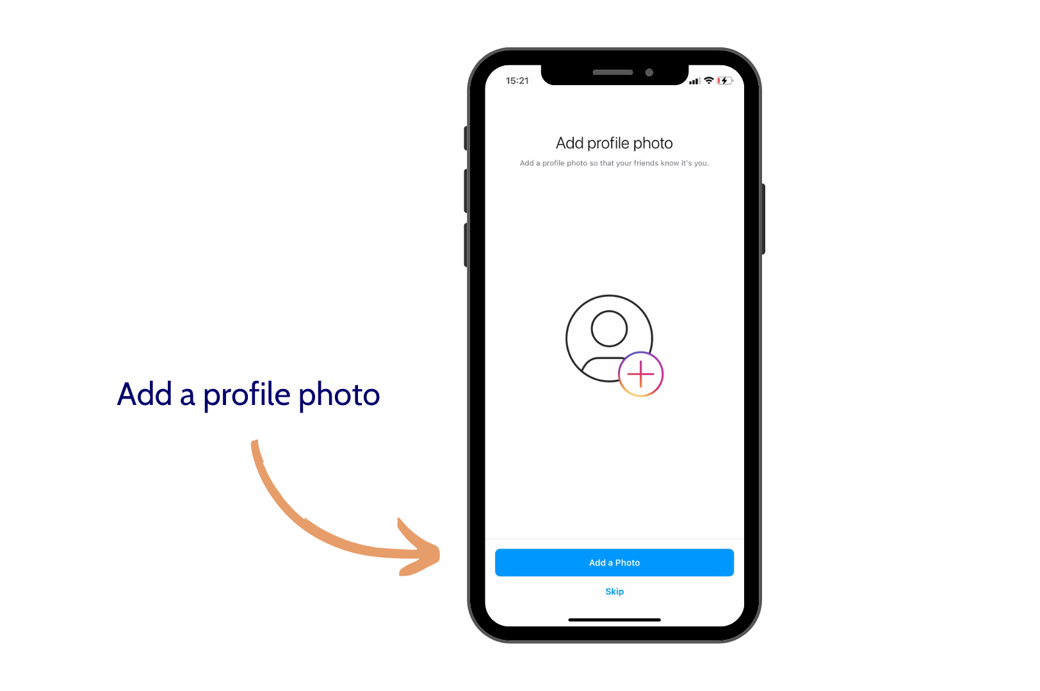

Slide 18
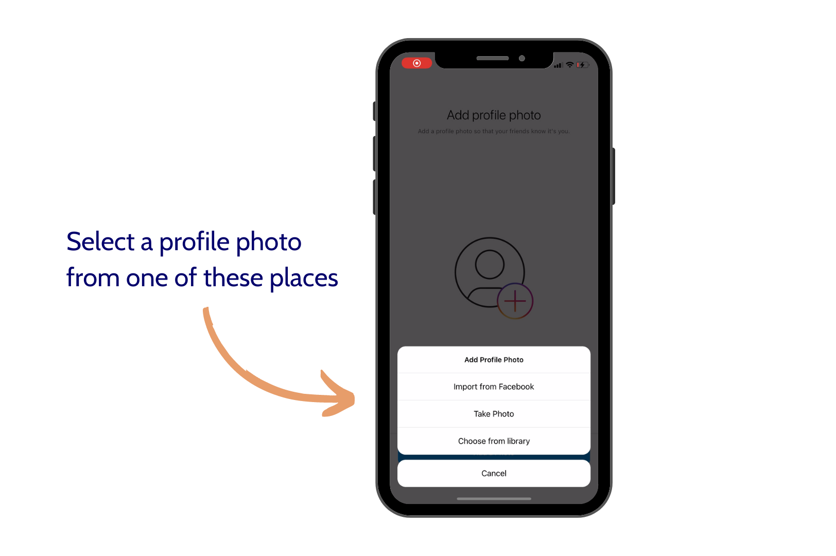

Slide 19
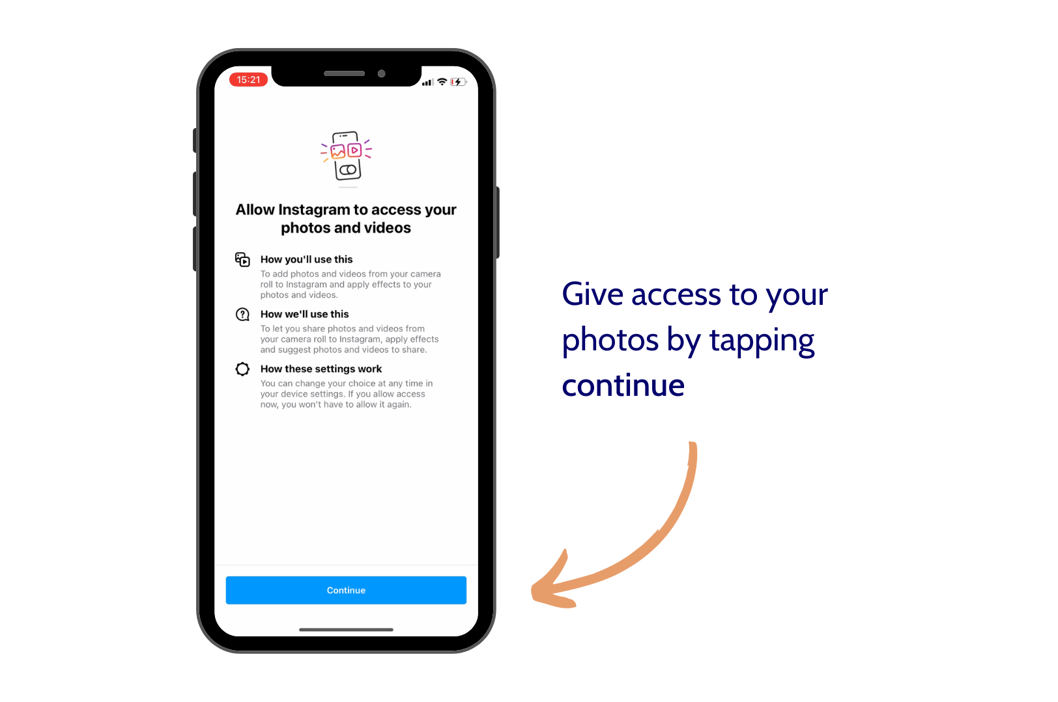

Slide 20
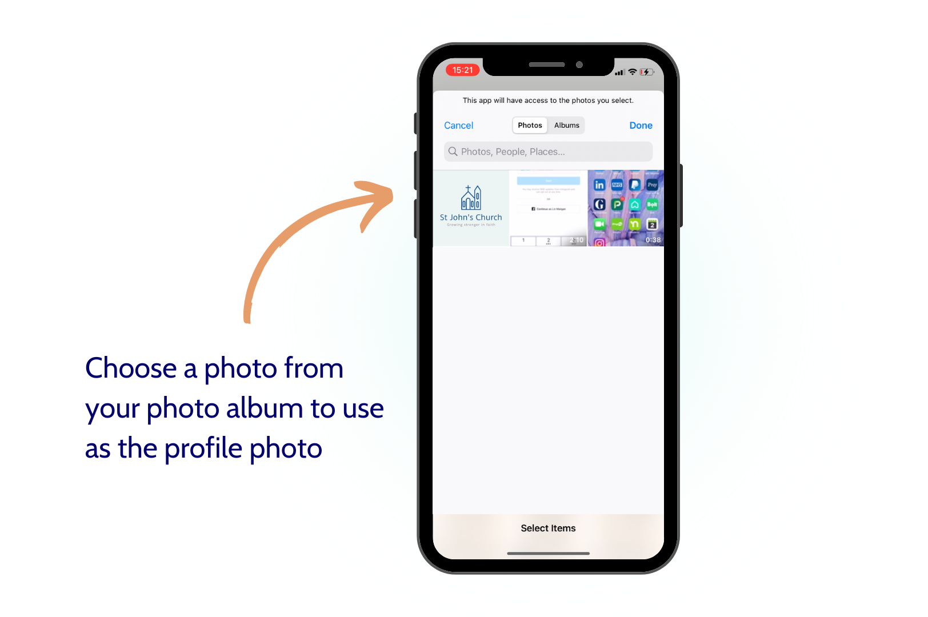

Slide 21
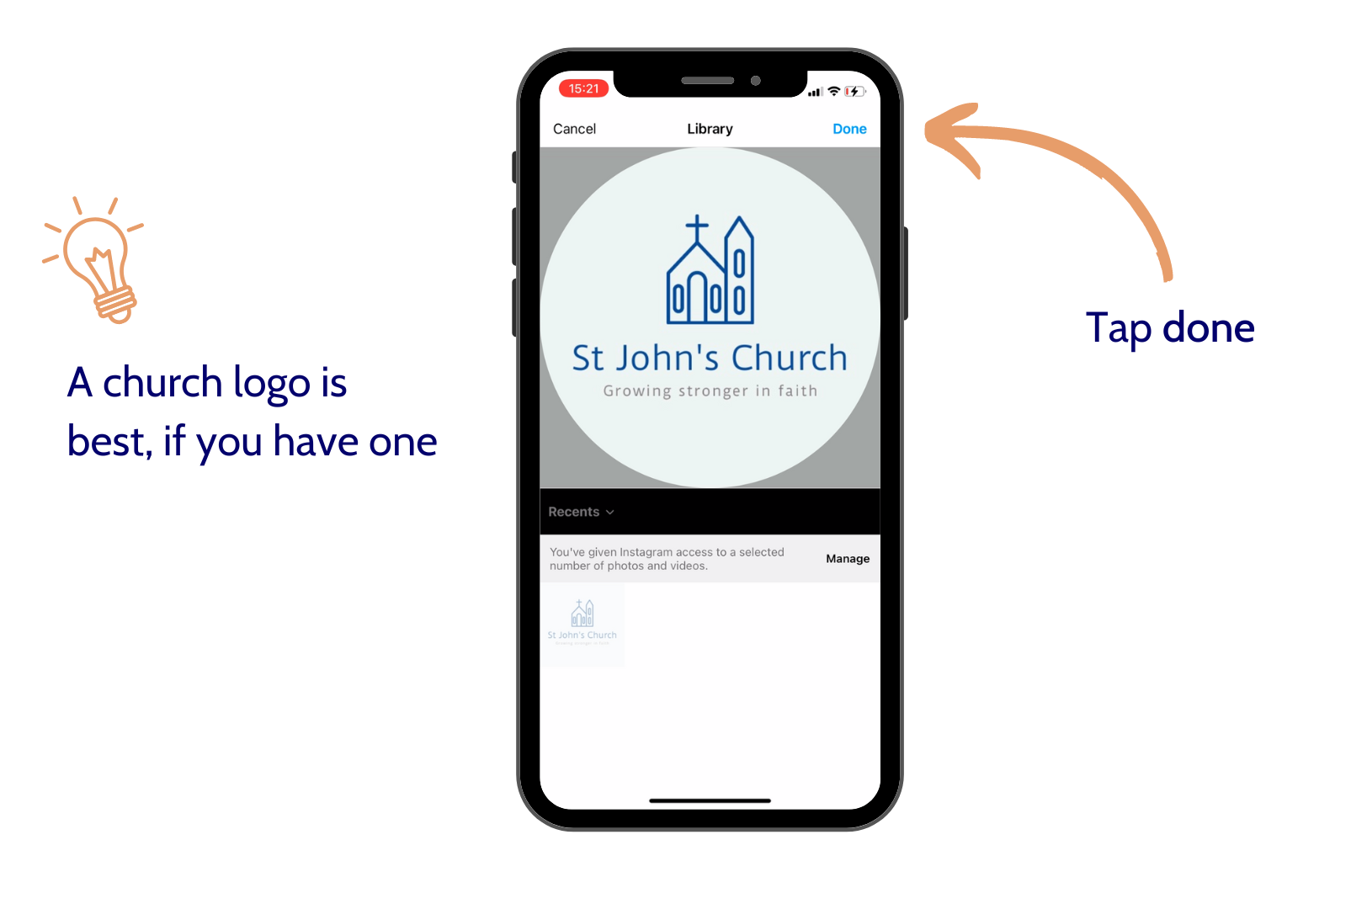

Slide 22
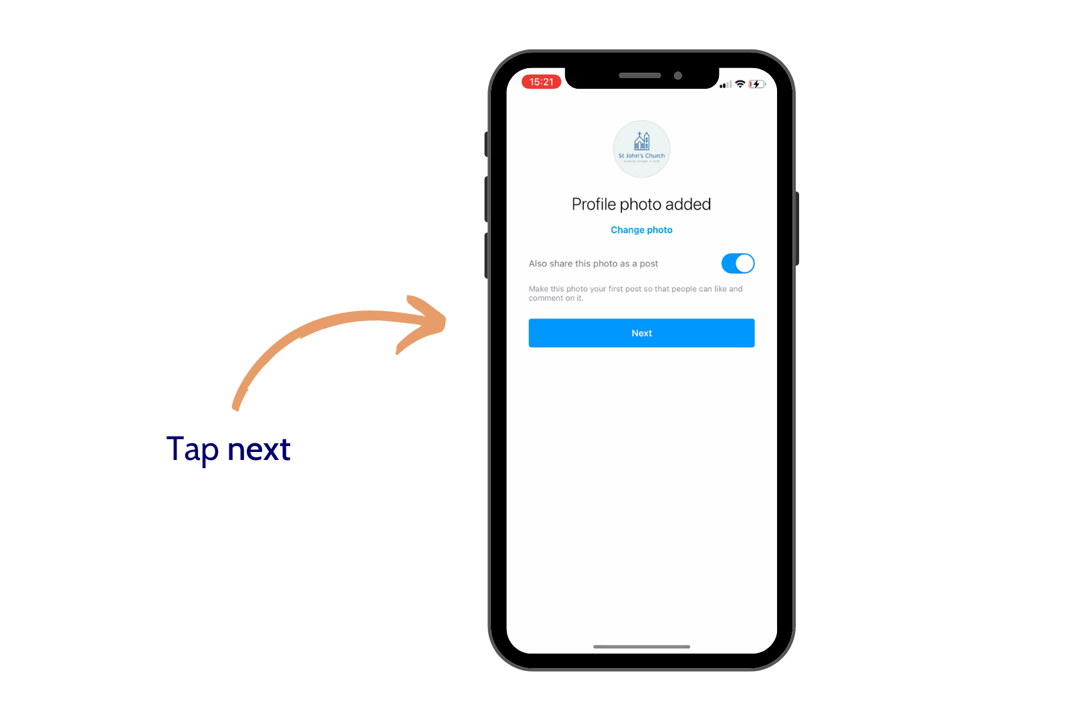

Slide 23
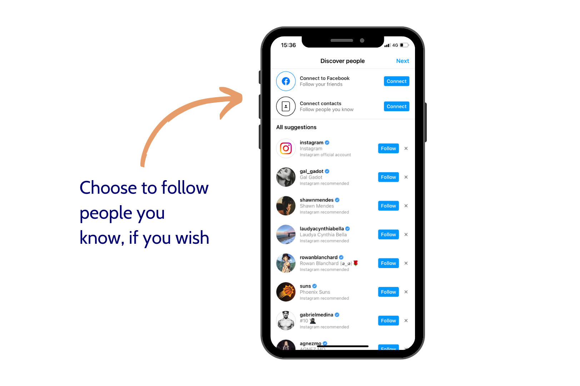

Slide 24
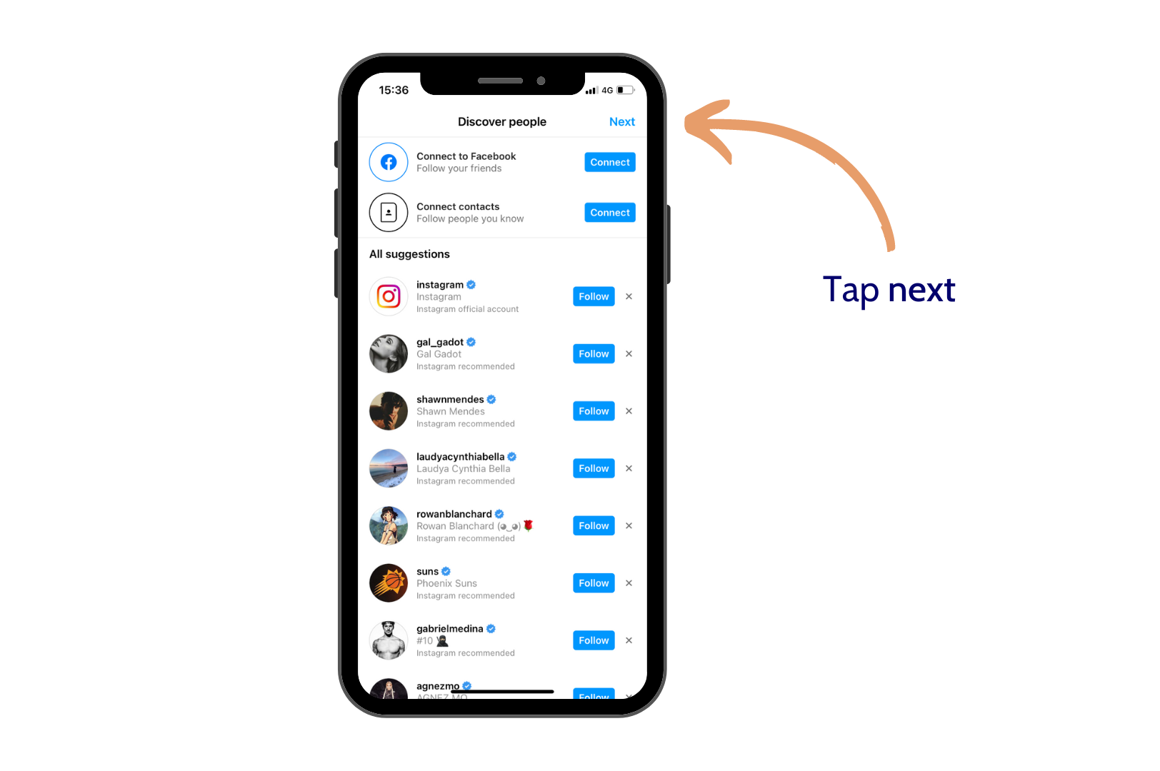

Slide 25
Instagram key terms glossary
Home page: where you see all the posts from accounts that you follow, also where you access other account’s stories
Grid/profile: the space where all of the things you upload appear and your information is displayed
Post: an image or video that you upload
Story: your Instagram story is a 24 hour feed of images or video that are considered more casual and on-the-go than your grid photos. These are portrait images or videos that appear at the top of your home page in a little circle
Caption: the text that goes underneath the image when you do a post – these should have extra information or a call to action. Let your captions do the talking!
Notes:
Instagram key terms
I’m aware that for some people, I’m about to say a whole lot of words that won’t make much sense, so let’s just quickly run through some key Instagram terms:
Home page: this is where you see all the posts from accounts that you follow. This is also where you can view other account’s stories.
Your grid/profile: this is where all of the things you upload to your account will appear, and your information is displayed here.
Post: posts are the images or videos that you upload and which appear on your grid. These do not expire like stories – you have to manually delete or archive them if you wish to remove them.
Story: your Instagram story is a 24 hour feed of images or videos that are considered more casual and on-the-go than your grid photos. These are portrait images or videos that appear at the top of your home page in a little circle. You can also view your own story from your own profile page.
Caption: the test that goes underneath the image or video when you do a post. Captions should have extra information or a call to action – your captions should do the talking, not your images!

Slide 26
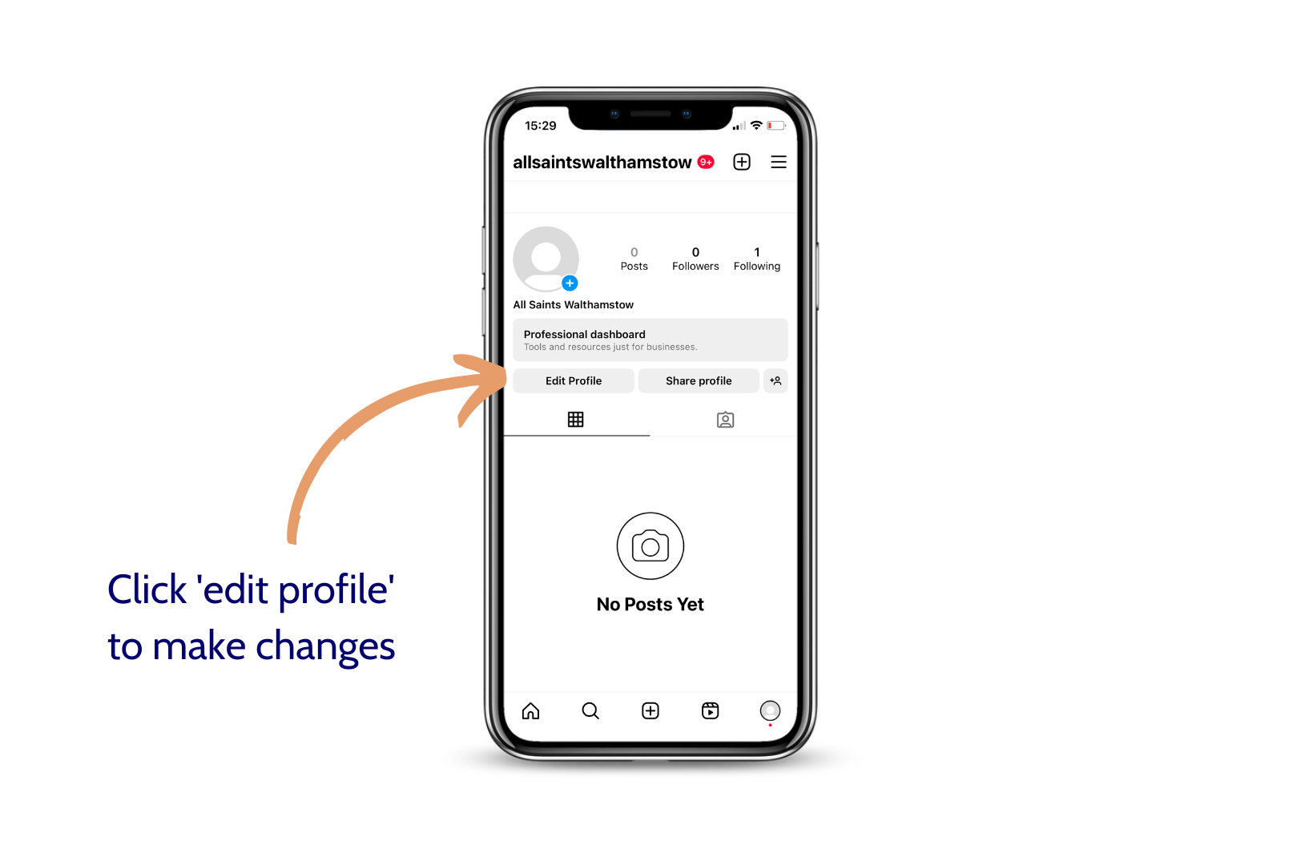
How to create a profile for your church
Notes:
about to do a live demo, but please note the instructions on slide 25 (next slide)

Slide 27
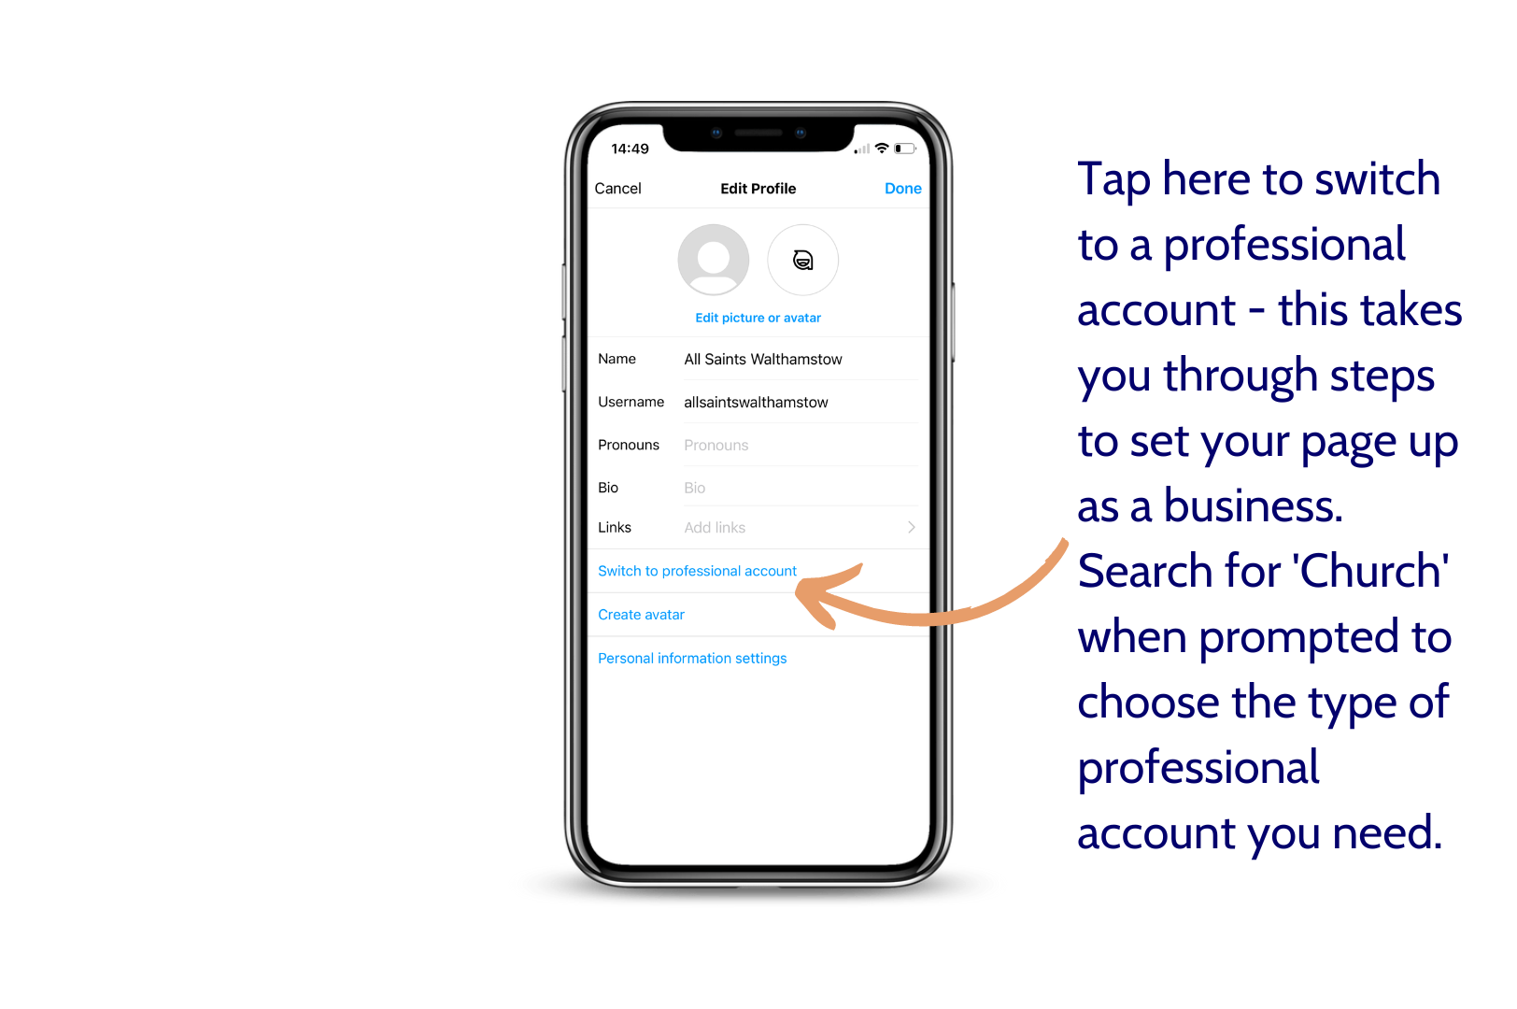
Notes:
to switch your account to a professional account rather than a personal one. I’ll also include instructions to do this in the follow-up email.
Now I’m going to switch over to do a live demonstration. You’ll just have to bear with me for a minute while I share my phone screen into the webinar – I’ll do the demonstration from my phone because Instagram is better optimised for mobile, though you can also use it on your browser.
While I get that set up, I’d like you to just have a think about who you’re trying to reach via Instagram? Is it teens? Students? Young adults? Thinking about who you want to reach will help you think about what kind of content you’re going to be posting.
Webinar ID: 950 0091 4374

Slide 28
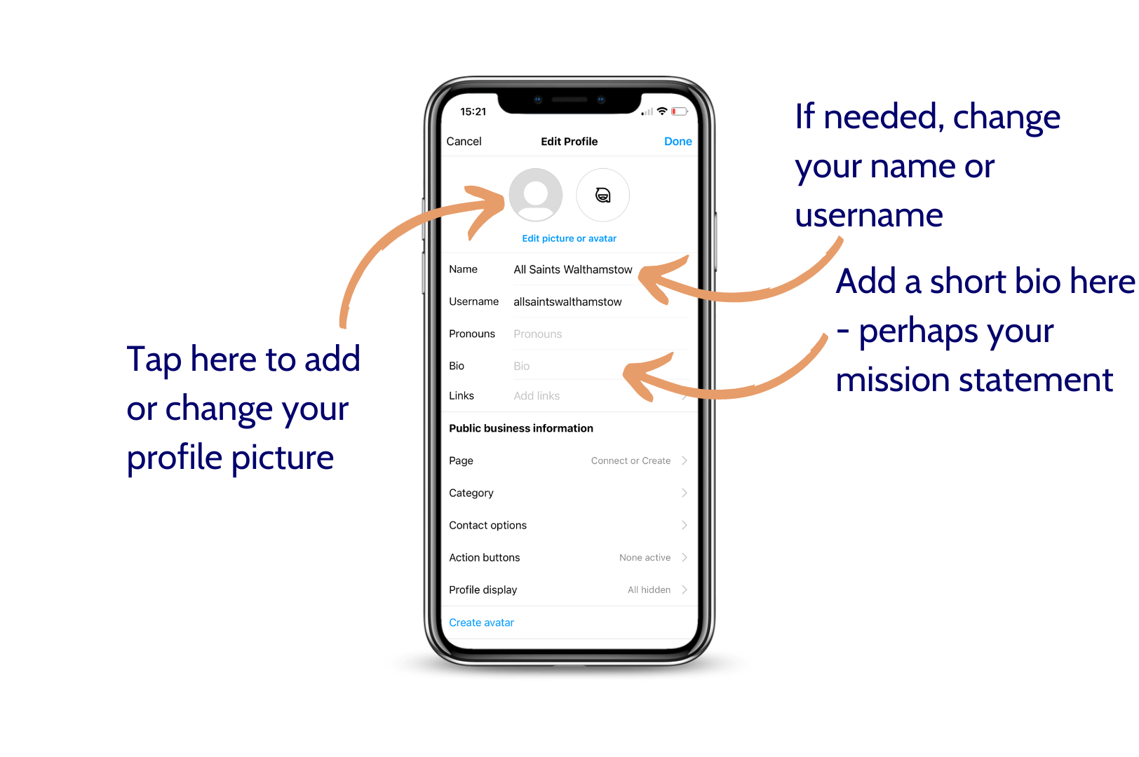
Notes:
Live demonstration for this section

Slide 29
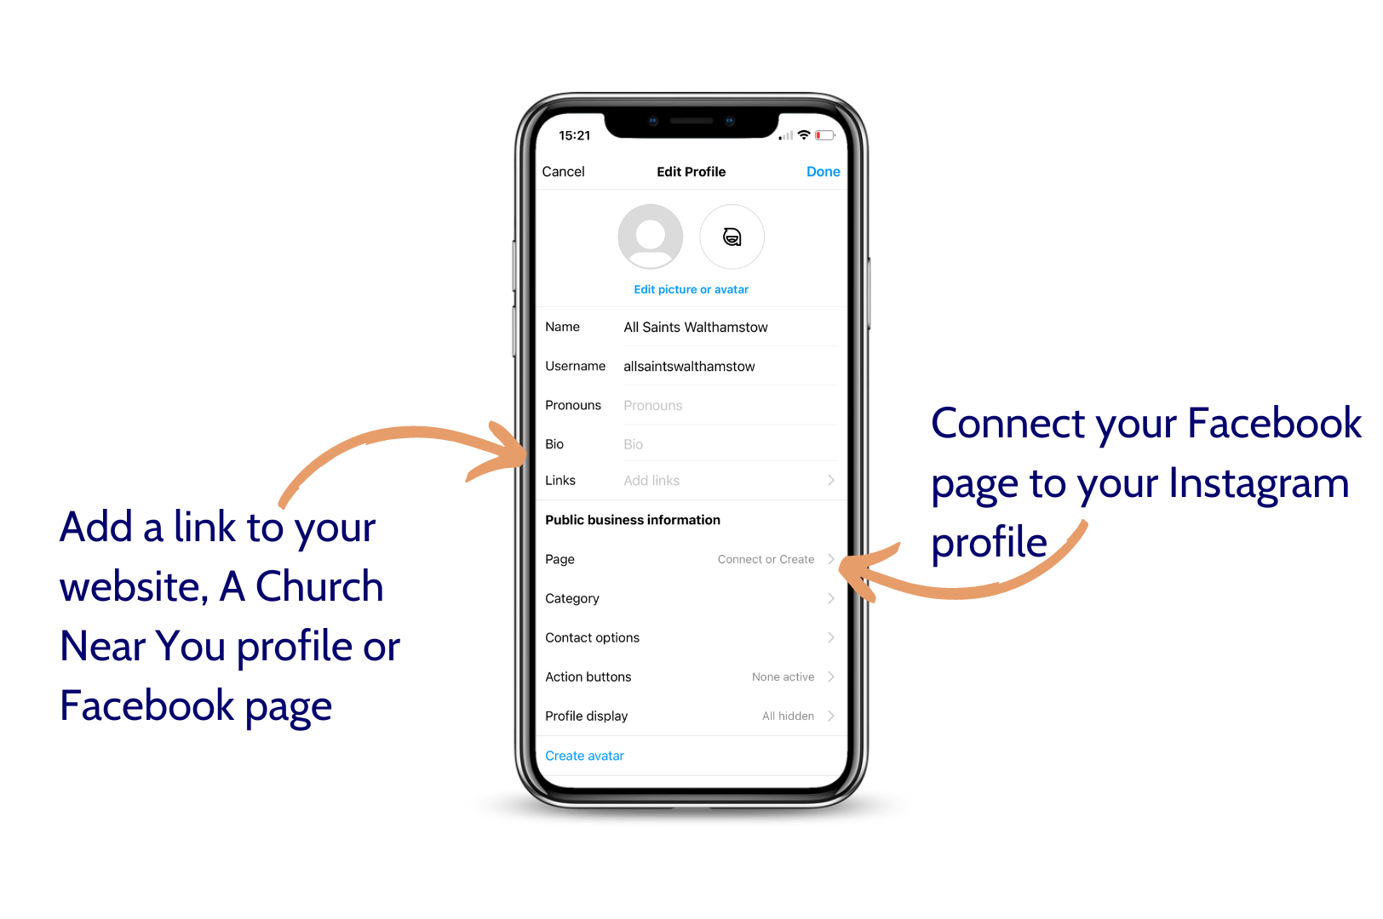
Notes:
Live demonstration for this section

Slide 30
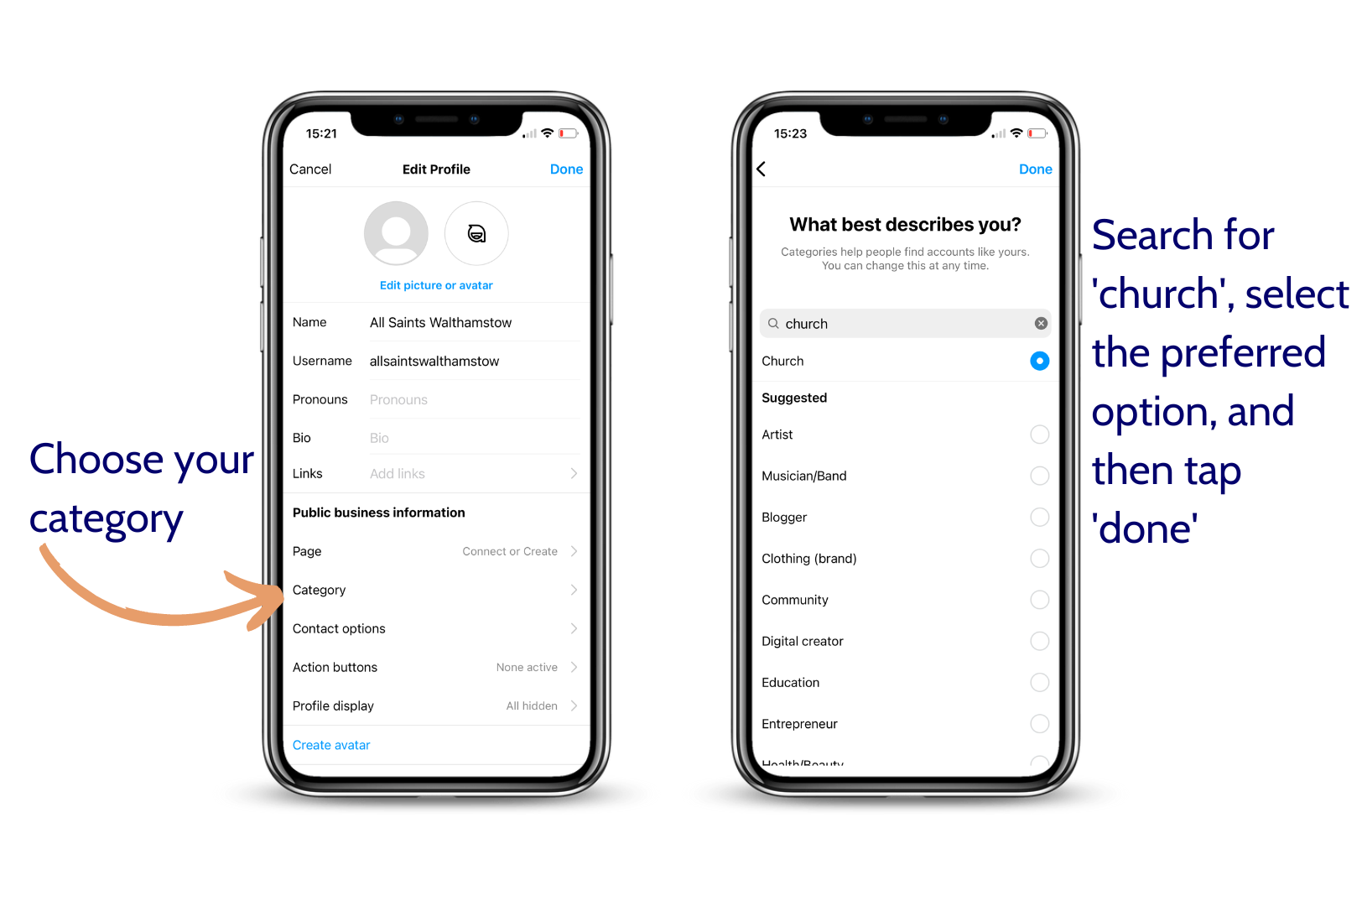
Notes:
Live demonstration for this section

Slide 31
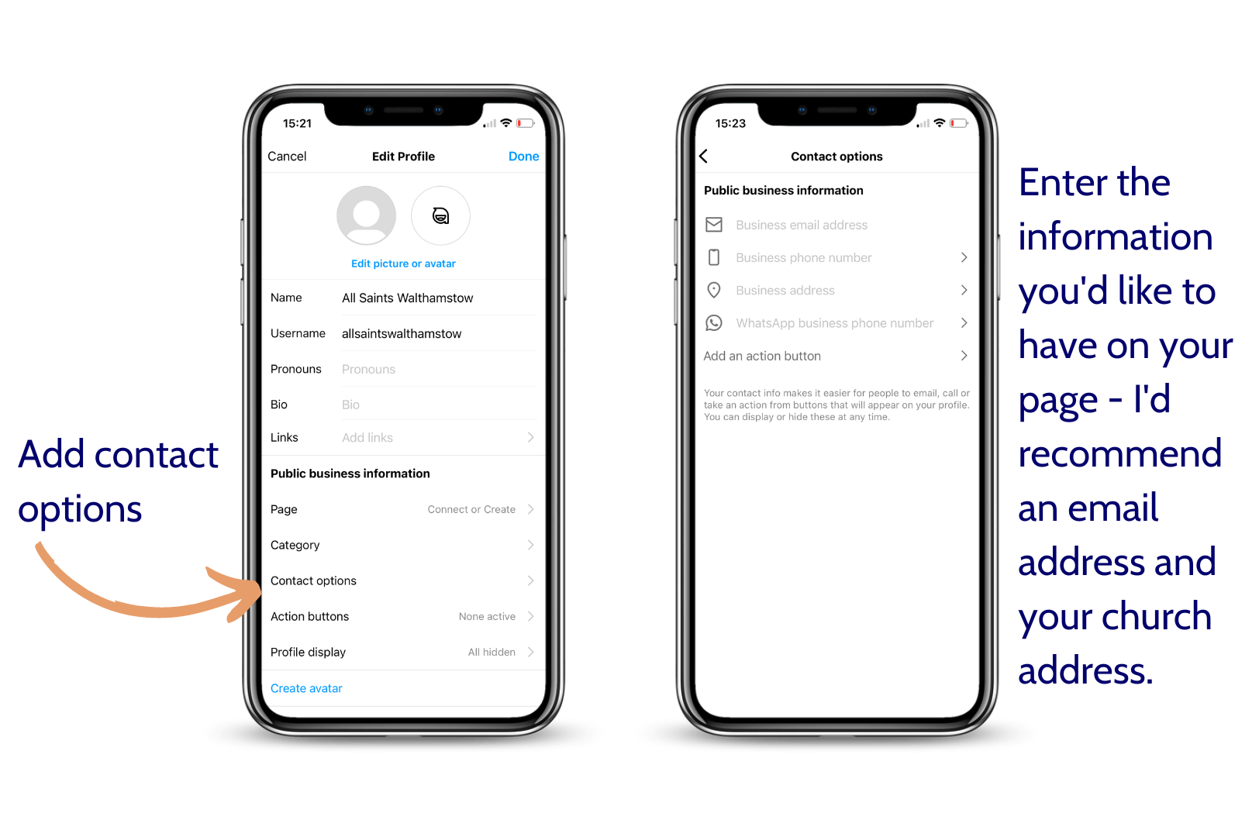
Notes:
Live demonstration for this section

Slide 32
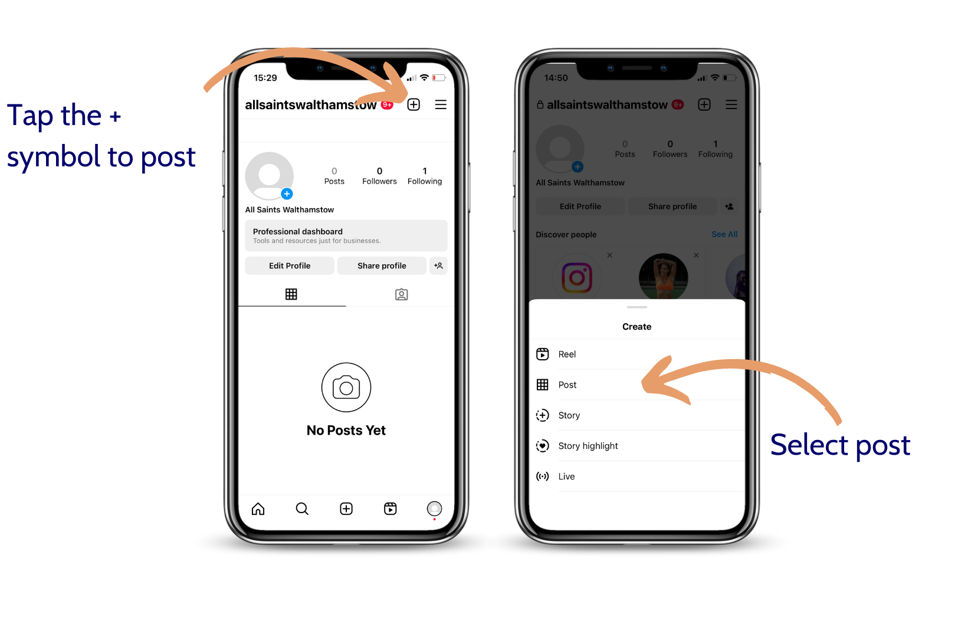
How to post photos and videos
Notes:
Live demonstration for this section

Slide 33
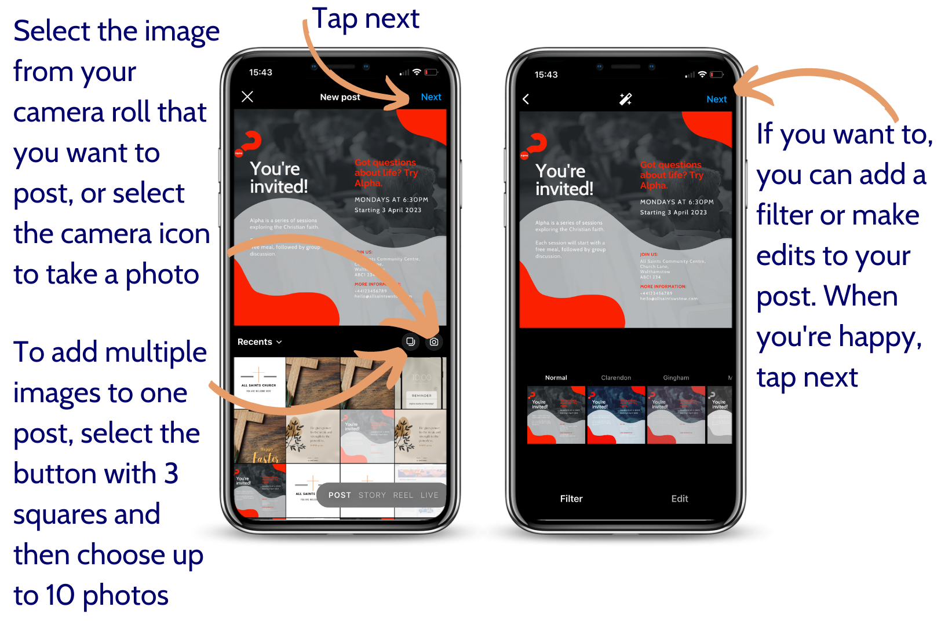
Notes:
Live demonstration for this section

Slide 34
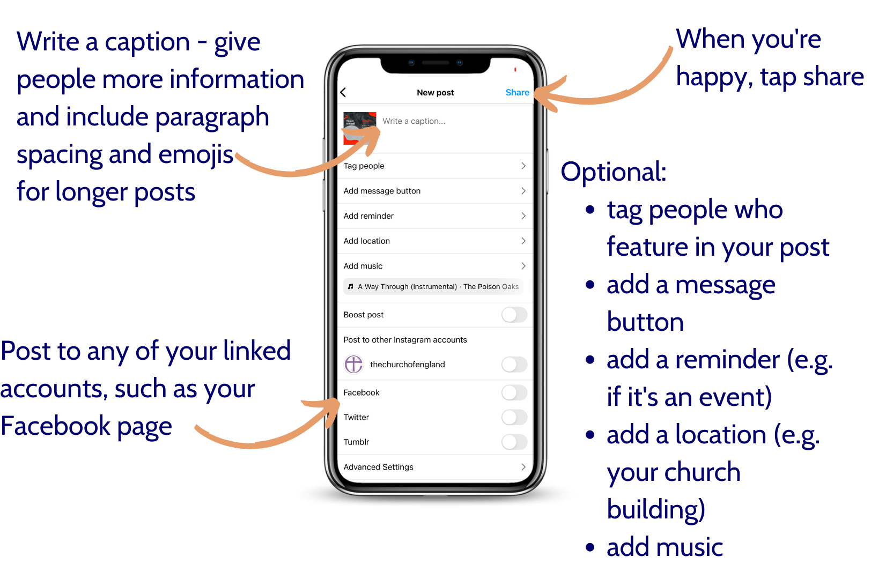
Notes:
Live demonstration for this section

Slide 35
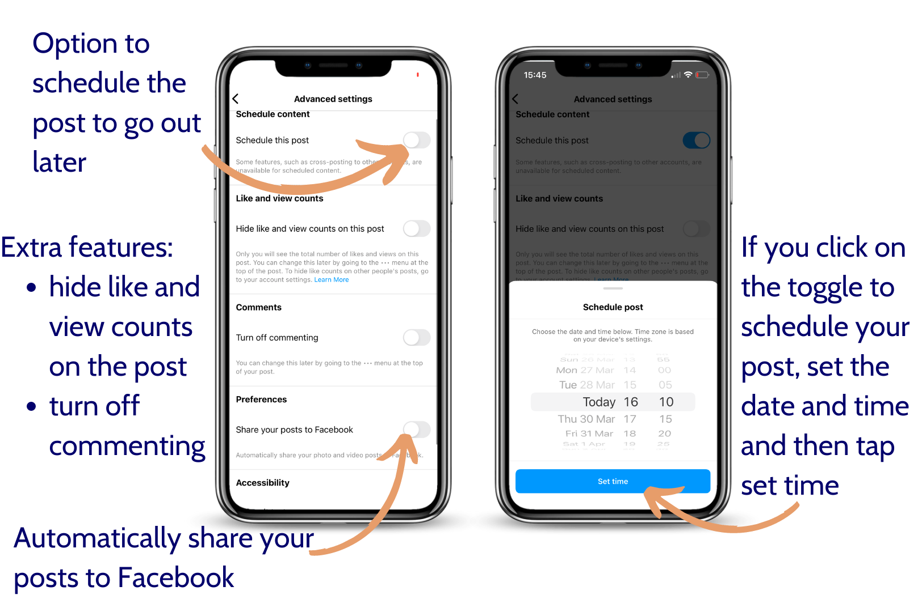
Notes:
Live demonstration for this section

Slide 36
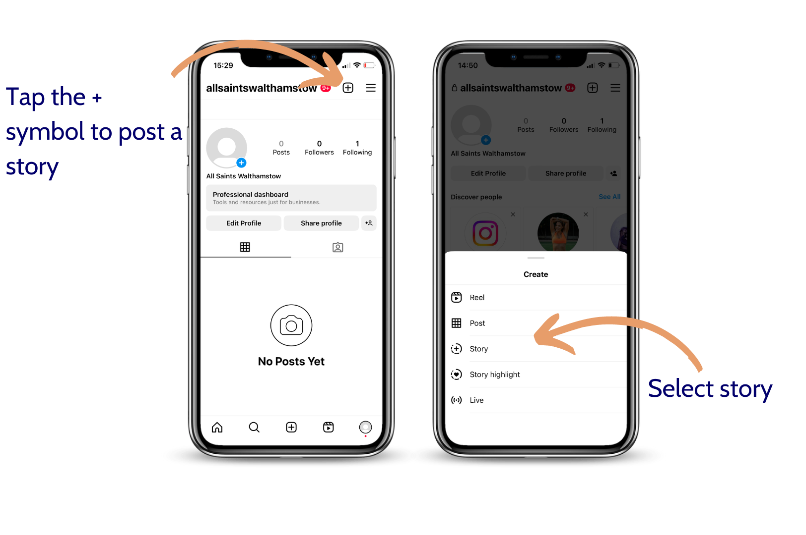
How to post a story
Notes:
Live demonstration for this section

Slide 37
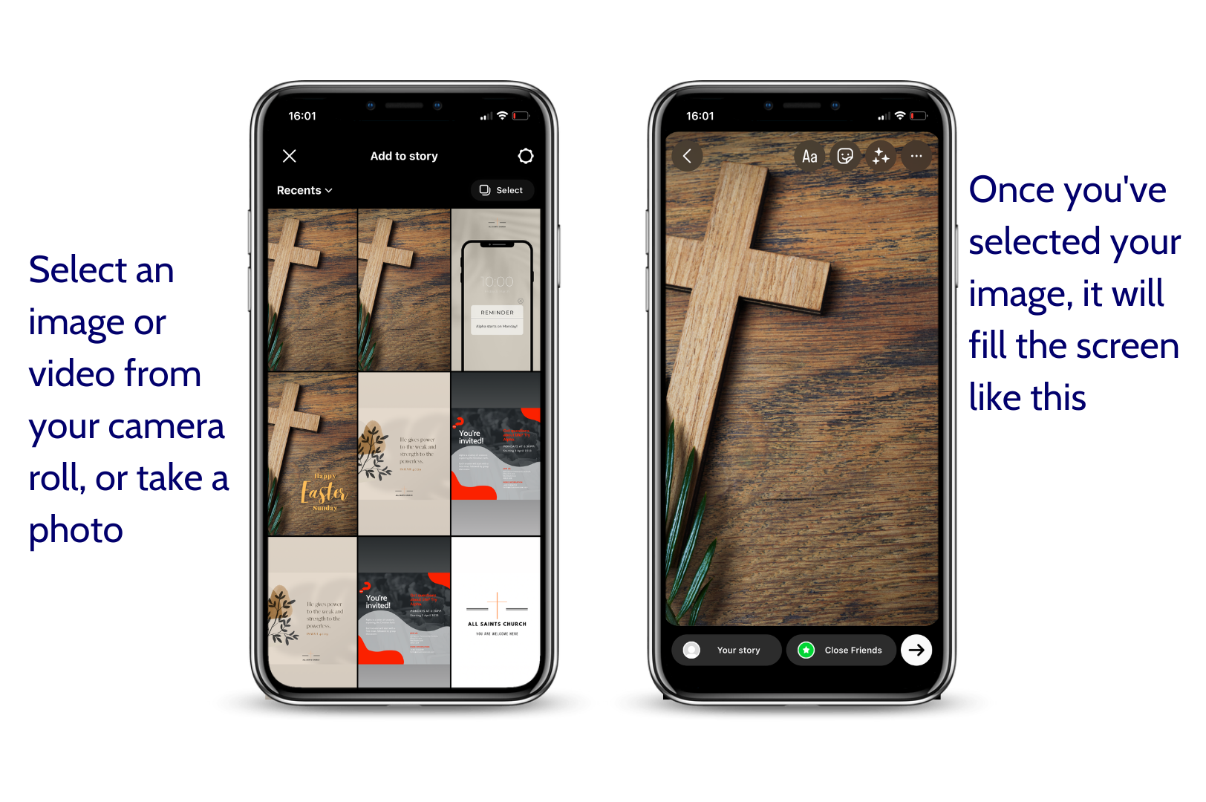
Notes:
Live demonstration for this section

Slide 38
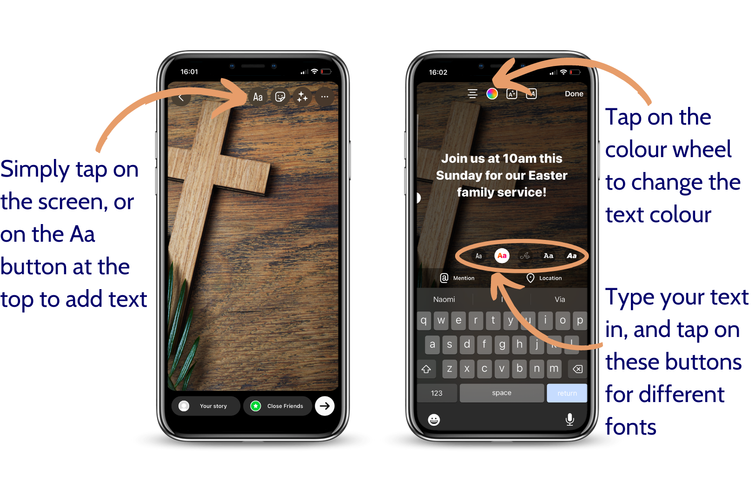
Notes:
Live demonstration for this section

Slide 39
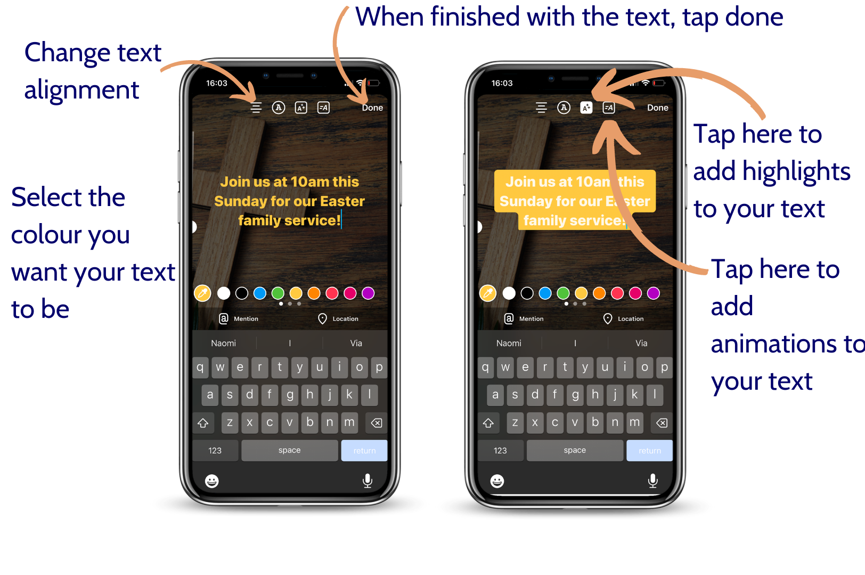
Notes:
Live demonstration for this section

Slide 40
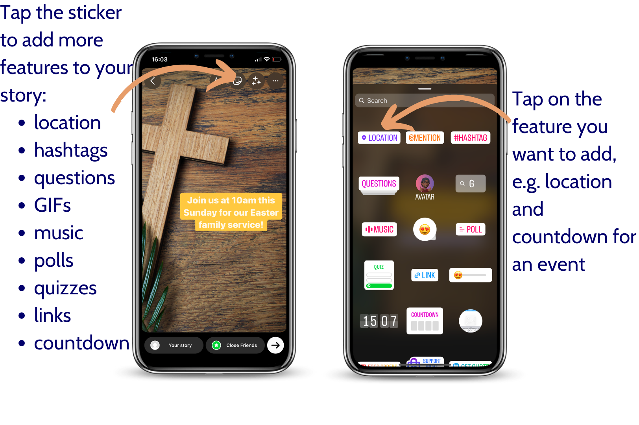
Notes:
Live demonstration for this section

Slide 41
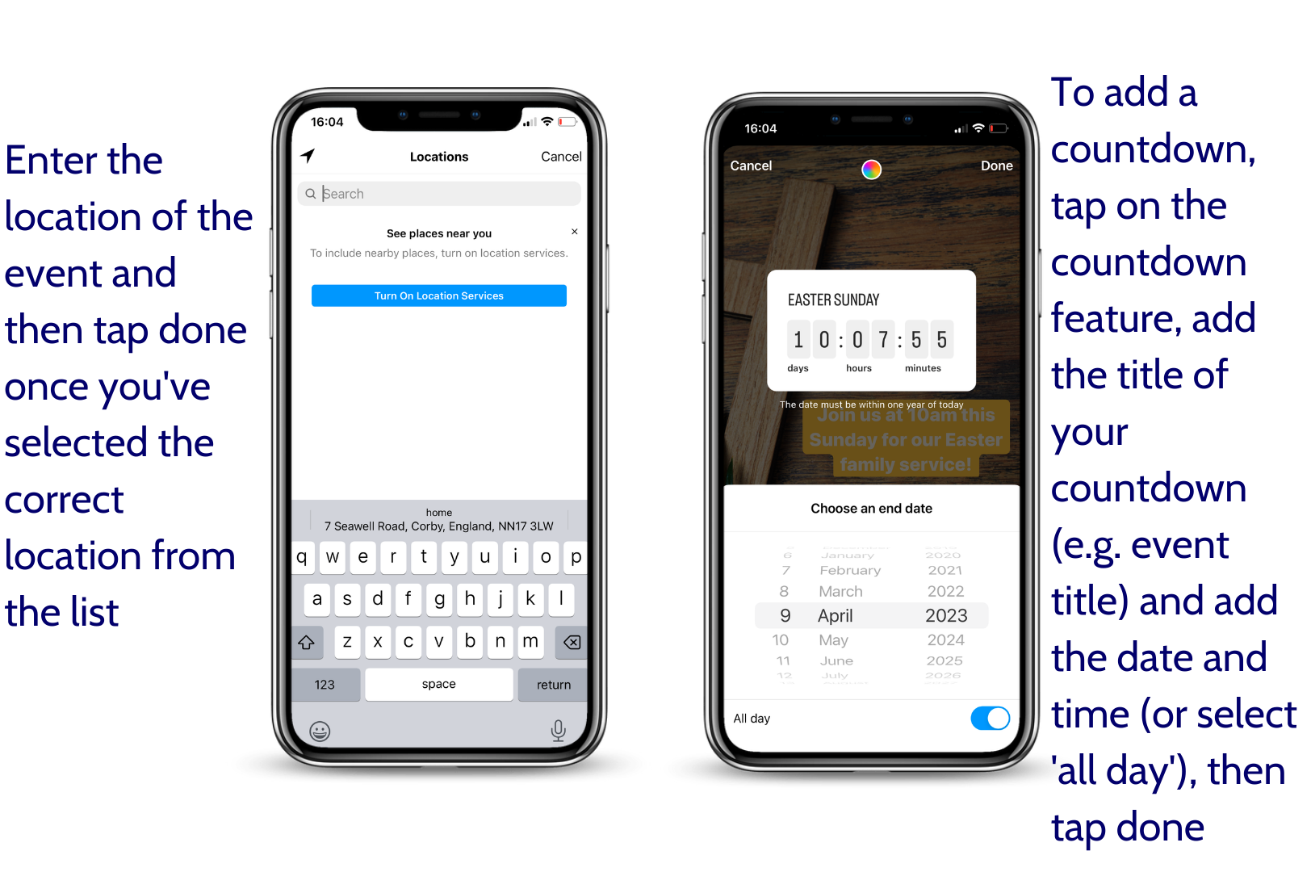
Notes:
Live demonstration for this section

Slide 42
Notes:
Live demonstration for this section

Slide 43
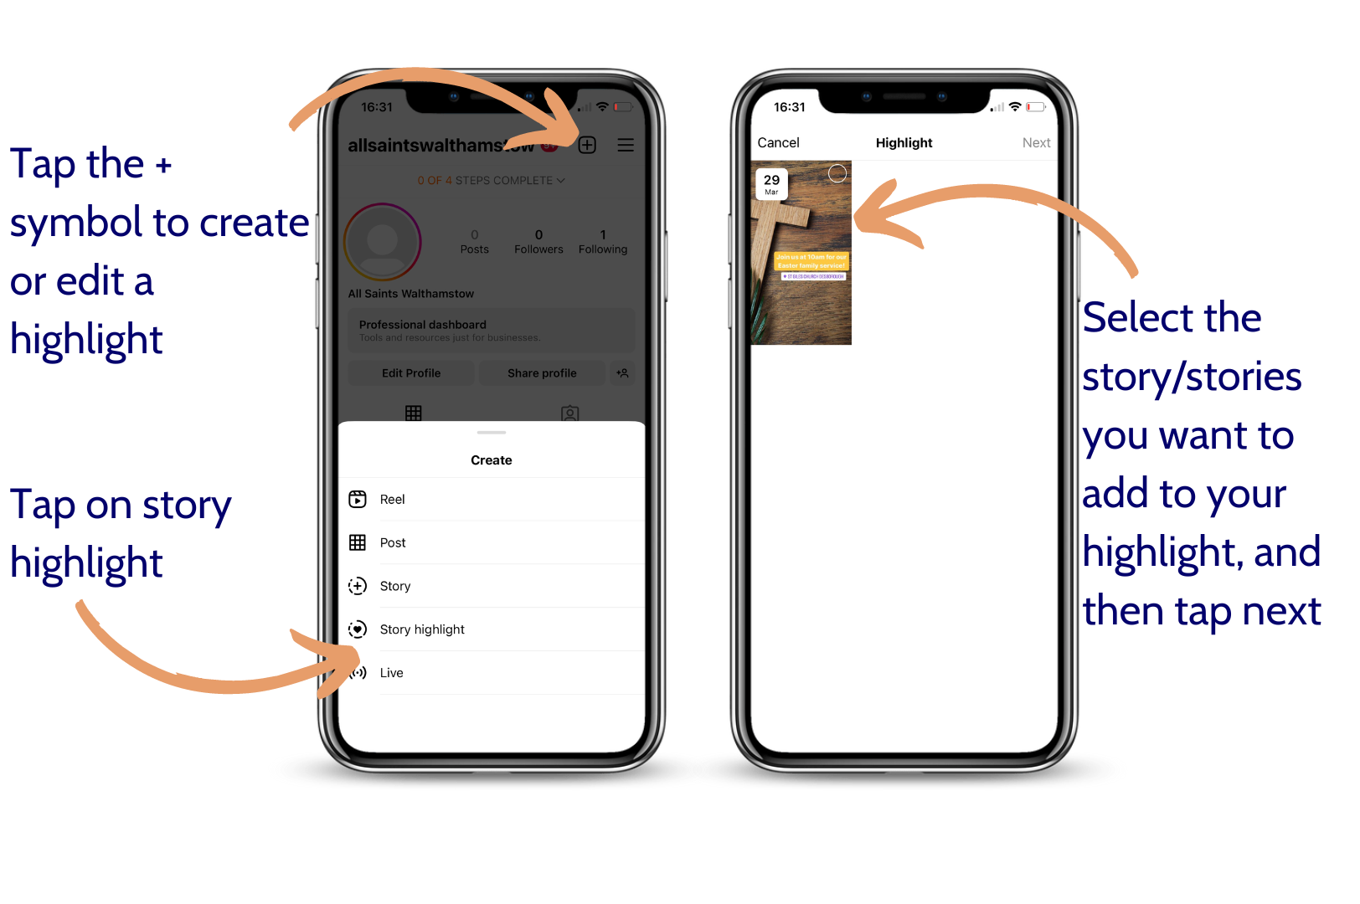
How to add a story highlight
Notes:
Live demonstration for this section

Slide 44
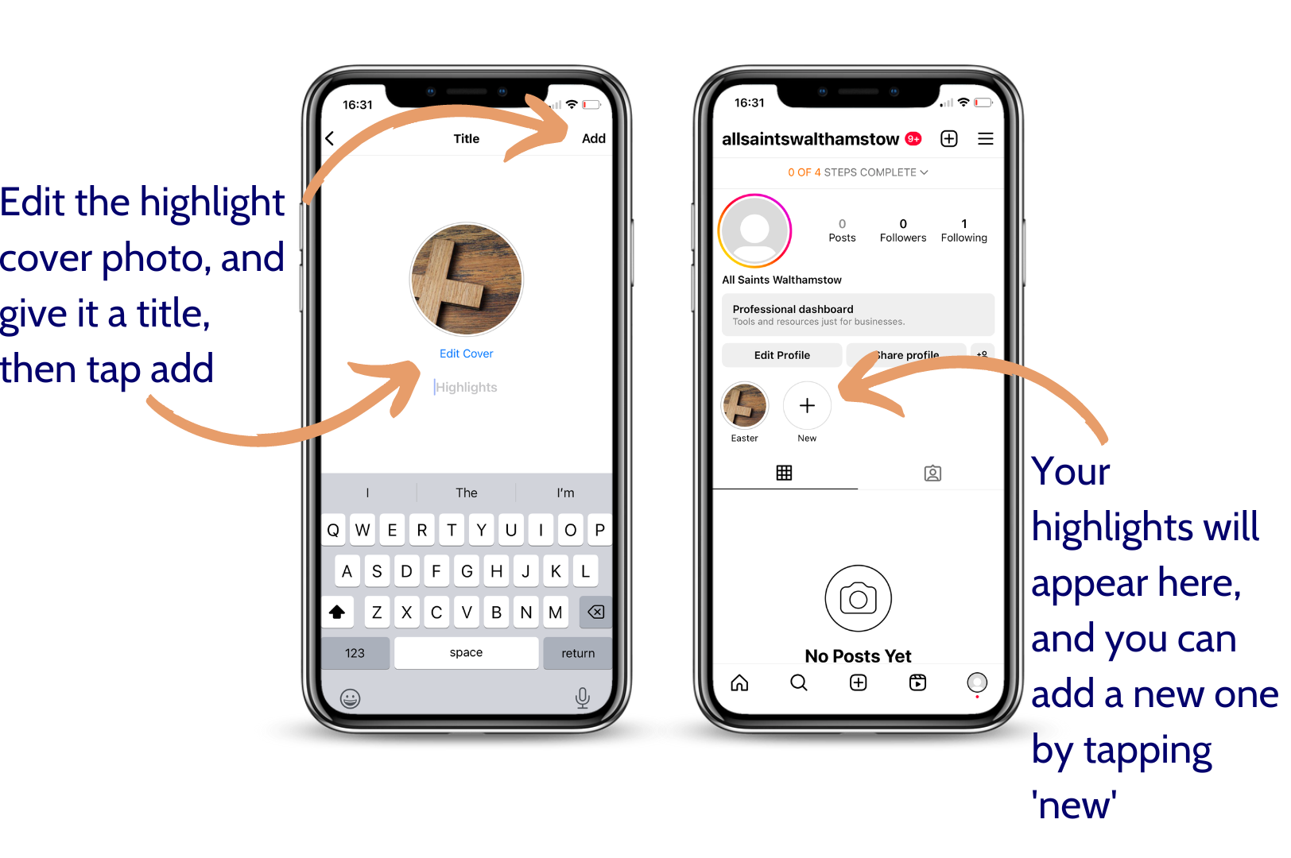
Notes:
Live demonstration for this section

Slide 45
Content ideas
How can we add value to our community?
Notes:
So, when you’re posting on Instagram, think about how you can add value to your community. You want to post a mixture of things, that will be useful and engaging.
Let’s have a think about some examples.

Slide 46
Simple post ideas
Bible verses
Invitations to events
Upcoming sermon series theme
Photos of your church building/garden/even your local community
Photos from a Sunday service/event
Short prayers
Static quote from Sunday’s sermon
Short video messages or a snippet from Sunday’s sermon
Notes:
Simple post ideas – remember, if you’re using photos of people, get their consent to post it first!
Bible verses
Invitations to events or services
Upcoming sermon series theme
Photos of your church building or gardens
Photos of your local community
Photos from a Sunday service or event
Short prayers
Static quotes from Sunday’s sermon
Short video messages or a snippet from the sermon

Slide 47
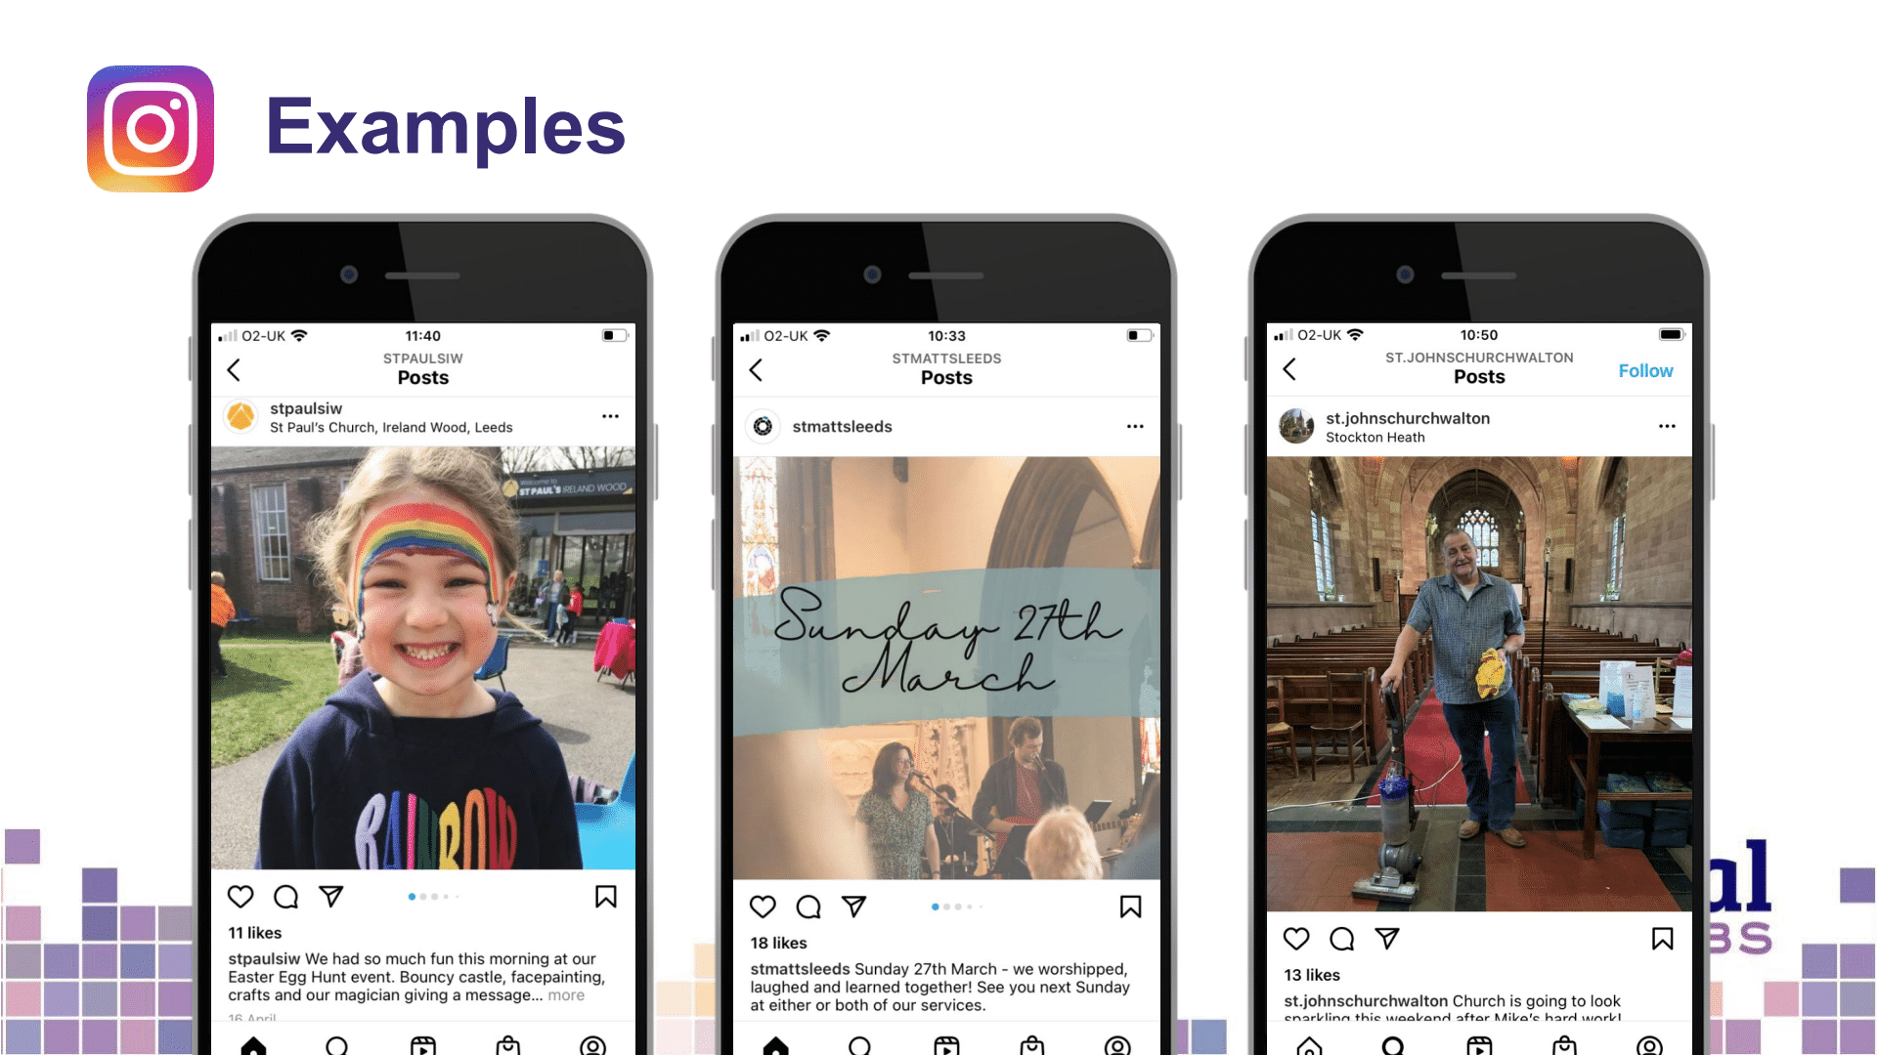
Notes:
Some great examples of what you could post!

Slide 48
Simple story ideas
Day in the life of your vicar/a member of the team
Snippet of Sunday’s sermon
Reminders about events
Invitation to your Sunday services
Snaps of things happening live e.g. your Sunday service or your weekly wellbeing café
Countdowns
Ask questions – stories are very interactive!
Raise awareness
Share daily prayers/reflections
Notes:
Simple story ideas – stories are very interactive! Make the most of this
Day in the life of your vicar/a member of the team – they log into the church Instagram page and take pictures/short videos of what they’re doing a different points in the day. This is a great way to build community. They could use things like the question box where people send them a question and they post a story of them answering it!
Snippet of Sunday’s sermon
Reminders and countdowns of events
Snaps of things happening live e.g. ‘we’re ready for you to arrive at Church!’ or your weekly wellbeing café – ‘here’s Naomi getting the coffee ready!’
Ask people questions or use the question box where people can ask you a question that you answer
Share daily prayers/reflections

Slide 50
Quick guide to hashtags
Notes:
Something you can utilise on Instagram are hashtags – people might search #church and posts which include this hashtag will come up – whether they’re following you or not.
Helps people find you.
So, what are they?
They’re a great way to group topics and are searchable
Use the #symbol, followed by one word or more, like Bible Verse, or Coronation
Include your hashtags at the end of your caption
Instagram allows up to 30 hashtags per post. I’ll include a link to a handy blog which will help you choose the hashtags you want to use
Use the search feature on Instagram to find out how often the hashtags are used – avoid hashtags that are in the millions, this will make it harder for people to find yours!
Three types of hashtags to use:
Location based
Topic based
Trending (popular hashtags at the time of posting)

Slide 51
Video tips
Viewers on social media take less than two seconds to decide to watch a video – keep introductions short to keep their interest
Find a quiet spot without background noise
Use a window for natural light
Videos less than 2 minutes long on Facebook get the most engagement
Average video length on YouTube is 8.4 minutes (for non-entertainment videos).

Slide 52
More tips
If adding text over images or video, increase readability by adding a box behind the text
Add subtitles when you upload to social media. All social media platforms have tools to add automatic subtitles.
Use a scheduling tool such as Meta Business Suite or Buffer – scheduling your social media content will save you a lot of time!

Slide 53
Useful tools – photography and design
www.canva.com
www.spark.adobe.com
www.unsplash.com
www.pixabay.com
www.pexels.com
www.freepik.com
Notes:
Live demonstration for this section

Slide 54
Blogs Webinars Newsletter Conference
Discover the free resources for churches
Churchofengland.org/DigitalLabs

