Slide 1
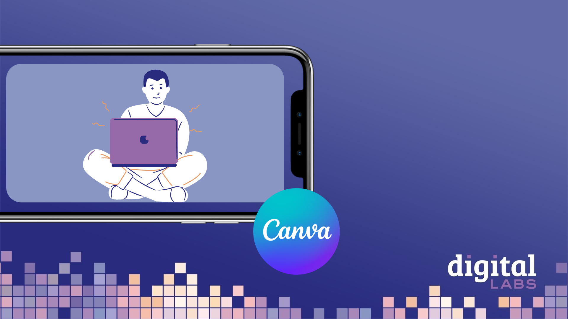
How to use Canva for your church:
an introduction

Slide 3
This year’s Christmas theme - Follow the Star: Join the Song - highlights how singing can help us draw closer to God and each other through the journey from Advent to Epiphany.
Join the Song includes an invitation to all choirs and singing groups to sing a new version of ‘The First Nowell’.

Slide 4
RESOURCES:
Free resources to help choirs of all ages and stages learn and perform the carol
Daily Advent and Christmas reflections
Our first printed Follow the Star Advent Calendar for families - with stickers!
Join the Song campaign logo pack
Brand and design guidelines
Music, social media graphics, PowerPoint assets, posters and other free tools and resources from A Church Near You
Digital promo planner, blogs and bitesize videos to support churches in using the digital resources available

Slide 5
You’ll learn:
The basic editing tools on Canva
How to choose the correct format for your platform
How to use and customise Canva’s templates
How to add text, graphics and images
How to download your content ready to share

Slide 6
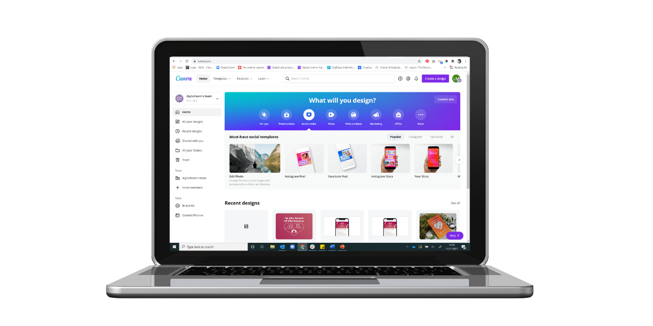
Open a free Canva.com account
Create a Canva account https://www.canva.com/signup
Canva for non-profits https://www.canva.com/canva-for-nonprofits/
Canva for church Facebook group
https://www.facebook.com/groups/CanvaForChurch

Slide 7
Explore the different templates available or search for what you want
Find your way around Canva.com
The home screen shows your recent designs and Canva templates to create something new.
Designs are automatically saved in Projects and Recent designs

Slide 8
Click on Create a design to get started!
Creating a design
Search for the type of design you want to create, e.g. Facebook post, A5 document, Presentation, and then select the one you want. This will open your blank design.

Slide 9
Page features
Name your design here
Add a page to your design
Delete a page
Duplicate a page
Zoom in & out on your design
See pages as thumbnails in grid view (useful if you’ve got a multi-page design)

Slide 10
Using templates
This is your blank design!
You have the option of using a template for your design so that all you need to do is input your own information.
Search for templates, or select one of the suggested categories, e.g. Flyer
Scroll through the various templates and select one for your design.

Slide 11
Using templates
Once you’ve selected a template, it will insert itself onto your design. From here, you can change the information and components of the template.

Slide 12
Using a blank design
You could also decide to create your design from scratch, without using a template.
Watch the webinar recording to watch exactly how we created this Facebook post using Canva, or go through the following slides for a quick guide to the basic Canva features!

Slide 13
Key ‘design ingredients’
‘Elements’: lines & shapes, graphics, stickers, photos, videos, audio, charts, tables, frames… the list goes on!
‘Uploads’: where all the photos and videos you upload to Canva are stores. Top tip: upload your church logo here so you can access it easily in all your designs!
‘Text’: add text to your design from here

Slide 14
Change the background colour
You can change the background colour of your design by clicking on the black page, and then selecting the colour wheel and choosing a colour. For this flyer, the background colour is a light grey.

Slide 15
3. Browse and select the font you want your text to be
5. Change the colour of your text
4. Adjust the size of your text
Adding text
6. Bold, itallics and underline
2. Add a text box or choose heading, subheading or body text
7. Text alignment, bullet points and text spacing
1. Click on the ‘text’ button in your design menu

Slide 16
2. Search for the element you want (eg. rectangle)
3. Change the colour of your element and adjust the border style
Adding elements
1. Click on the ‘elements’ button in your design menu
Shapes can be used to highlight text on your design
Adjust the size and shape of your element by dragging the edges or corners

Slide 17
2. Change the colour
Adding elements
1. Search for icons/images in the search bar, e.g. ‘calendar’ or ‘Instagram logo’, and click to insert
3. Duplicate or delete the element
4. Change the size of the elements by dragging the corners

Slide 18
3. Resize your image by dragging the corners/sides, and duplicate or delete your image
Uploading and adding images
1. Click ‘uploads’ button to view your existing images, videos and audio, and to upload files from your device
4. Rotate your image by clicking and dragging this symbol
2. Click on an image to insert it onto your design

Slide 19
1. Left click on your element/image/text
2. Click on the three dots that appear in the menu
Adjusting the layering
To make the various components of your design appear as you want them (in this example, I want the Alpha logo to be layered at the front, on top of the rectangle element), you can adjust the layering.
3. Hover your mouse over ‘Layer’
4. Select the relevant option (bring forward, bring to front, send backward, send to back, or show layers)

Slide 20
Share and download your design
Once you’re happy with your design, click on ‘Share’, and then click ‘Download’

Slide 21
Click on ‘file type’ to select the relevant option – e.g. PNG or JPG for a social media post or image, PDF for flyers or posters, MP4 Video for videos or animations
Downloading your design

Slide 22
Downloading your design
Adjust the size of your design if needed
If you’ve made something like a logo, you could select ‘Transparent background’
Click ‘download’ to save the design to your device

